Slide 1
StratusLab Sustainability Discussions
C. Loomis (CNRS/LAL)
DCI Projects Meeting (Amsterdam)
24 October 2011

Slide 2
Disclaimer
Although an initial sustainability plan exists, serious discussions about StratusLab sustainability have just started.
Ideas presented here are initial thoughts on how to sustain the results of StratusLab and can’t be treated as engagements of the partners.

Slide 3
First (Draft) Sustainability Plan
Assets
Infrastructures, Knowhow & Expertise, Appliances, Software
Exploitation
All partners planning to use StratusLab software after project for both public and private clouds
Partners not necessarily planning to use StratusLab in its entirety
Continued Funding
Building on StratusLab in future European projects
Looking for funding via national initiatives
Evolution/support through national infrastructures (grid and cloud)
D3.3: Exploitation and Sustainability First Plan http://stratuslab.eu/doku.php/deliverables

Slide 4
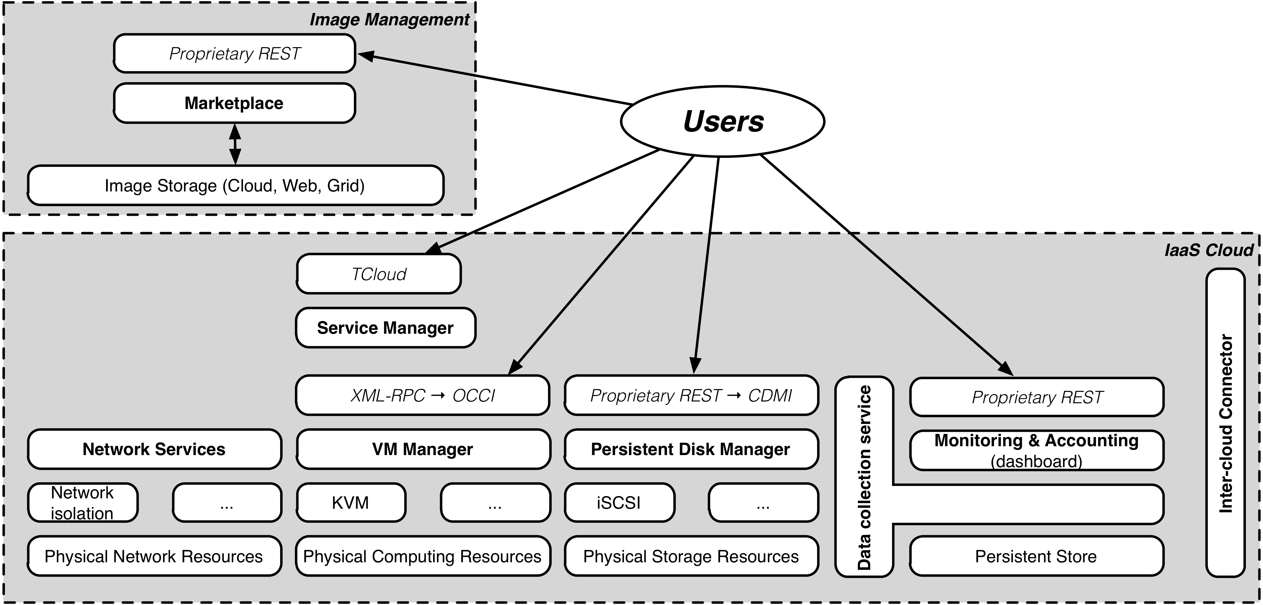
StratusLab Architecture (v1 → v2)
D4.4: Reference Architecture http://stratuslab.eu/doku.php/deliverables

Slide 5
Assets: Infrastructures
Physical Resources
GRNET: Public reference cloud
LAL: Test, Private, and Public clouds
Hardware will continue to be used at institutes
Both partners will continue to provide public/private cloud services
Need coordination to ensure evolution of StratusLab as coherent distribution
Development Services
Tools: git, hudson, jira, google apps, ldap, …
Test resources: machines to support tools and tests
Move to public services where possible (e.g. github)
European Software Forge would be more complete/coherent sol’n

Slide 6
Assets: Knowhow and Expertise
Documents and Reports
Cover the knowledge and experience gained from project fairly well
All are public and available from the project web site
Project Web Site
Contains software documentation, FAQs, news, etc.
Service documentation should move into code repository
Overall distribution documentation depends on StratusLab evolution
LAL will (very likely) continue to provide static website after project ends and continue to maintain stratuslab.{eu, org, com} domains.
Operational Expertise
Permanent site personnel involved in cloud operations and will maintain knowledge for short term
Issue with the “support services” (e.g. mailing list) to make this knowledge available to others adopting StratusLab

Slide 7
Assets: Appliances
Base Images
Plan to automate production of base images (CentOS, ttylinux, Ubuntu, SuSE, …)
Should be minimal effort to maintain provided build infrastructure and resources are available
Need for these images by cloud users/administrators should cover minimal maintenance effort
Scientific Images
Expect scientists and engineers to take responsibility for creating and maintaining these images
Service Images
Similarly, expect developers/projects to take responsibility for creating and maintaining images for grid services, etc.

Slide 8
Assets: Marketplace
Software
Provided service is used, LAL and TCD will maintain and evolve the Marketplace software
Service
StratusLab currently provides a central Marketplace to facilitate sharing of images between cloud instances
View continued operation of this service as essential to minimize duplication of effort, promote sharing, and help convergence towards common image descriptions/behavior.
It is very likely that TCD will continue to operate Marketplace, but may need to be done as contribution to EGI ecosystem, requiring agreement by EGI that this is a necessary global service

Slide 9
Assets: Software
Authentication Proxy
Registration Service
Persistent Storage Service
Installation tools
Service Manager (Claudia)
Marketplace
Quarantine system
Remote tools
Federated caching mechanism
Standardized contextualization
Machine image creation tools
Standardized virtual networks
Monitoring/Accounting/Billing
Dashboards
Code
All code will continue to be available either from current git repository, from github, or European Forge
Commercial Offerings
UCM/C12G to provide commercial support for aspects related to OpenNebula including StratusLab developments merged into code base
SixSq to provide commercial support for StratusLab services used by SlipStream
Non-commercial Offerings
Possible that LAL/France Grilles could offer support based on signed MoUs
Support would need to be “paid” as in-kind contribution to some project or initiative

Slide 10
Assets: Software
Authentication Proxy
Registration Service
Persistent Storage Service
Installation tools
Service Manager (Claudia)
Marketplace
Quarantine system
Remote tools
Federated caching mechanism
Standardized contextualization
Machine image creation tools
Standardized virtual networks
Monitoring/Accounting/Billing
Dashboards
Public Funding
Possible cloud infrastructure projects using StratusLab could provide continued maintenance and evolution of code base (e.g. CAPRI in France)
Considering “follow-on” European projects that would provide a PaaS built over a StratusLab IaaS cloud
Community and/or Consortium
Would take significant time to develop
Unlikely to happen before end of StratusLab, but possible longer term option

