Slide 1
EGI Technology Sustainability
Discussion Points

Slide 2
Alignment to the Cloud
Virtual Research Communities
(Users)
Key
Ecosystem
Partners
NGIs + EIRO EGI.eu
Software
Central Services
Domain Services
Community Services
Services
Planning & Coordination
Platforms
gLite
UNICORE
dCache
ARC
Globus
Infrastructure
Support
NGI
NGI
EIRO
NGI
NGI

Slide 3
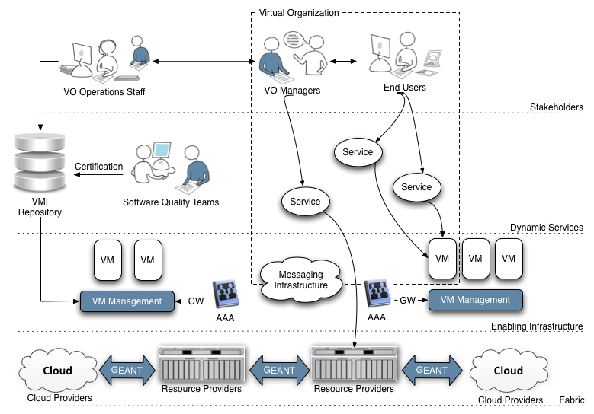
DCI Ecosystem
EMI & IGE
VO Specific Operations Staff
EDGI
EGI-InSPIRE
StratusLab
VENUS-C

Slide 4
EGI Cloud Operation
Individual communities get the environments they require
Community Services
Community Services
Virtual Machines
EGI.eu Coordination
Globus
Core Software & Support
gLite
ARC
Globus
UNICORE
Community Platform
dCache
Federated Virtual Machine Managers
NGI
NGI
NGI
EIRO
Amazon
Microsoft

Slide 5
Architecture
Usage
Usage
Service
Service
Application
Operating System
Platform
Operating System
Physical
Federated Management
Hypervisor
Physical

Slide 6
Sustainable Responsibility
EGI.eu
Virtual
Research
Communities
Usage
Virtual Machine
Image Generation
Service
Application
Platform
Endorsement
Deployment
Operating System
Resource
Infrastructure
Providers
Resource
Centres
Federated Management
Hypervisor
Physical

Slide 7
Software Sources
Usage
End-Users
Service
Science Domain
Specific
Application
Platform
Community Specific
Operating System
Mainstream Software
Federated Management
Customised Software
Hypervisor
Mainstream Software
Physical

Slide 8
Federated Management
Federated Identity
X.509
Infrastructure Authorisation
e.g. VOMS, Argus
Service Discovery
e.g. BDII
Messaging to support Accounting & Monitoring
e.g. ActiveMQ
Virtual Machine Image Replication & Management
e.g. GlobusFTP, Globus on-line, …
e.g. Open Nebula, Open Stack, …

Slide 9
Different Usage Models
Individual Research Groups
Generate own VMIs for external endorsement
Deploy, operate & monitor as required
Virtual Research Community
Generate own VMIs for internal endorsement
Deploy, operate & monitor at scale
Coordination
Software & Virtual Machine marketplaces
Endorsement policy & service

Slide 10
Example Platforms
MPI
UNICORE, GridFTP, QosCosGrid
Intensive HTC
CREAM, FTS, WMS, BDII, Argus, GANGA & DIANE
Basic Environment
Current CE, SE, WN & central discovery
VENUS-C
VENUS-C VMI
Low Volume HTC
CREAM, GridFTP, GridWAY

Slide 11
What must be sustained?
For the Infrastructure (EGI.eu’s priority)
Operations Infrastructure
BDII, Argus, VOMS, OpenNebula, …?
For the VRCs
Domain Specific Platform Software
EGI.eu could facilitate VRC & TP link
Services for all users (EGI.eu opportunity)
e.g. Globus on-line

