Slide 1
The GreenDIGIT Project – 1 Year Progress Status
Gergely Sipos (EGI Foundation)
GreenDIGIT Technical Coordinator

Slide 2
Outline
GreenDIGIT project scope and goals
Progress in year 1:
Landscape analysis
Environmental Impact Assessment (Methodology and Tools)
Software solutions for energy efficient operation
Opportunities for getting involved

Slide 3
GreenDIGIT project and its RIs HORIZON-INFRA-2023-TECH-01-01: New technologies and solutions for reducing the environmental and climate footprint of RIs
EBRAINS - An open research infrastructure that gathers data, tools and computing facilities for brain-related research
EGI - International federation delivering e-Infrastructure and open solutions for advanced computing and data analytics in research and innovation
SLICES - Scientific Large-scale Infrastructure for Computing and Communication Experimental Studies
SoBigData - Distributed, pan-European, multi-disciplinary research infrastructure aimed at using social mining and Big Data to understand the complexity of our contemporary, globally interconnected society
https://greendigit-project.eu

Slide 4
GreenDIGIT Project (2024-2027) - Objectives
O1: Assess status and trends of low impact computing within 4 DIGIT RIs (EGI, SLICES, SoBigData, EBRAINS) and in the broader digital service provider community of ESFRIs, to produce recommendations and roadmaps for providers during and beyond the project.
O2: Provide reference architecture and design principles, as well as an actionable model for RIs about environmental impact assessment and monitoring, reflecting on the whole RI lifecycle and including the digital infrastructure components and their interaction with the broader environment.
O3: Develop and validate new and innovative technologies, methods, and tools for digital service providers within European Research Infrastructures through which they can reduce their energy consumptions and overall environmental impact.
O4: Develop and provide for researcher technical tools that assist them in the design, execution and sharing of environmental impact aware digital applications with reproducibility, Open Science and FAIR data management considerations.
O5: Educate and support digital service providers and researchers in the RI communities about good practices on environmental impact conscious lifecycle management and operation of infrastructures and services.

Slide 5
Sustainability Aspects: Energy Efficiency – Decarbonisation – Environmental Impact
Energy Efficiency in Digital Infrastructures:
Definition: This refers to optimizing digital infrastructures to consume as little energy as possible for a given workload or service. It's about achieving more computational or storage results with less energy input.
Decarbonization of Digital Infrastructures:
Definition: This specifically targets the reduction of carbon emissions associated with the operation and maintenance of digital infrastructures.
Reducing Environmental Impact of Digital Infrastructures:
Definition: This is a more comprehensive consideration of the various ways digital infrastructures might affect the environment, going beyond just energy consumption and carbon emissions.

Slide 6
Shared Responsibility in Sustainability
Research
Environment and
Development Tools
Four categories identified
Manufacturers
SW developers
RI users
RI operators
Each category must assume their share towards the common goal
Research/Experiment Description and Data Model
Design & Developm
Application Software Design
GreenDIGIT brings various solutions to help these 3 groups and to incentivise the 1st group
CI/CD & Operation
Platform Deployment and Scaling
Data Storage
Code Efficiency
Utilisation & Scaling
Exchange resources availability and status, monitoring metrics and KPI (API, Info model)
Research Infrastructure and/or Datacenter
SW developer Responsibility Application and Middleware Development, Deployment, Energy usage and KPI monitoring
RI user Responsibility Workflow development and Execution, Energy usage monitoring
RI operators responsibility Research
Infrastructure Equipment
or Datacenter, Monitoring Energy and environmental impact metrics and KPI
DC Operat data collection
Datacenter/Cloud Management
Comp Cluster
Storage
Network
DC/RI Operation Monitoring
Electricity Supply
Building materials
Light, Logistics
Cooling
Water
Waste

Slide 7
Progress report
Landscape analysis
Environmental Impact Assessment (Methodology and Tools)
Software solutions for energy efficient operation

Slide 8
RIs Landscape Survey
Objective
To collect and analyse RIs practices, needs and gaps, and opportunities-barriers-good practices
What did the RIs do so far? → Good practices
Where are they going? → Initiatives
Where could we help? → Opportunities
Target
GreenDIGIT consortium (EGI, SoBigData, EBRAINS, SLICES)
Thematic RIs with significant digital infrastructures
Methodology
Preparation, survey and interviews, analysis of results and identification of key aspects
Timeline: May 2024 - December 2025

Slide 9
RIs Landscape Survey - Responses
Data, Computing and Digital
PREPARATORY PHASE
PRE-PRODUCTION PHASE
PRODUCTION PHASE
ICT facilities at 14 sites (5G, Networks, Clouds)
6 Computational
25 Research facilities
3 HPC centers
~200 HTC sites
~30 cloud sites
+
CERN (Particle acc., Intern.)
ELI-Beams (Laser facility, CZ)
Physical Sciences
CLARIN (Language resources)
Social Sciences & Humanities
GÉANT (Networks, Intern.)
Switch Cloud (CH)
University of Freiburg (DE)
Data, Computing and Digital
Responses represent over 50 academic providers from 20 countries

Slide 10
RIs Landscape Survey - Findings
Included separated responses from EGI Federation sites
Responses represent over 50 academic providers from 20 countries:
80% offering "Computation resources" as the primary resource
60% offering "Networking / Communication resources"
40% offering archives and scientific data
30% offering also "Scientific equipment / instruments"
Each of the ~50 centers running between 50-10,000 physical core systems

Slide 11
RIs Landscape Survey - Findings
RIs served (https://ri-portfolio.esfri.eu/)
Energy
EUROfusion
Environment
LifeWatch
Health & Food
ELIXIR, French Bioinformatics, Instruct, METROFOOD
Physical Sciences & Engineering
WLCG, CTA, HESS, SKAO, LOFAR, BELLE II, ESA, AGATA, FOCAL
Social Sciences & Humanities
CLARIAH, CESSDA, ODISSEI (NL)

Slide 12
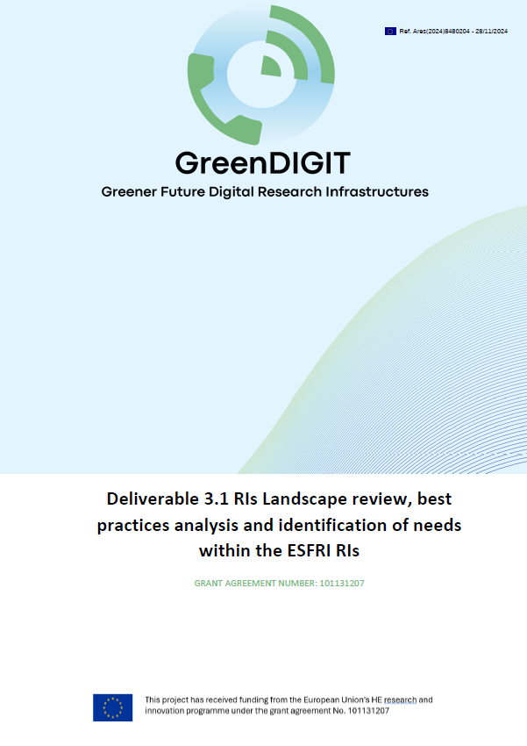
RIs Landscape Survey Main Findings
Public version available: D3.1
https://greendigit-project.eu/deliverables/
Energy is primary, water is secondary environment impact
Tracking total energy consumption is nearly everywhere (paying bills)
Power Usage Efficiency (PUE) is most common (between 1.1 - 1.7).
Others: Watts/VM, Watts/GPU, Watts/vCPU, FLOPS/Watt
Initiatives to lower consumption/waste exist, but isolated
Physical upgrade (modernise HW, A/C, building, waste heat reuse) → Requires big investment
Software based optimisation at very few places → Opportunity for GreenDIGIT
Green computing policy is rare. An existing example at IRES, France:
https://scigne.fr/resources/policies/green-computing-policy.pdf
Very few centres encourage/educate staff on good practices → Opportunity for GreenDIGIT
Switching lights or equipment off, reduce travel, cycling to work
Both staff operating the IT equipment and the end users are targets

Slide 13
Survey → Opportunities → GreenDIGIT Plans
Framework for managing the full digital RI lifecycle from the environmental impact perspective
For status assessment, Design, Implementation, Operation, Decommissioning
Software tools for power usage efficiency
Metrics infrastructure, Schedulers, Reproducibility frameworks, Resource managers (VMs, containers, workflows, AI/ML models, Data, etc.)
Develop skills and collaborations
Training resources, events, courses, forums

Slide 14
Planned SW Tools for Power Usage Efficiency
PROVIDERS’ SIDE
Metrics infrastructure
Gather relevant environmental sustainability metrics from providers
Serve metrics to decision making systems (schedulers, frameworks, VREs)
Energy-efficiency aware schedulers
Reshuffle jobs based on its type (CPU bound or I/O bound)
Delay execution based on electricity cost, regulations, carbon intensity
Developer tools for energy efficient software design
JupyterHub, Greenspector
Scientific reproducibility and resource management platform
JupyterHub, Binder, DataHub, SoBigData, etc.
USERS’ SIDE

Slide 15
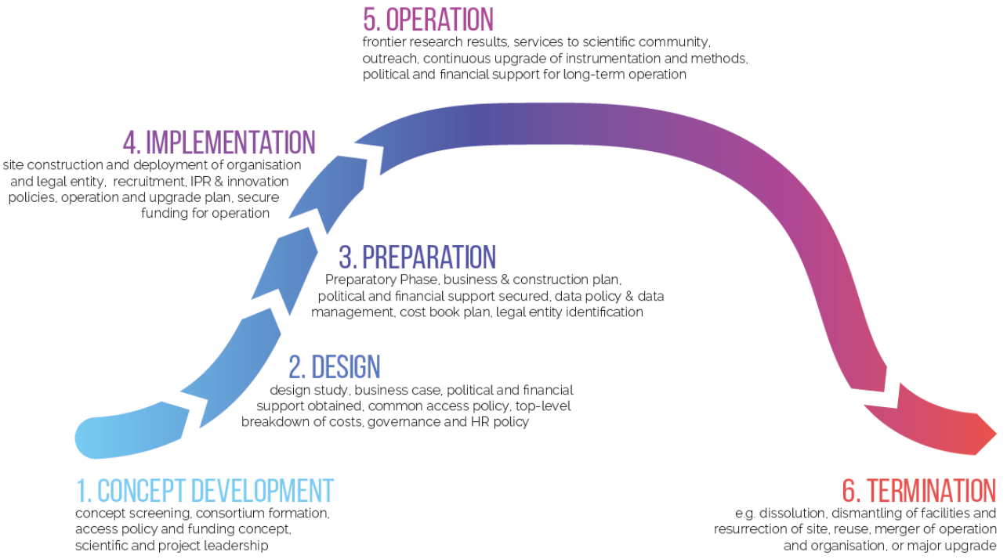
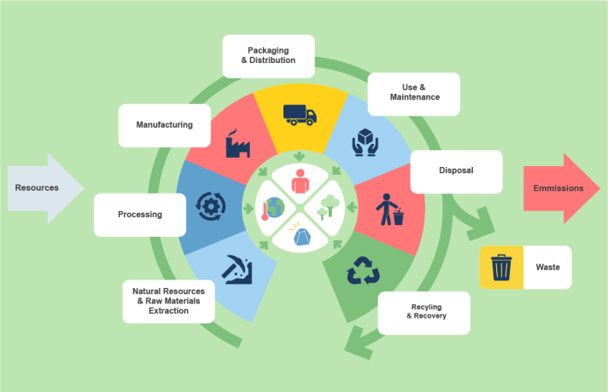
RI environmental Impact Assessment
ESFRI Lifecycle
Product Environmental Footprint https://green-business.ec.europa.eu/environmental-footprint-methods/pef-method_en

Slide 16
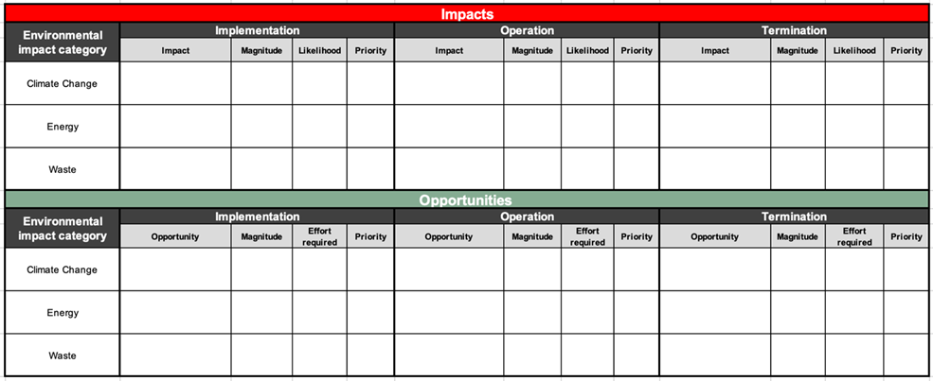
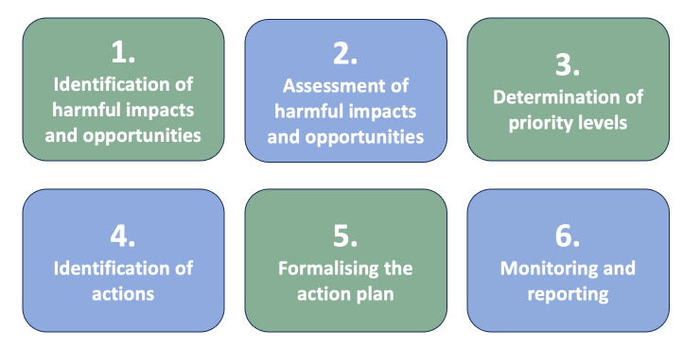
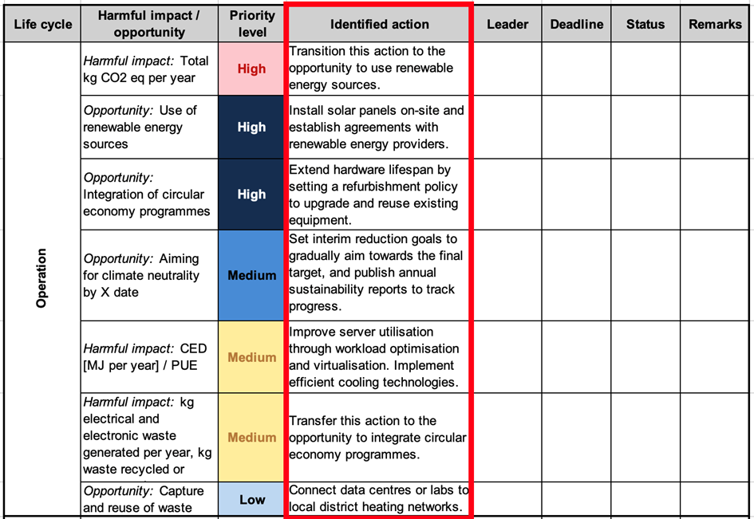
Ongoing work (D3.2 in May 2025)
Assessment tools
Methodology
Action plan

Slide 17
Software solutions for energy efficient operation
ESFRI Lifecycle
Product Environmental Footprint https://green-business.ec.europa.eu/environmental-footprint-methods/pef-method_en

Slide 18
Specific objective, big picture architecture
(Ongoing work → D4.2 - May 2025)
Objective: Collect environmental impact metrics related to user experiments* on digital infrastructures, and use this information for impact reporting and for experiment optimisation.
Optimisation can happen at 3 levels:
Requires a code optimisation module AND an experiment provenance and result DB (TUM, UvA)
Developer environment
RI manager
Dashboard
Level 1
Researcher
Level 1 | Experiment level | Decide what to (not) run (code efficiency)
Level 2 | Infrastructure level | Decide where to run (site selection)
Level 3 | Site level | Decide what to operate (on/off)
Site
Broker
Site
Level 2
Site
Requires resource specific metrics and facility specific optimisation (SZTAKI for VMs)
Site
Resources
Level 3
R
R
Resource optimiser
Site manager
Dashboard
R
R
* An experiment is considered a workflow that consists of multiple data taking, data storing, data transfer and data analysis steps

Slide 19
Questions:
What was the environmental impact of all tasks run by USER A / by Community B / everyone in March 2025?
Where to send the next tasks to minimise environmental impact, while maximizing throughput?
EGI Accounting (Test) Repo + New DB to setup in GreenDIGIT
CO₂[kg] caused by Task-1 = Energy [kWh] * CO₂content [kg/kWh]
Site
Environmental impact metrics infrastructure
Broker
Task-1(t₁-t₂) | Energy (t₁-t₂) | Energy CO2 content (t₁-t₂)
Task-2(t₃-t₄) | Energy (t₃-t₄) | Energy CO2 content (t₃-t₄)
Task-3(t₅-t₆) | Energy (t₅-t₆) | Energy CO2 content (t₅-t₆)
…
AI4OS
DIRAC
Site
JupyterHub
…
Site
Test cases with WeNMR, VIP (& others?) in 2026
EGI Accounting data
CPU Thermal Design Power
CPU HEPScore23 benchmark
Facility Power Usage Efficiency (PUE)
electricitymaps.com
Ongoing work: D4.2 (May 2025) → MS6.1 (Nov 2025)

Slide 20
Opportunities for getting involved
Energy metrics
Share your experiences
Provide feedback on our approach
Report metrics from your HTC/Cloud/HPC resource
Bring your scientific community as a test case
Environmental Impact Assessment
Test and provide feedback on our methodology and tools

Slide 21
Thank you!
Questions!

