Slide 1
Release Procedure
Install into production for central instances
Test fail
SR fail
T0
T1
Internal testing functionalities and documentation
Development
TR
Release to Production
Staged Rollout
First Announce:
- release notes
- documentation links
- detailed test plan
- expected release date
Release Announce:
- release date
- release notes
- documentation links
- testing results
Release to SA1 for regional instances

Slide 2
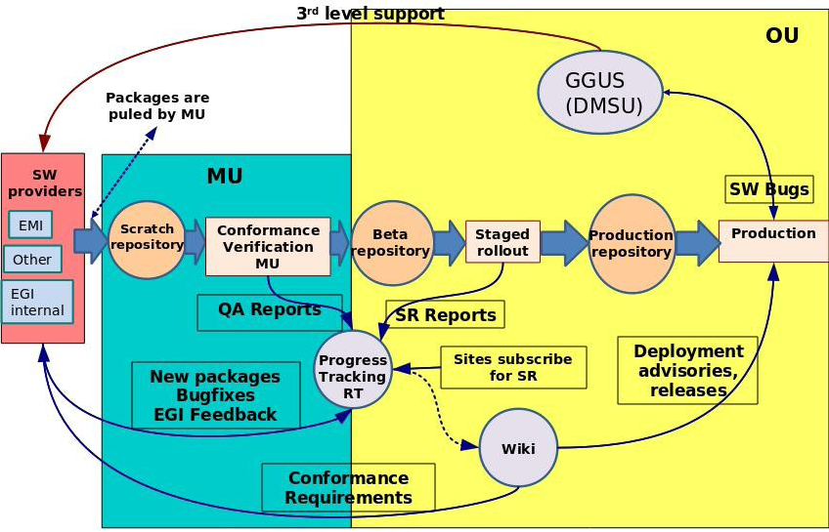
STAGED ROLLOUT

