Slide 1
e-ScienceTalk – WP2
André-Pierre Olivier - WP2 Leader, APO

Slide 2
WP2 Overview
4 Beneficiaries
72 PMs
2.2 FTEs
Participant no. | Name | Effort (PM)
3 | APO | 23
2 | QMUL | 10
4 | Imperial | 25
5 | CERN | 14
Task 2.1 GridCafé (APO and CERN)
Task 2.2 Real Time Monitor and GridGuide (Imperial with APO, CERN and QMUL)
Task 2.3 GridCast (QMUL with APO and CERN)

Slide 3
WP2 Objectives
Keep the GridCafé at the cutting edge of grid and e-Science dissemination by refreshing the look and feel and keeping it constantly updated with new material, expanding the content to cover other forms of computing.
Explore interactive environments and new web tools to ensure that GridCafé and GridCast have impact on their audiences and are easy to use.
Update the GridCast website and expand the marketing of the GridCast site to the grid and e-Infrastructure community and beyond.
Expand the GridGuide to cover more sites, improve its impact and develop further interactive functionality between the GridGuide and the Real Time Monitor.
Explore the continuation of the BELIEF Digital Library and support the e-concertation meetings.

Slide 4
Web statistics
e-ScienceTalk
Grid Café
Grid Guide
Grid Cast
Visits
2810
150,588
2040
12,574
Unique visitors
1339
16228
1549
8293
Pages viewed
4850
166212
2685
20,373
Time of visit
00:01:30
00:01:27 *
00:00:57
00:02:23
Bounce rate
72%
72% *
79%
73%
New visits
48%
76% *
2% **
75%
65%
.org
** CERN

Slide 5
WP2 Major achievements

Slide 6
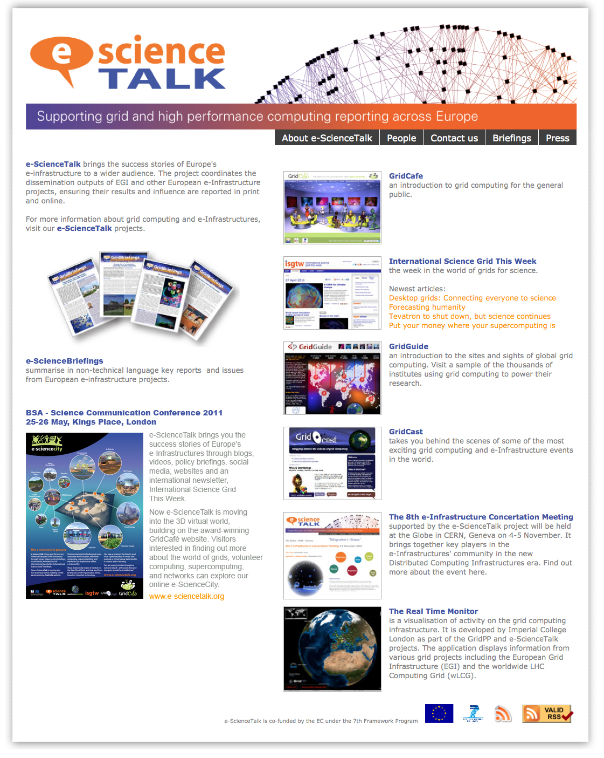
e-ScienceTalk
e-ScienceTalk website
e-ScienceTalk is the project website;
it is designed to be a simple-to-use portal,
guiding people to our different websites.
It also gives visitors access to a lot of the project's material such as e-ScienceBriefings (in PDF and HTML versions), posters, leaflets, and other documents we have produced during this first year.

Slide 7
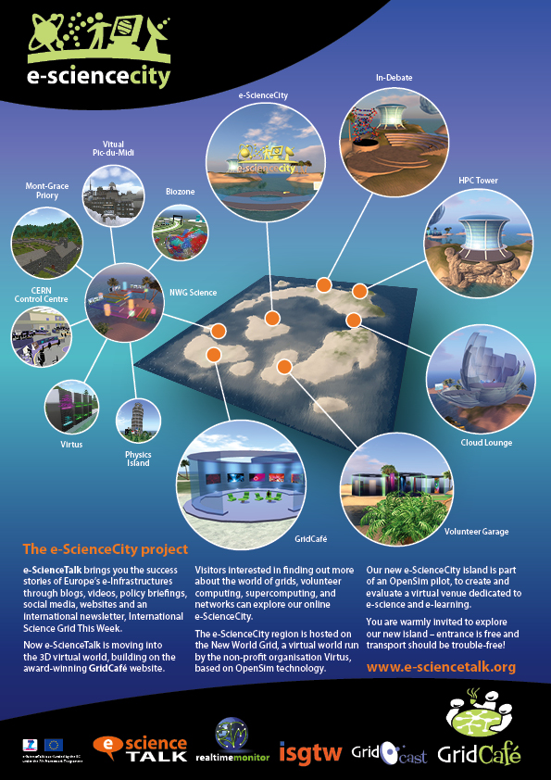
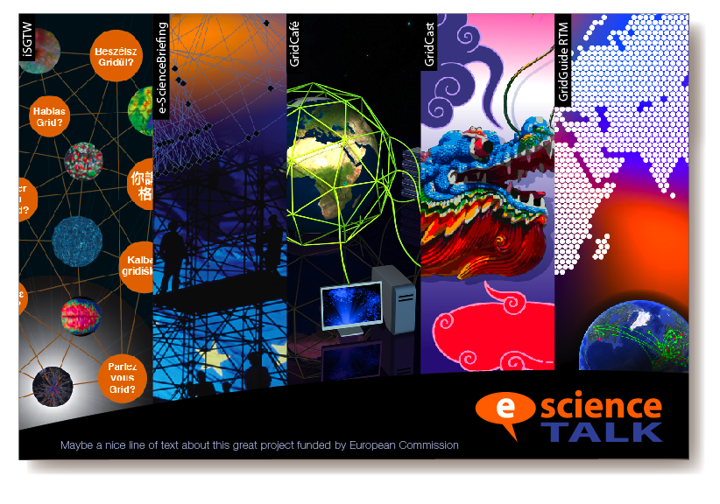
e-ScienceTalk
What has been done?
Creation of the website (original design, html construction)
Creation of a simple administration in order to quickly update e-science briefings
Continuously updating content (events, e-science briefings, documents, etc…)
Created an event website for the 8th e-Infrastructure Concertation meeting

Slide 8
WP2 Major achievements

Slide 9
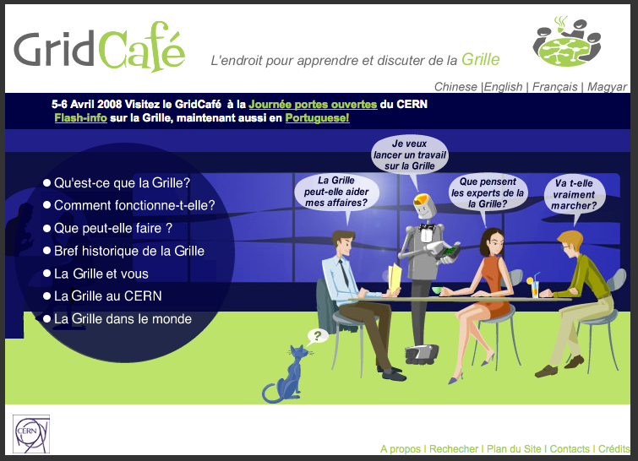
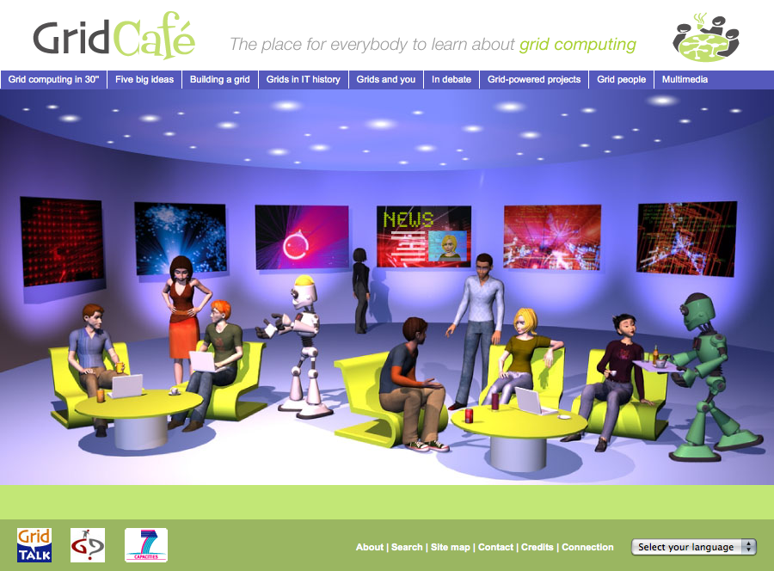
The background
The GridCafé website (www.gridcafe.org) was produced by CERN in 2003 with the aim of explaining to non-experts “what the grid is and what it could soon be”.
GridTalk redesigned the GridCafé website, keeping the friendly and welcoming feel of the original but introducing 3-D elements, new characters and a new navigation system to ensure easy access to all the site’s pages. The project also developed a new administrative system, and revised the site's content to include a policy section entitled ‘In debate’ and a selection of tutorial videos from EGEE explaining how to use the grid.

Slide 10
GridCafé update
The e-ScienceTalk project has continued to develop the website in the same spirit, with updated content, as well as new translations in Russian complete with Cyrillic support.
What has been done?
The GridCafé content has been updated (grid projects list, minor changes)
The administration has been updated (bug corrections)
The CMS has been upgraded: Cyrillic alphabet is now supported
The Russian language has been added.

Slide 11
e-ScienceCity concept
e-ScienceCity will be the place to learn all about grids, volunteer computing, supercomputing, and networks. e-ScienceCity aims to bring all e-ScienceTalk products together in one place.
e-ScienceCity is constructed like a virtual town, with sections dedicated to different areas of e-science; it will also be available to navigate through a 3D virtual world hosted by New World Grid.
e-ScienceCity was launched in September, and will be updated during the remainder of the project as we continue to create new content and sections to populate the site.

Slide 12
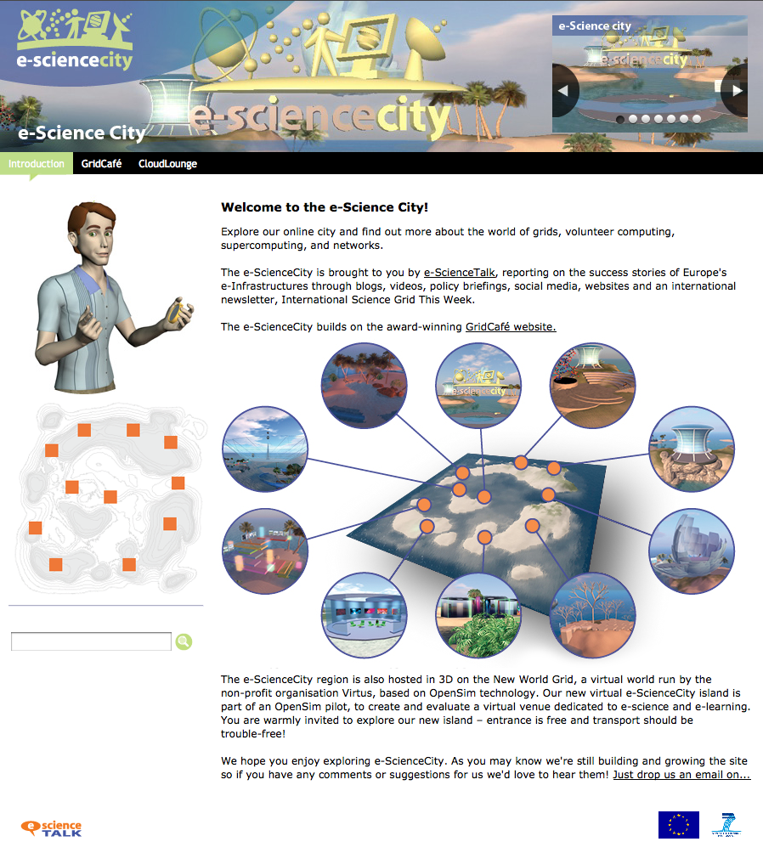
e-ScienceCity website
What has been done?
Creation of a new concept of website: design and technology
New ways to navigate through the website, which is a literally an e-science city, with several major sections
Hybrid technology: unique dynamic menu with static html content, in order to:
Simply update content with standard tools
Avoid technology problems like the use of Cyrillic alphabet
Simple maintenance for the future
Addition of the Cloud Lounge website launched in September (Y2) but the bulk of the work done in Y1.

Slide 13
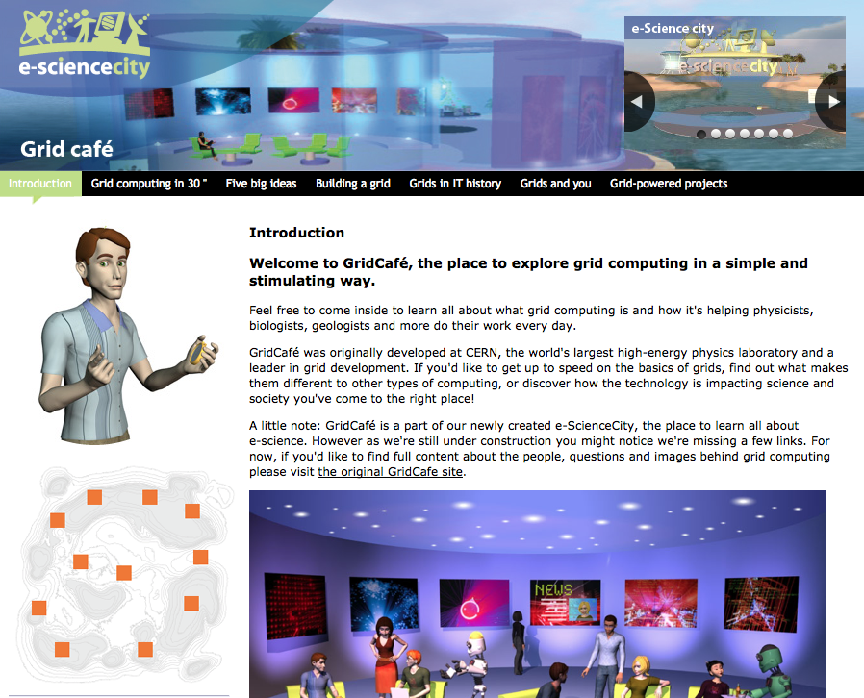
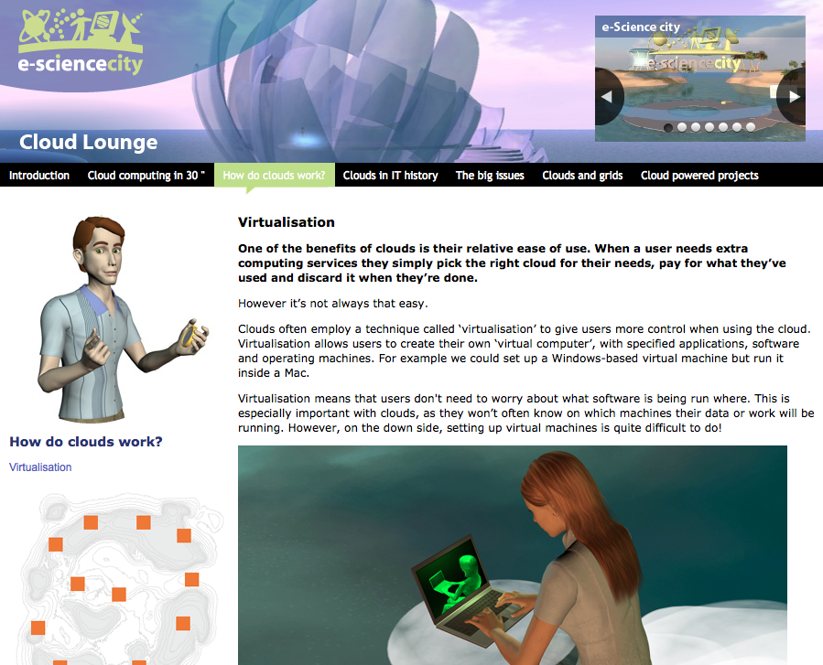
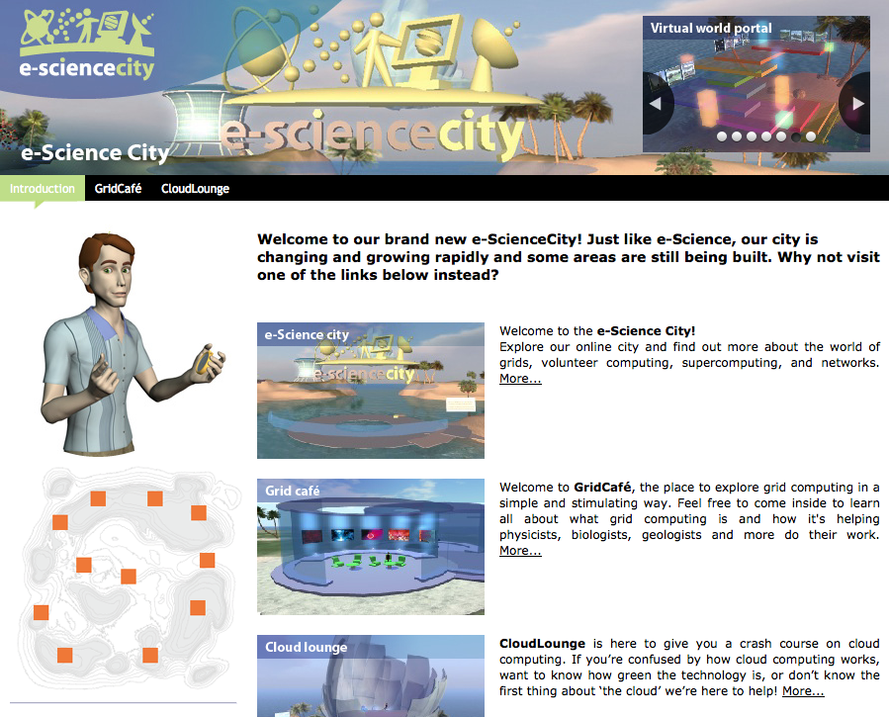
e-ScienceCity website
New version of
GridCafé
The new
Cloud Lounge area
A presentation of
future areas planned

Slide 14
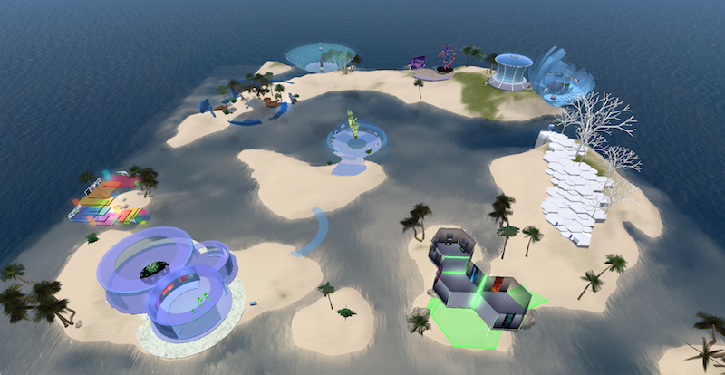
Virtual e-ScienceCity
General view of the virtual e-ScienceCity

Slide 15
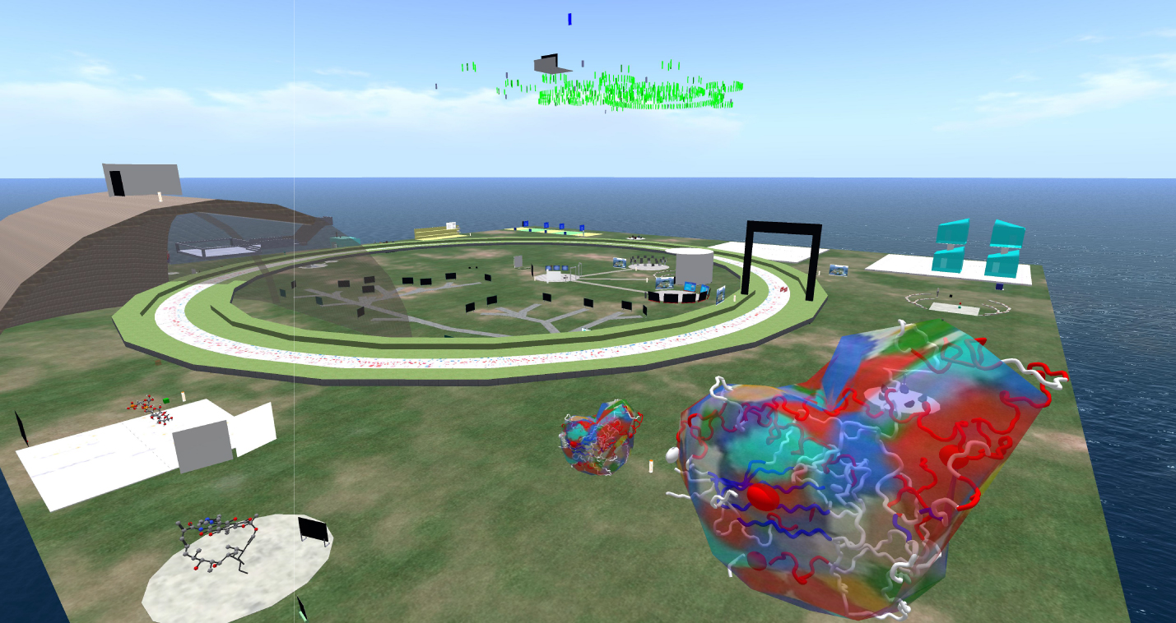
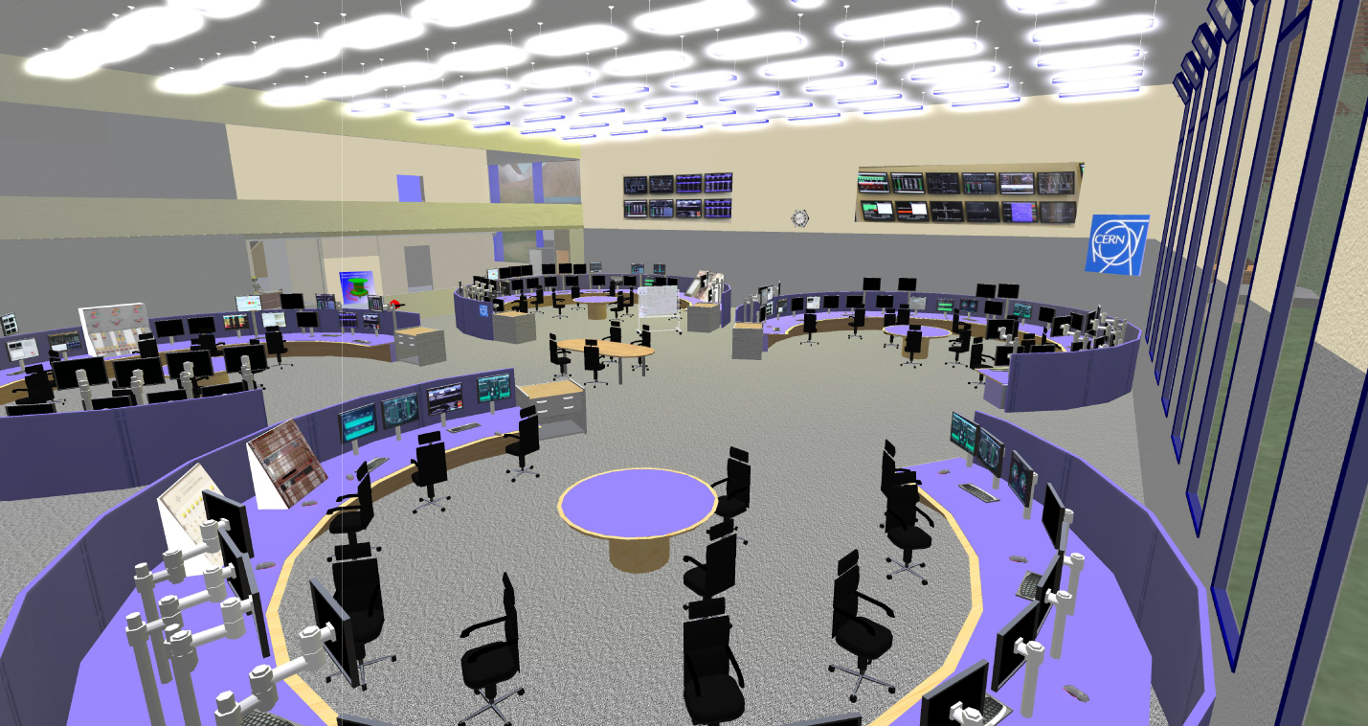
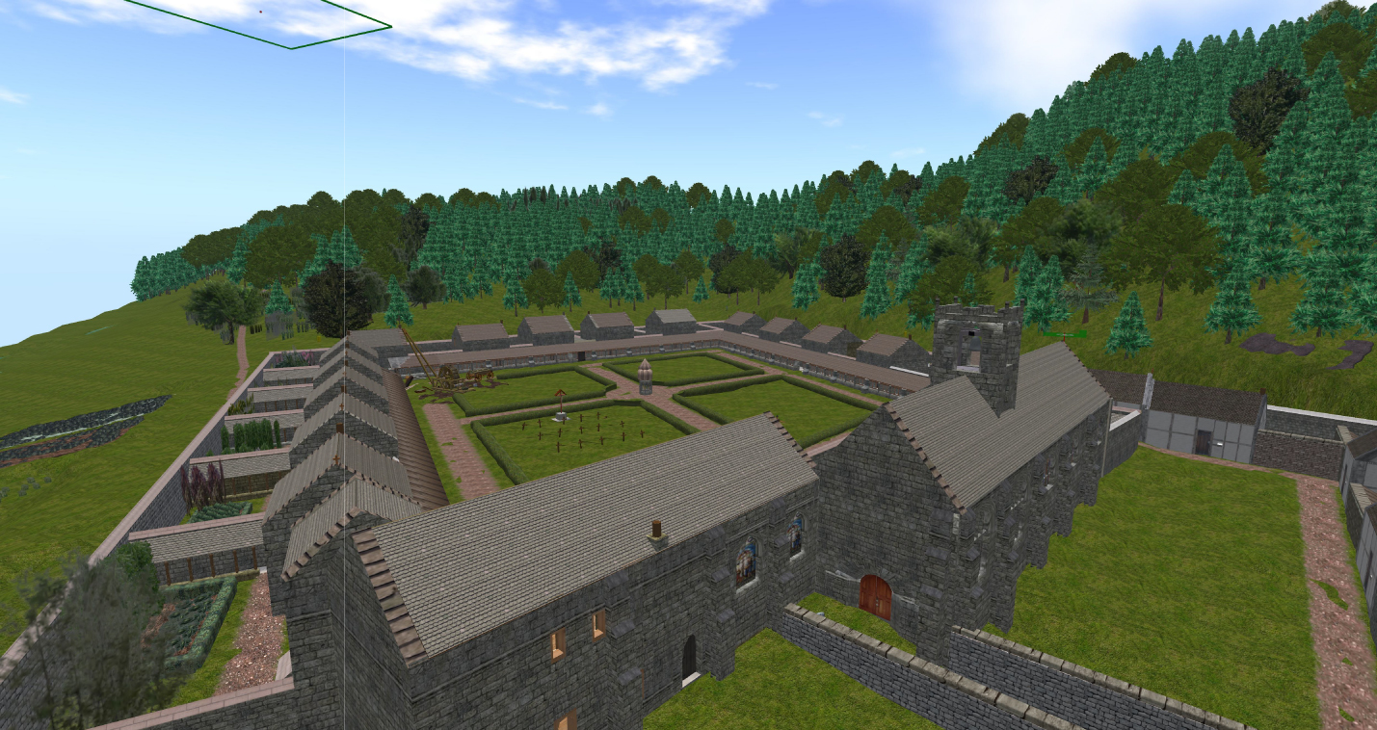
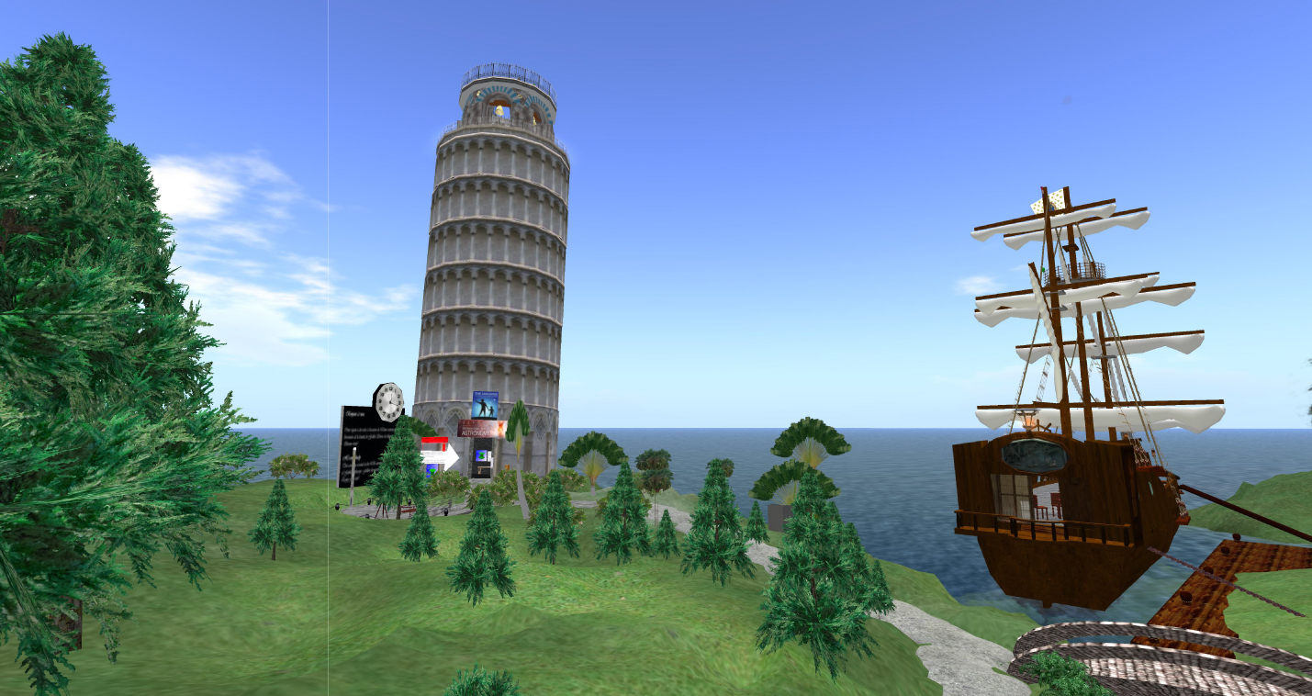
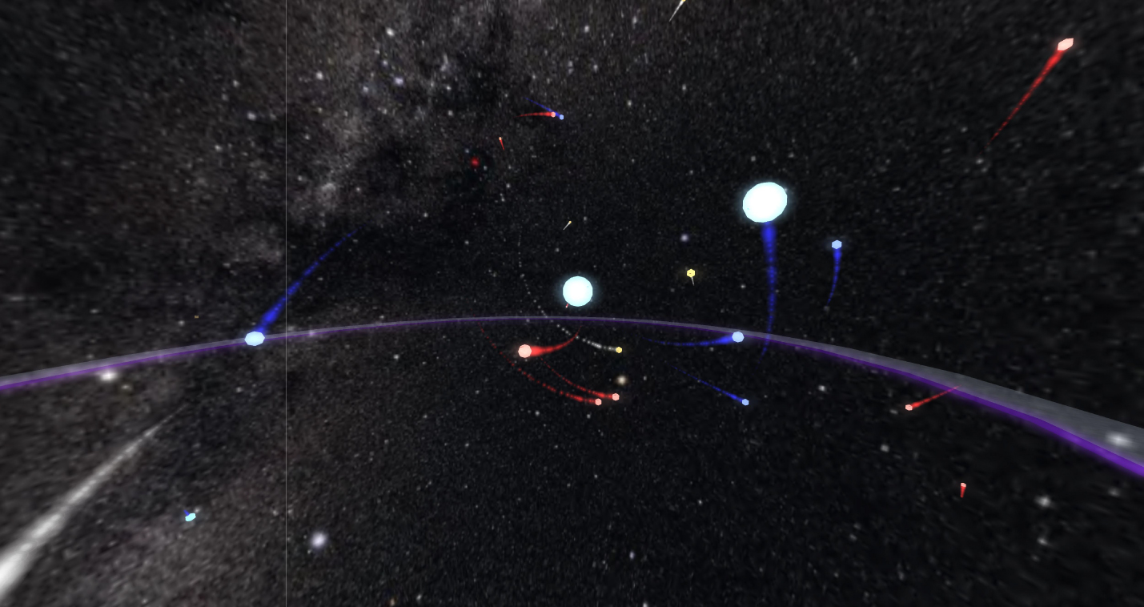
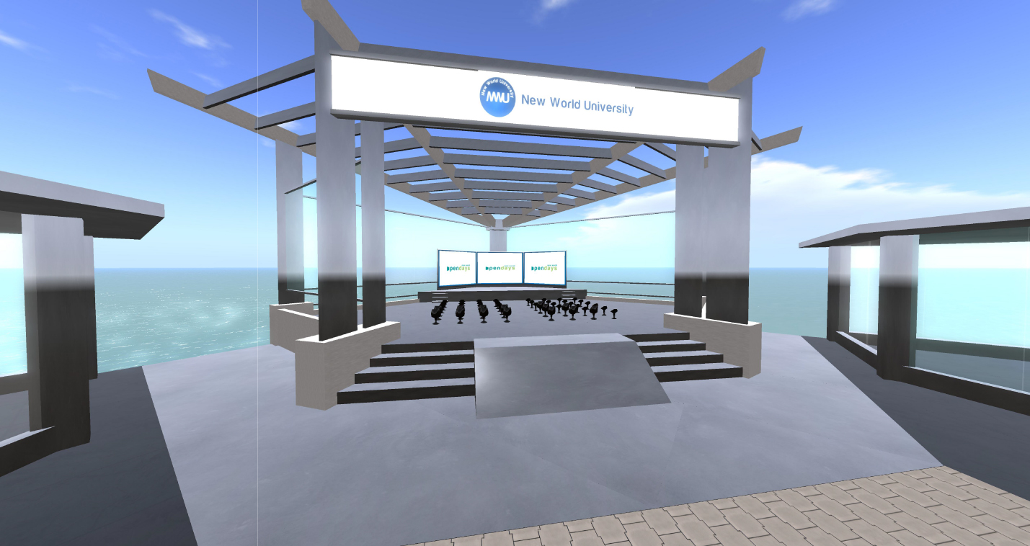
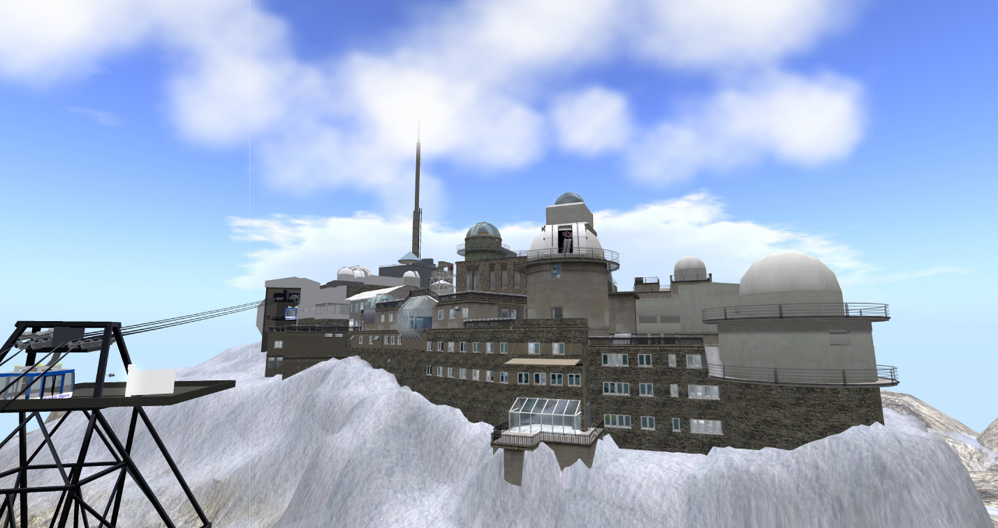
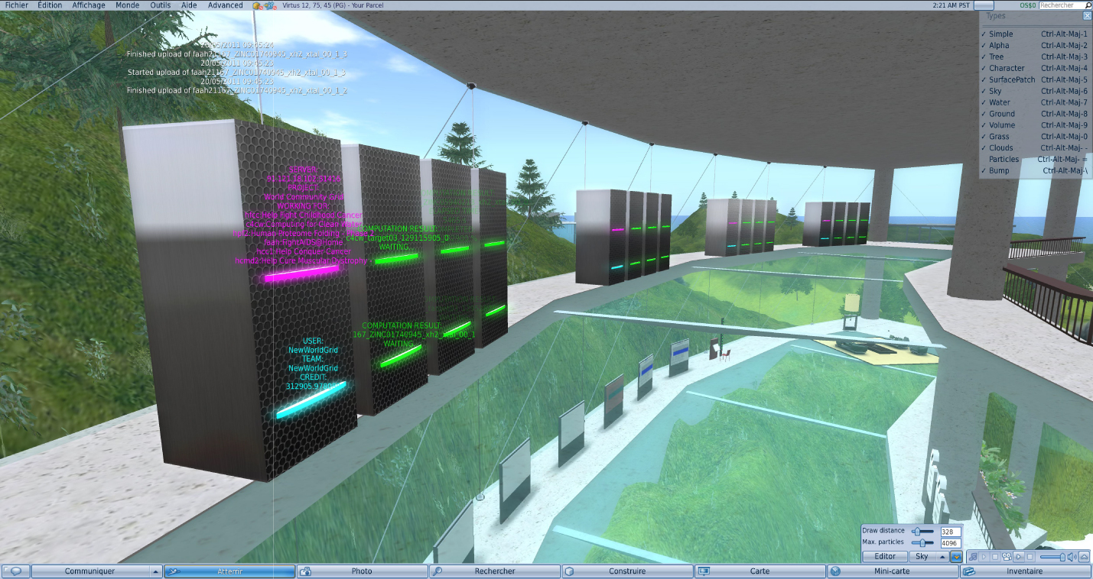
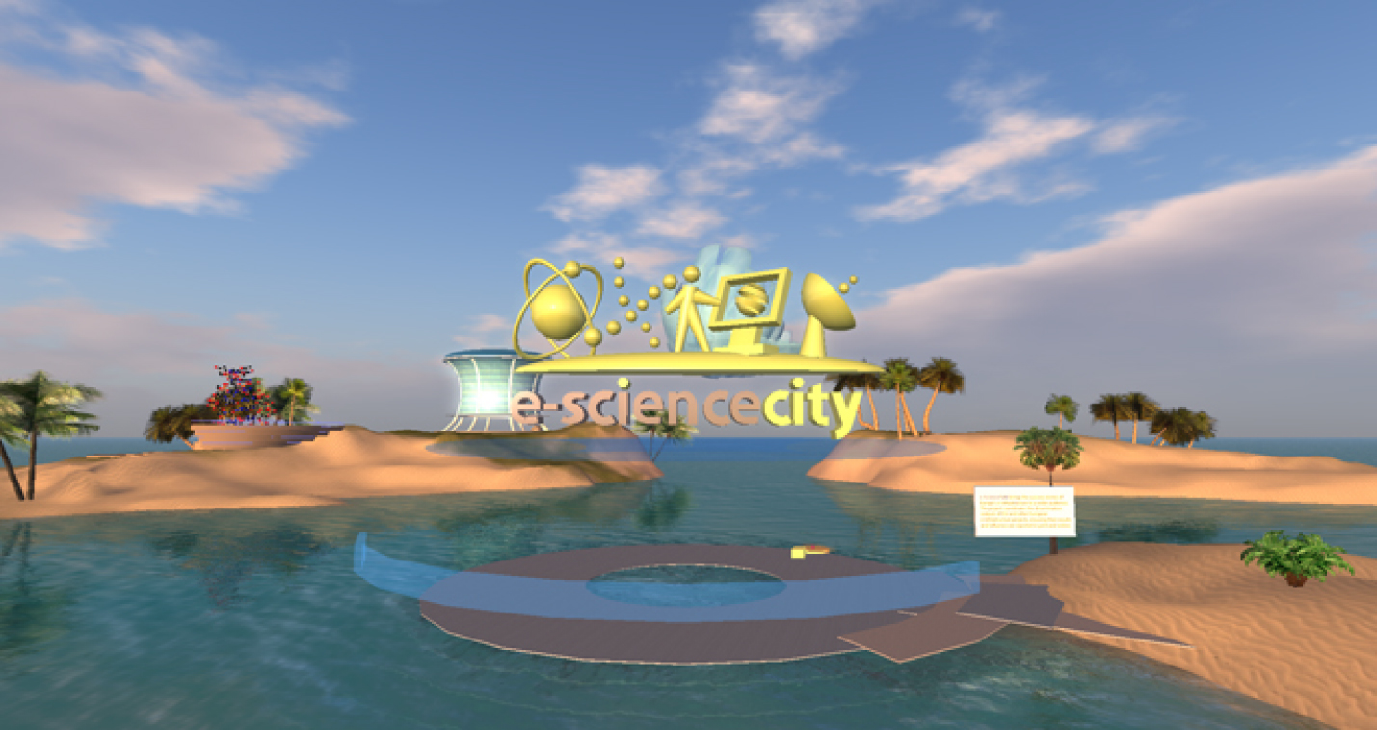
Science in New World Grid
A selection of destination for a travel in science in New World Grid
videos available on YouTube www.youtube.com/user/NewWorldGrid

Slide 16
WP2 Major achievements
Notes:
GridCasts

Slide 17
Grid Cast
GridCasts are blogs from major grid computing conferences, taking readers behind the scenes of these events. e-ScienceTalk has held 11 GridCasts and 4 "mini" GridCasts in total:
Citizen Cyberscience Summit: London, 2-3 September 2010
EGI Technical Forum 2010: Amsterdam, 14-17 September 2010
ICT2010: Brussels, 27 – 29 September 2010
eChallenges 2010: Warsaw, 27-29 October 2010
Notes:
GridCasts

Slide 18
Grid Cast
8th e-infrastructure concertation meeting: Brussels, 4-5 November 2010
Cloudscape-III: Brussels, 15-16 March 2011
ISGC2011: Taipei, 19-25 March 2011
EGI User Forum 2011: Vilnius, 11-14 April 2011
FET11: Budapest, 4-6 May 2011
Role of eInfrastructures in Climate Change: Trieste, 16-20 May 2011
HealthGrid11: Bristol, 27-28 June 2011
Notes:
GridCasts

Slide 19
Grid Cast
Mini GridCasts
DEISA-TeraGrid Summer School: 4-7 Oct 2010
Euro-Africa e-Infrastructures Conference: 9-10 Dec 2010
PRACE/LinkSCEEM Winter School: 24-27 January 2011
TeraGrid2011, Salt Lake City: 18-21 July 2011
In total this represents 192 posts and 66 webcasts.
A video filmed by WP2 about a humanoid robot at FET’11 has been viewed more than 50,000 times (http://www.youtube.com/watch?v=1dpB1yHxkuA)
Notes:
GridCasts

Slide 20
WP2 Major achievements
Notes:
GridCasts

Slide 21
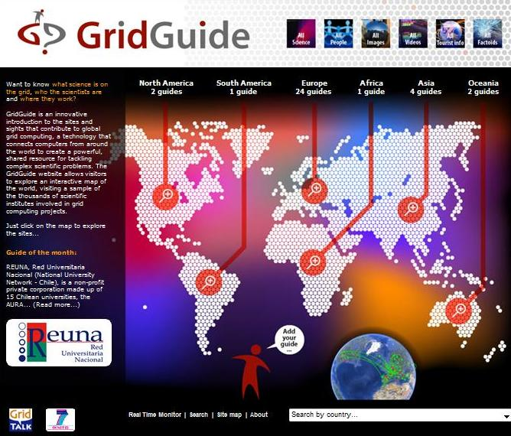
Grid Guide
GridGuide shows the sites and sights of grid computing. Users can view a sample of the sites worldwide that use the grid, introducing the scientists, the science and their institutions. In total, 40 guides are currently available worldwide.
7 new guides (sites) have been added, with new content.
These 7 new guides are based on 4 different continents: Oceania, Asia, South America, Europe.

Slide 22
Grid Guide
Users can listen to podcasts from grid sites worldwide, read about the ongoing work and watch interviews with researchers.
There are currently 38 sites on the GridGuide, including 28 EU sites and 11 non-EU in the US and the Asia-Pacific region.
Of these, 34 are also currently included in the Real Time Monitor.

Slide 23
WP2 Major achievements
Notes:
GridCasts

Slide 24
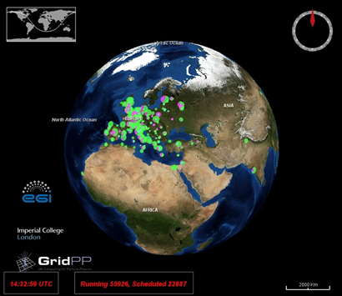
Real Time Monitor
Visualisation of activity on the grid computing infrastructure, using the NASA World Wind virtual globe, which is based on OpenGL and Java.
The RTM overlays the movement of site activity and job transfers onto the 3D globe.
In PY1, 64 countries are included in the RTM and the team has visited 16 events where the RTM has been demonstrated.

Slide 25
Real Time Monitor
Website: easier to navigate, improved design.
User support: Contact with users has been improved, and the RTM is now easier to use by non-experts.
Functionality: Application calls up the computer’s default browser and redirect the user to the GridGuide - over 30 sites have a GridGuide entry.
New users: Jobs from the LHC experiments, including ATLAS, represent more than 90% of the traffic on the grid.
ATLAS moved to PANDA from the WMS/L&B combinations service provided by gLite. The RTM team was unable to get access to the PANDA system to query it directly and so needed to go via the CERN dashboard, which monitors and publishes data from all the LHC experiments.
The RTM has been extended to give increased integration with the CERN dashboard. PANDA and “normal” jobs are displayed on separate animation layers of the RTM and can be turned on and off easily by the user.

Slide 26
WP2 Issues
Adding non-Cyrillic languages to the websites – resolved through updates to the CMS
Travel costs to events – to be addressed in Y2
Slow addition of GridGuide sites during the year – changes to the GridGuide considered
Digital Scientist branded materials not used

Slide 27
WP2 Summary
Project website launched and branding rolled out to templates eg posters, briefings…
GridCafé website updated
New e-ScienceCity site and Cloud Lounge sites prepared
3D pilot of the e-ScienceCity available in NewWorldGrid
GridCasts at 11 events, and 4 mini GridCasts
Total of 192 posts and 66 webcasts – one video viewed 50,000 times
38 sites on the GridGuide, including 28 EU sites and 11 non-EU in the US and the Asia-Pacific region (34 in the RTM)
7 new sites added to the GridGuide in 4 continents
RTM upgraded to show PANDA jobs and webstart version available

