Slide 1
WP1: Policy, Impact and Sustainability
Manisha Lalloo
WP1 Leader, QMUL
www.e-sciencetalk.eu

Slide 2
WP1 Overview
3 Beneficiaries
46 PMs
1.4 FTEs
Participant no. | Name | Effort (PM)
2 | QMUL | 28
3 | APO | 5
5 | CERN | 13
Task 1.1 Production and distribution of grid policy articles and reports (QMUL and APO)
Task 1.2 Impact and sustainability of iSGTW and GridCafé (QMUL with CERN and APO)
Task 1.3 Events attendance and media impact event organisation (QMUL with CERN and APO)
Notes:
Wp1 mainly based at queen mary , me plus zara who has been recruited to do impact and sustainability. Also have had two interns – who have contributed to feedback and attended the e-concertation meeting at CERN.

Slide 3
WP1 Objectives
Provide reporting targeted at policy makers in government and businesses to illustrate the scientific results and impacts from grid computing, e-Infrastructures and other forms of distributed computing.
Expand the audience and distribution lists for these targeted reports to regions outside Europe eg the US, Asia, South America, Africa.
Assess the impact of long running products such as iSGTW and the GridCafé and explore options for the sustainability of all e-ScienceTalk’s products beyond the end of the project.
Identify and attend a series of events in order to influence policy makers and journalists and to distribute the e-ScienceBriefings.
Assume a key leading and coordinating role in the concertation activities and meetings related to the e-Infrastructure area, maximising media impact.
Notes:
Same as gridtalk doing policy brieifngs, but epanding not just past grids but also in geographical regions.
Also looking at impact of project to see which parts work and which don’t. sustainability
Events, and collaborations as a smalll rpject and doing concertation meetings.

Slide 4
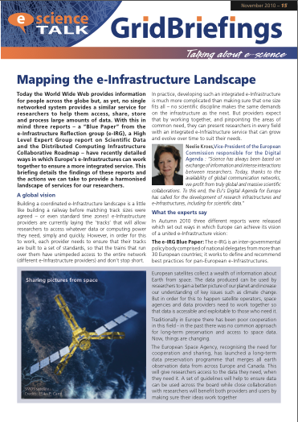
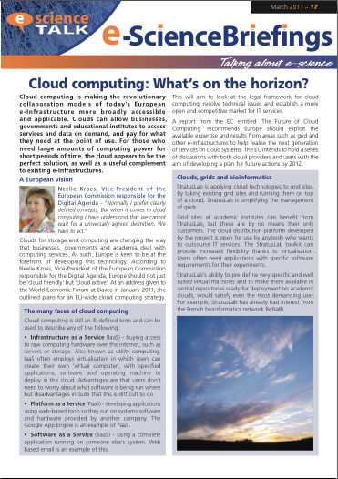
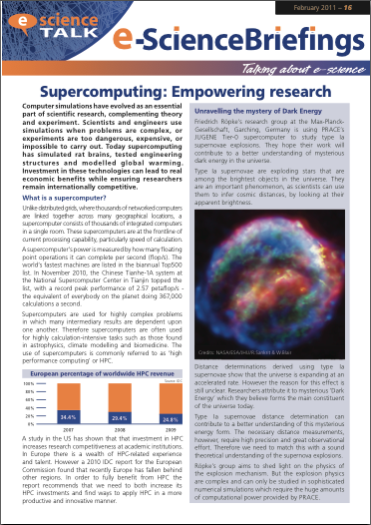
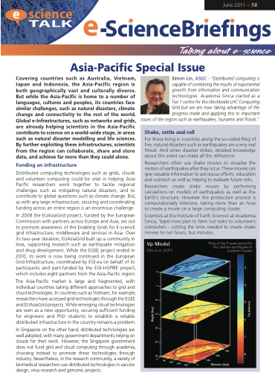
e-ScienceBriefings
Renamed and rebranded
Wider scope
Available in html version with added links and media
Notes:
Also QR codes

Slide 5
e-ScienceBriefings
Mapping the e-Infrastructure Landscape – Nov 2010
The World Wide Web provides information on a global scale but no single networked system provides a similar service for researchers. How Europe’s e-Infrastructures can work together to ensure an integrated service.
Supercomputing – Feb 2011
Supercomputing has simulated rat brains, tested engineering structures and modelled global warming. How investment in HPC technologies can ensure researchers remain internationally competitive.
Notes:
5 e-science briefings released since the start of the project. Renamed and rebranded, and cover a larger range than just grids.
First one took a look at the e-infrastructure landscape and was released at e-concertation meeting. Based on Blue Paper from the e-Infrastructure reflection group, a High Level Expert Group report on Scientific Data and Distributed Computing Infrastructure Collaborative Roadmap.
Supercomputing – worked closely with PRACE – as a start of covering more than just grids.

Slide 6
e-ScienceBriefings
Cloud Computing – Mar 2011
Cloud computing is making today’s European e-Infrastructure more broadly accessible and applicable. How clouds can complement existing e-Infrastructures.
Asia-Pacific – Jun 2011
Exploring how global e-Infrastructures, such as networks and grids, are helping scientists in the Asia-Pacific contribute to world-wide science, in areas such as natural disaster modelling and life sciences.
Notes:
Released at CloudScape-III and ISGC2011.
Asia-Pacific Special Issue, in response to ISGC2011. Released at HealthGrid11.

Slide 7
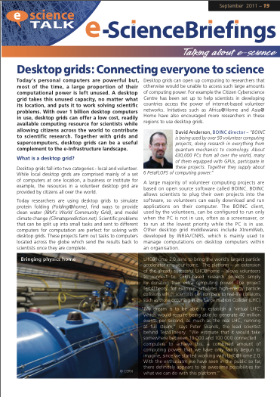
WP1 Major achievements
e-ScienceBriefings
Desktop grids – Sep 2011
With over 1 billion desktop computers in use, desktop grids can offer a low cost, readily available computing resource for scientists while allowing citizens across the world to contribute to scientific research. Together with grids and supercomputers, desktop grids can be a useful complement to the e-Infrastructure landscape.
Notes:
Desktop Grids released at EGI Technical Forum in Lyon.
Also distributed at CERN stand of the Frankfurt bookfair. (e-IRG Poland).

Slide 8
Systems of review
Briefing topics are decided and agreed by the e-ScienceTalk PMB with suggestions from our Policy Advisory Board and the EC.
Policy advisory board includes e-IRG delegates as well as representatives from projects covering clouds, networks, data and middleware.
Briefings are reviewed by:
Contributors
e-ScienceTalk PMB
Policy advisory board
European Commission
Helps to ensure articles are reliable and balanced.
4 briefings covered 38 projects across Europe and beyond.
Notes:
One of the successes of GridTalk project was To ensure editorial balance blah blah
Talk about the increased collaborations with e-IRG
Policy advisory board = is Matti, Deiter, Leif (e-IRG), Florida (EMI), Silvana (data clouds), Paul (networks).
6 people

Slide 9
Distribution
Available online and in print
Disseminated through:
iSGTW (7,800 subscribers, 8% funding programme managers)
GridCast and Twitter (1,320 followers)
Selected briefings in GridCafé
e-IRG (national delegates in 29 countries)
Distributed to 36 countries:
All contributing organisations
EGI NA2 dissemination list (53 people, 32 countries)
e-Science briefing mailing list set up in Sep 2011 (97 names, including EC representatives)
Conferences (e.g. ICT2010, ISGC 2011, Cloudscape–III, Fet11, British Science Communication Conference, EGI User Forum 11, HealthGrid11, e-IRG workshops)
Notes:
Compared to before we distribute more online and via email than in paper format.
Shortened excerpts are run in isgtw, announced on GridCast, usually as part of an event, - added to in debate section of GridCafe. Input into new e-sciencecity and cloudlounge
Close collaboration with e-IRG, take to meetings, disseminate through newsletters, in their knowledge base.
Since NA2 and NA3 are merging will go out to an even wider list of people.
Mailing list, also rss feeds
Disseminate paper copies to conferences – e.g. ICT2010

Slide 10
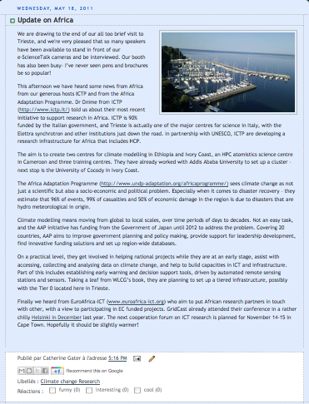
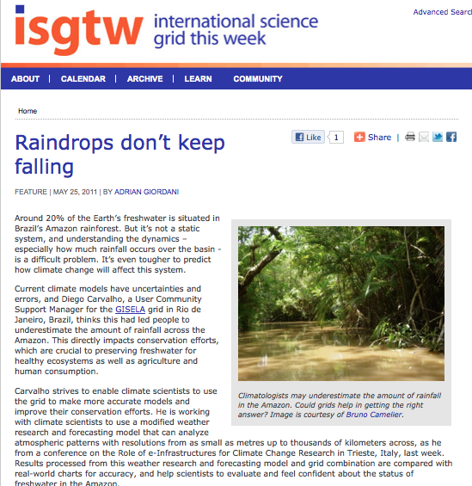
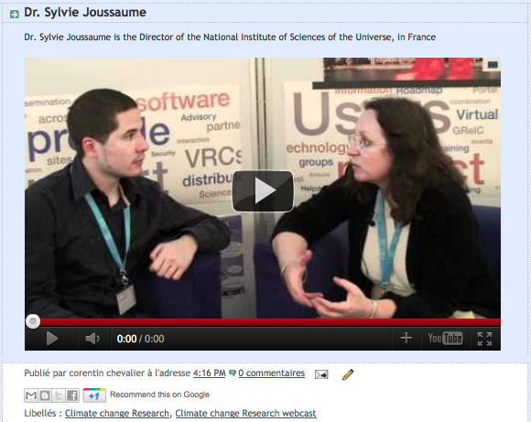
Policy events
Role of e-infrastructures for Climate Change Research,
Trieste 16-20 May 2011
Addressed how e-infrastructures can lead towards a better understanding of climate change.
134 delegates including High level representatives from Africa, Asia Pacific, European Union and Latin America.
e-ScienceTalk and EGI booth
Ran a GridCast from the event
15 posts including 7 videos
Article in iSGTW
Notes:
Increase the visibility of the project, build relationships in the community and to keep up to date with what’s going on.
Number of conferences – here are the oes with a policy angle.
Geographical representation Europe 67 Mediterranean 5 (Algeria, Cyprus, Egypt, Morocco) Latin America 3 (Argentina, Brazil, Venezuela) Africa 28 (Benin, Cameroon, Congo PR, Cote d'Ivoire, Ethiopia, Ghana, Kenya, Lesotho, Malawi, Mauritius, Namibia, Nigeria, Senegal, Sudan) Asia 20 India 15 (China, India, Kazakhstan, Pakistan, Taiwan, Vietnam) MO and Turkey 6 (Israel, Jordan, Saudi Arabia) USA 5 134

Slide 11
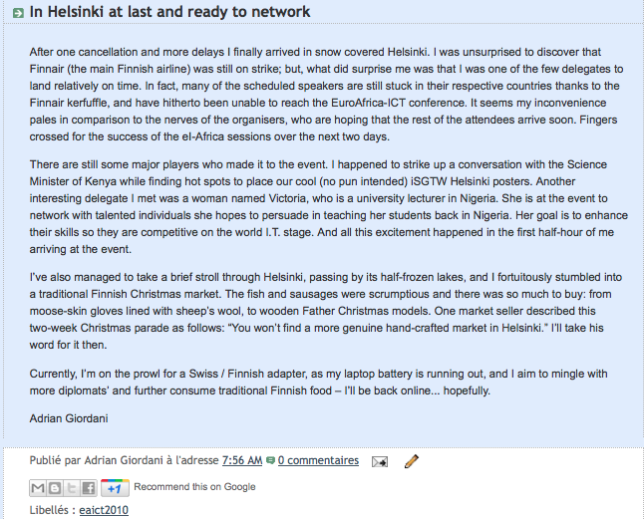
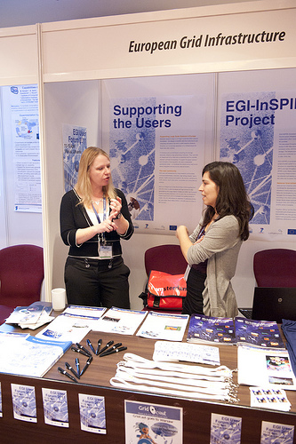
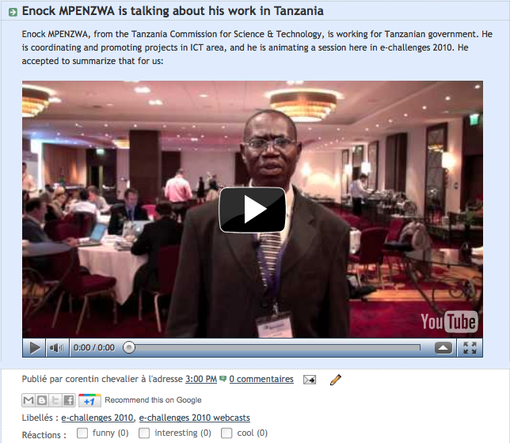
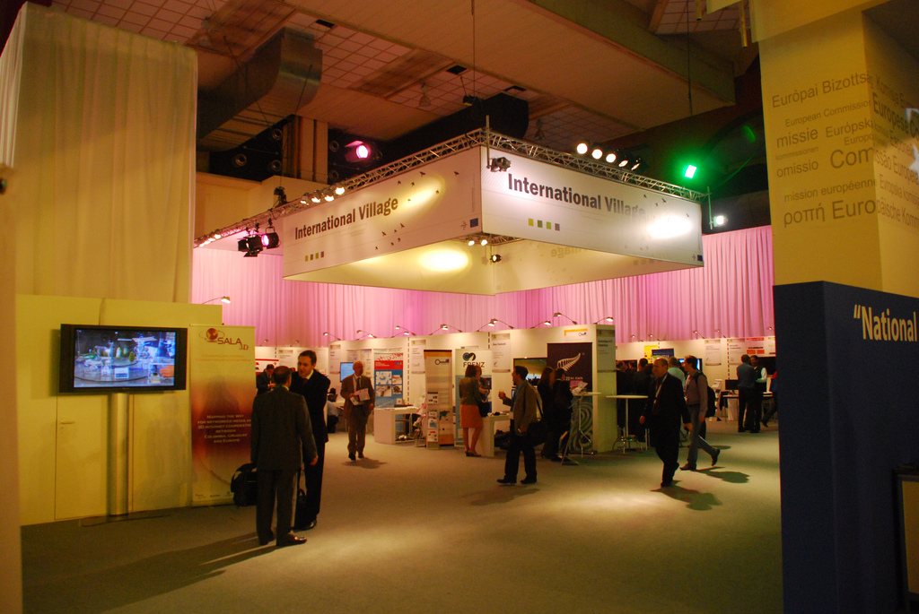
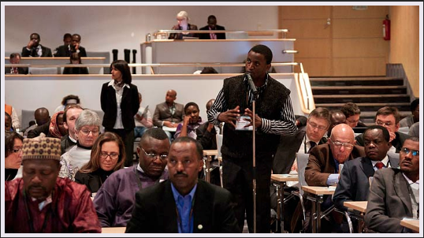
Policy events
Euro-Africa e-Infrastructures Conference: attracted 200 key stakeholders from Europe and Africa. e-ScienceTalk reported on the event on GridCast and iSGTW.
e-IRG workshops: in Brussels and Budapest. Attended by national delegates plus other interested parties.
eChallenges: in Budapest (2010). e-ScienceTalk shared a stand with EGI at the event which attracted over 650 delegates from leading commercial, government and research organisations.
ICT2010: attracted around 10,000 delegates. e-ScienceTalk exhibited on a stand with EGI and infrastructures on climate change.
Notes:
Attendees
About 200 key stakeholders in the field coming from all over Europe and Africa attended the “2010 Euro-Africa e-Infrastructures Conference”, which was held at the Scandic Marina Congress Center in Helsinki, Finland on Dec. 9-10, 2010.
Who attended the event?
Policymakers
Senior representatives from governments
Representatives from international development cooperation agencies
ICT project managers
Programme managers
Heads of research labs
Researchers
IT engineers
Deans, directors, lecturers and researchers from universities and the higher education sector
Managers of NGOs, professional associations, centres of excellence, trade unions, chambers of commerce, etc.
Industry stakeholders
etc.
Increase the visibility of the project, build relationships in the community and to keep up to date with what’s going on.
Number of conferences – here are the oes with a policy angle.
So we attend, maybe blog, exhibit, give out brieifngs
Also cover in iSGTW, e.g. were askedto cover the report of the high-level expert group.

Slide 12
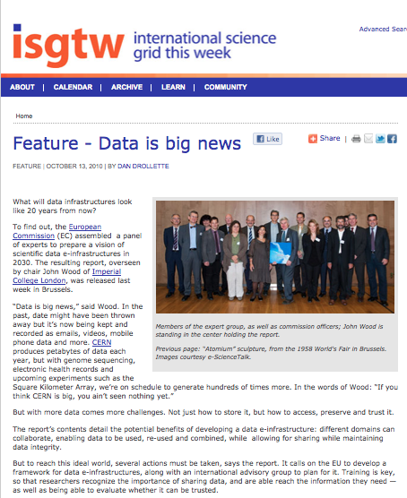
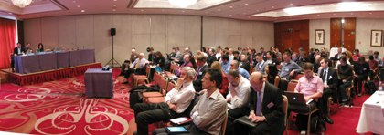
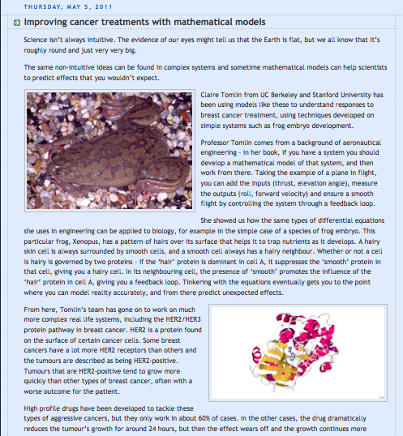
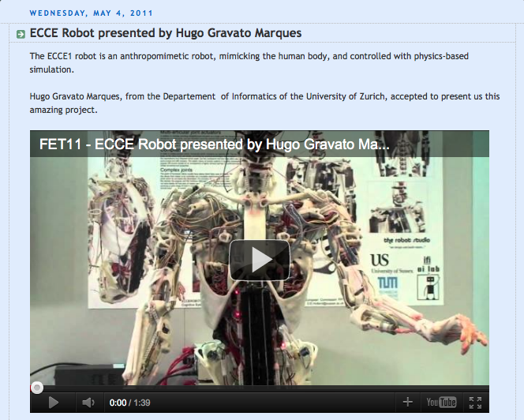
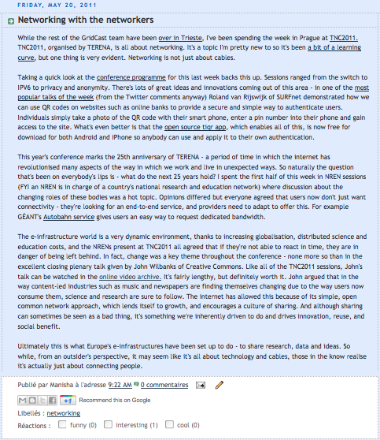
Policy events
Presentation of the Report of the High-Level Group on Scientific Data: asked to report on the event in iSGTW, also featured in e-ScienceBriefings.
Cloudscape-III: attracted over 100 participants. e-ScienceTalk ran a GridCast and launched a cloud computing briefing.
Fet11: exhibited at the conference and ran a GridCast from the event which had over 1000 participants..
TNC2011: the biggest European networking conference with over 500 participants. Reported from the event on GridCast and the EGI blog.
Notes:
Cloudscape The event saw over 100 participants gather at this premier Cloud computing event which, through a series of key presentations and interactive roundtables, identified a series of challenges impacting on the adoption of standards in Cloud computing. These challenges are universal and call for a broad consensus and a global approach. Data protection was spotlighted as one of the hottest topics that needs addressing at policy level while experts also stressed the value of risk assessments and feasible exit strategies for anyone thinking about moving to the Cloud.
Fet11, moving into new areas.
Asked to go to Trieste.
Building up relations with netowrks. TNC2011
ver 500 participants including decision makers, networking specialists and managers from all major European networking and research organisations, universities, worldwide sister institutions and industry representatives attend.

Slide 13
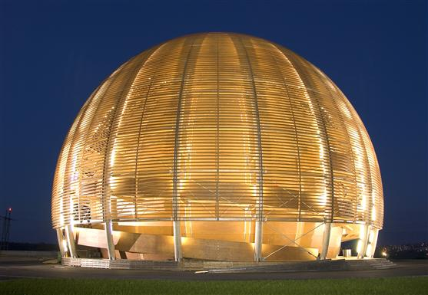
e-Concertation meeting 2010
Took place at the Globe in CERN, Geneva on 4 and 5 November 2010 and attended by 110 delegates.
Discussions included:
socio-economic evaluation of e-Infrastructures.
e-Infrastructure for simulation software.
presentations from the new projects funded in Call 7.
training session on OpenAIRE.
Publicised on GridCast, iSGTW and a dedicated event website.
Reported from the meeting on GridCast and Twitter, using the hashtag #concertation
An area for online discussions was made available on the GridCafé forum
Live webcast attracted 80 viewers (day 1), 73 viewers (day 2).
Notes:
A new aspect of the project is prganising the e-concertation meetings which are an opportunity for newly funded projects to come together and have a view about what’s happening.
Along with the logistical organisation of these meetings e-ScienceTalk put together a communications strategy to highlight the projects and discussions coming out of the meeting. This included the following:
A website for the event was set up on the e-ScienceTalk site, http://www.e-sciencetalk.org/e-concertation/index.php The event was also publicised on the e-ScienceTalk homepage http://www.e-sciencetalk.org and in iSGTW http://www.isgtw.org/?pid=1002817
The event was webcast online for those who were not invited or could not attend in person, http://webcast.cern.ch/
Projects had the opportunity to disseminate paper publications on site as well as electronically through an online virtual goody bag, http://www.e-sciencetalk.org/e-concertation/e-concertation-goody-bag.php
The e-ScienceTalk team, plus colleagues covered the event on our blog, GridCast, through written posts and web videos, http://gridtalk-project.blogspot.com/search/label/8th%20e-concertation
An area for online discussions was made available on the GridCafé forum, http://www.gridcafe.org/SMF/index.php
The tag #concertation was chosen for use on Twitter, so delegates and followers could track news from the conference online.
From 3 to6 November there were 83 visits from 42 unique visitors to the e-ScienceTalk website, which contained information on the e-Infrastructure Concertation meeting. 30% of these visits were from new visitors to the site.
A total of 17 posts were uploaded to the GridCast blog over the two-day conference. These were contributed by four members of the e-ScienceTalk team as well as Owen Appleton from Emergence Tech Ltd and Sara Coelho from EGI. Posts gave brief summaries and opinions on the discussions from the conference as well as announcing the release of the latest e-ScienceTalk GridBriefing and a new competition from iSGTW. There were also photos of the conference posted to the blog as well as four video interviews with delegates at the conference.
From 3 to 6 November there were a total of 248 visits to the GridCast blog, from 165 unique visitors. On average visitors spent 3.5 minutes on the site when visiting. 57% of these visits were from new visitors.
From 3 to6 November there were 83 visits from 42 unique visitors to the e-ScienceTalk website, which contained information on the e-Infrastructure Concertation meeting. 30% of these visits were from new visitors to the site.
A total of 17 posts were uploaded to the GridCast blog over the two-day conference. These were contributed by four members of the e-ScienceTalk team as well as Owen Appleton from Emergence Tech Ltd and Sara Coelho from EGI. Posts gave brief summaries and opinions on the discussions from the conference as well as announcing the release of the latest e-ScienceTalk GridBriefing and a new competition from iSGTW. There were also photos of the conference posted to the blog as well as four video interviews with delegates at the conference.
From 3 to 6 November there were a total of 248 visits to the GridCast blog, from 165 unique visitors. On average visitors spent 3.5 minutes on the site when visiting. 57% of these visits were from new visitors.

Slide 14
WP1 Major achievements
e-Concertation meeting 2011
Took place during the EGI Technical Forum in Lyon on 22- 23 September 2011.
Discussions included:
-Scientific Data
-e-Science Environments
-eHPC State of Play
-Infrastructures Future prospects under Horizon 2020
Event was publicised on GridCast and iSGTW
The live webcast attracted:
Day 1 - 305 unique visits from 36 different countries
Day 2 - 149 unique visits from 21 different countries

Slide 15
Impact
Analysed the impact of all e-ScienceTalk products in the Impact and Sustainability report (Deliverable D1.3).
Included both quantitative and qualitative feedback methods.
Overall e-ScienceTalk products are being well-received.
Will review metrics and feedback gathered for upcoming years.

Slide 16
Sustainability
Established a sustainability plan
Determine impact
Examine maintenance needed
Explore financing and partnership options for continuing after the project’s lifetime
Will also produce an overview guide to dissemination for EU projects as a final deliverable.

Slide 17
WP1 Issues
Ensuring editorial balance in e-ScienceBriefings
Included a total of 38 projects
Close relations with e-IRG
Reaching appropriate audiences
Online distribution increased from GridTalk
Tracing downloads
Determining impact factors
Implementing new methods in year 2

Slide 18
WP1 Summary
e-ScienceTalk has engaged policy makers in a number of ways.
Printed and online publications
Attending and organising events
Collaborations with other projects
Briefings have covered a total of 38 projects and been distributed to 36 different countries, including via a new mailing list.
Feedback is positive, stakeholders remark that the articles are useful and often print or link to briefings.
Impact of e-ScienceTalk products looks promising, and we are exploring new ways of tracking this in the second year as well as determining sustainability of products.

Slide 19
WP1 Summary
‘Thank you for putting everything together…you have done amazing work!’ – Anni Jakobsson, PRACE
‘I love the format and content of this piece.’ – Elizabeth Leake, TeraGrid
‘Many thanks, and looking forward to another possibility of collaboration!’ - Beniamino Di Martino, mOSAIC

