Slide 1
EGI user requirements – processes, tools and achievements
Karolis Eigelis, Gergely Sipos
karolis.eigelis@egi.eu
gergely.sipos@egi.eu

Slide 2
Overview
Processes and achievements
EGI Ecosystem
Requirements process
Statistics about requirements
Requirements tools (tracking and submitting)
Requirements system
Wiki pages
Web gadgets

Slide 3
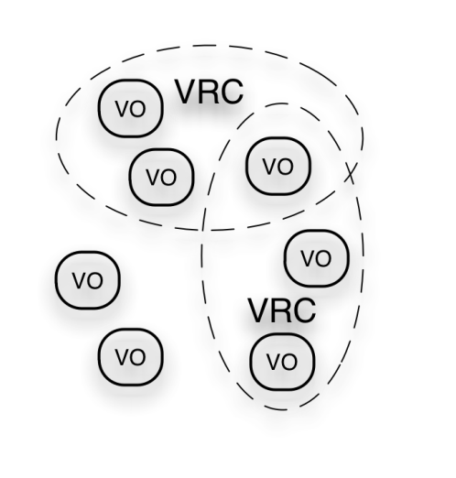
EGI Ecosystem
User Community
Project 1: SHIWA
Project 3: CLARIN
TRANSfoRm
Policies + Funding
Project 2: BioVel
Project X: ...
Project X: ...
Project X: ...
Requirements + Feedback
Services + Support
EGI-InSPIRE
Service & Resource Providers
Requirements + Feedback
Public Funding Bodies
Policies + Funding
Requirements + Feedback
European Commission
EGI.eu
Technology Providers
Currently:
EMI
IGE
SAGA
National Research Councils
Resource Infrastructure Providers
Strategic Feedback
Technology + Support
Policies + Funding

Slide 4
The EGI requirement gathering and tracking process
Channels for Operation requirements
User Support Team of EGI.eu
Technology providers
VOs
Channels for User & community requirements
EGI Requirements Tracker
Techn. Coord. Board
VRCs
User Comm- unity Board
projects
NGIs
events
EMI
IGE
SAGA,
...
Helpdesks
(EGI, NGIs, projects,...)
The EGI Community
Submit your requirements
Browse requirements
Offer solution to requirements:
http://go.egi.eu/requirements

Slide 5
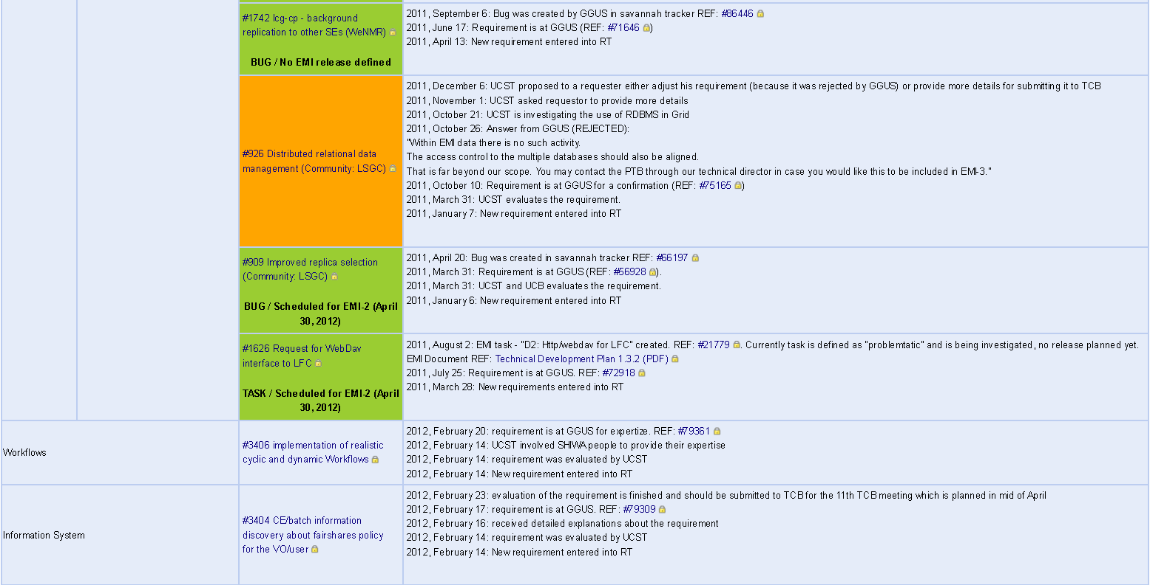
List of user community requirements
Detailed view of currently open user requirements
Accessible from http://go.egi.eu/requirements

Slide 6
User community requirements (solved)
Quarterly statistics about solved and created requirements
Accessible from http://go.egi.eu/requirements page

Slide 7
EGI requirements statistics: user requirements
EGI requirements: submitted since May 2010
Total number of requirements (users and operations) in the system: 546

Slide 8
EGI requirements statistics: solved user requirements
Total number of submitted user community requirements including VRCs, VOs and others: 188

Slide 9
EGI requirements statistics: user requirements per VRCs
Total number of requirements submitted by VRCs: 63

Slide 10
EGI requirements statistics: user requirements per VO disciplines
Total number of requirements submitted by VOs: 41

Slide 11
The EGI requirement gathering and tracking process
Channels for Operation requirements
User Support Team of EGI.eu
Technology providers
VOs
Channels for User & community requirements
EGI Requirements Tracker
Techn. Coord. Board
VRCs
User Comm- unity Board
projects
NGIs
events
Technology Coordination Board (TCB) process
Total submitted: 188
EMI
IGE
SAGA,
...
Helpdesks
(EGI, NGIs, projects,...)
The EGI Community
Total solved: 131
Submit your requirements
Browse requirements
Offer solution to requirements:
http://go.egi.eu/requirements

Slide 12
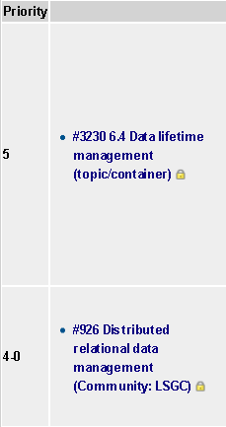
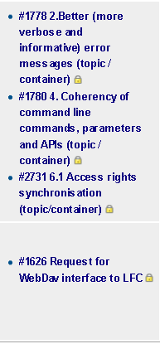
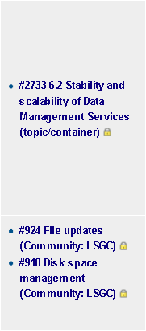
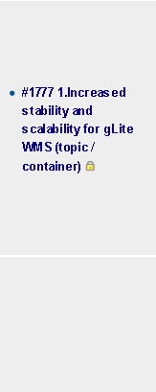
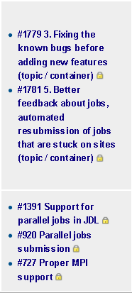
TCB catalog of requirements
Submitted
Endorsed
Assessed
Planned
Delivered
Accessible from http://go.egi.eu/requirements

Slide 13
TCB process
User Comm- unity Board
User

Slide 14
TCB process
User Comm- unity Board
Requirement is submitted to the TCB
2 requirements were submitted to the TCB in February 2012.
REF:#3230 6.4 Data lifetime management (topic/container)
REF: #926 Distributed relational data management (Community: LSGC)
Feedback and new status should be provided by TCB F2F meeting in April, 2012.
Link to the agenda - http://go.egi.eu/TCB_F2F_April_2012

Slide 15
TCB process
User Comm- unity Board
The need of the requirement is recognized by the TCB
4 requirements were endorsed by TCB and are waiting for technology providers to assess the requirement.
REF: #1778 2.Better (more verbose and informative) error messages (topic / container)
REF: #1780 4. Coherency of command line commands, parameters and APIs (topic / container)
REF: #2731 6.1 Access rights synchronisation (topic/container)
REF: #1626 Request for WebDav interface to LFC
Feedback and new status should be provided by TCB F2F meeting in April, 2012.
Link to the agenda - http://go.egi.eu/TCB_F2F_April_2012

Slide 16
TCB process
User Comm- unity Board
Technology provider provides and assessment of requirement
3 requirements submitted in November 2011 were recently assessed by TCB:
REF: #2733 6.2 Stability and scalability of Data Management Services (topic/container)
REF: #924 File updates (Community: LSGC)
REF: #910 Disk space management (Community: LSGC)
Feedback and new status should be provided by TCB F2F meeting in April, 2012.
Link to the agenda - http://go.egi.eu/TCB_F2F_April_2012

Slide 17
TCB process
User Comm- unity Board
The requirement is included in the technology provider’s plan
The delivery of “documentation about WMS recommended configuration” (a topic considered as priority by the UCB in 2010) was already delayed twice, and it is now promised to come as part of EMI-2 release in April, 2012.
REF: #1777 1.Increased stability and scalability for gLite WMS (topic / container)
Feedback and new status should be provided by TCB F2F meeting in April, 2012.
Link to the agenda - http://go.egi.eu/TCB_F2F_April_2012

Slide 18
TCB process
User Comm- unity Board
Technology provider delivers the solution
5 requirements were delivered by technology providers:
REF: #1391 Support for parallel jobs in JDL
REF: #920 Parallel jobs submission
REF: #727 Proper MPI support
REF: #1779 3. Fixing the known bugs before adding new features (topic / container)
REF: #1781 5. Better feedback about jobs, automated resubmission of jobs that are stuck on sites (topic / container)

Slide 19
Will be submitted to TCB
3 requirements will be submitted to the next TCB F2F in April, 2012:
REF: #3406 implementation of realistic cyclic and dynamic Workflows
REF: #3404 CE/batch information discovery about fairshares policy for the VO/user
REF: #3563 Full support for PCKS8 private keys

Slide 20
Complex topics (1)
Data management tools
Scientific data flows
Pilot job frameworks
No single technical solution
exist
.
EGI therefore
Links to and mobilise support through external projects,
e.g.SHIWA, SCI-BUS, Scalalife,…
Training marketplace:
events, trainings, best practices
Topical workshops:
portals, workflows, data management
Applications database:
Registry of applications, tools, gateways, etc.

Slide 21
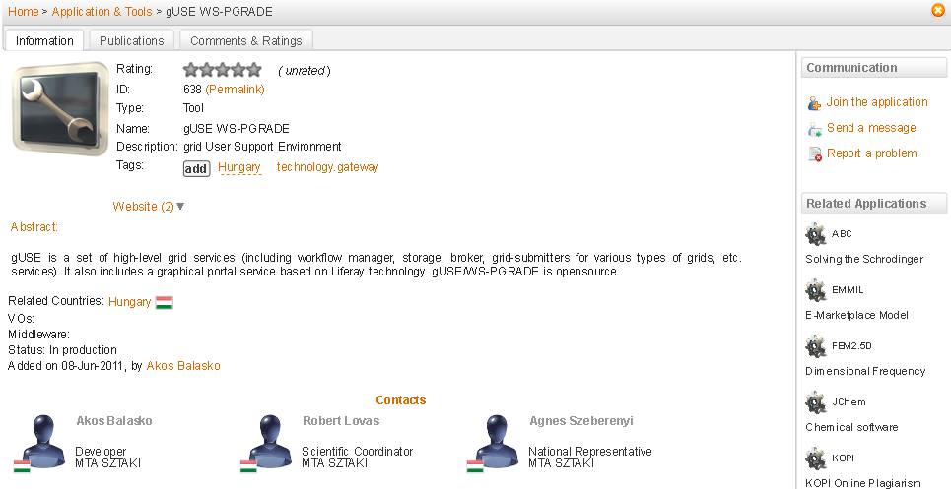
Applications and tools database
http://appdb.egi.eu/

Slide 22
Complex topics (1)
Dedicated workshops:
SHIWA Workflow Simulation Platform Tutorial, Munich.
https://www.egi.eu/indico/sessionDisplay.py?sessionId=25&confId=679#20120330
Data technologies, Munich.
https://www.egi.eu/indico/sessionDisplay.py?sessionId=52&confId=679#20120327
Kepler tutorial (workshop), Munich.
https://www.egi.eu/indico/sessionDisplay.py?sessionId=7&confId=679#20120327
Workflow systems – workshop, Munich.
https://www.egi.eu/indico/sessionDisplay.py?sessionId=66&confId=679#20120328
Workflows: solutions currently in use, Munich.
https://www.egi.eu/indico/sessionDisplay.py?sessionId=26&confId=679#20120328
e-Science Workflows in Budapest.
https://www.egi.eu/indico/conferenceTimeTable.py?confId=656#20120209
Data management in Lyon.
https://www.egi.eu/indico/sessionDisplay.py?sessionId=14&confId=452#20110919
.

Slide 23
Complex topics (2)
Robot certificates supporting CAs
Robot certificates are used mostly by scientific gateways and portals to simplify access to the grid for the users.
Currently these CAs support robot certificates:
CERN IT/IS
CESNET
DFN-PCA Grid Germany CAs
DutchGrid
INFN (Italy)
IRAN-GRID
FNAL SLCS
Grid-Ireland
UK eScience

Slide 24
Complex topics (2)
We talk with local NGIs and ask them to submit the requests to their CAs.
There is a process defined by The International Grid Trust Federation (IGTF) how to implement robot certificates in the national CAs.
e.g. for Germany it worked.
List of CAs supporting robot certificates - https://wiki.egi.eu/wiki/Robot_certificates
List of known users/VOs using robot certificates https://wiki.egi.eu/wiki/EGI_robot_certificate_users

Slide 25
Complex topics (3)
Homogeneous APIs to all middleware services
We investigated the APIs for middleware services.
List of APIs of middleware services - https://wiki.egi.eu/wiki/Service_APIs
It will be finalised by EMI project as part of EMI-2 release (April 2012) (gLite, ARC, Unicore, dCache)

Slide 26
Requirements tools
Requirements tracker (RT) native interface
RT Dashboards lists only your requirements
Wiki pages and RT gadgets: not part of requirements tracker.

Slide 27
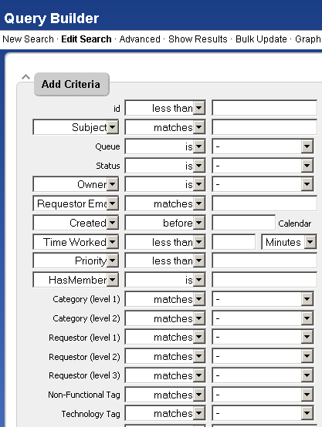
Requirements tracker native web interface
Many users did not find it
Comfortable to search for
their requirements
http://go.egi.eu/requirements

Slide 28
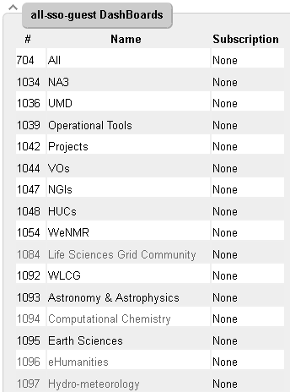
RT dashboards
Requirements tracker (RT) native
web interface with
pre-defined dashboards
http://go.egi.eu/requirements

Slide 29
List of user community requirements
Detailed view of currently open user requirements
Accessible from http://go.egi.eu/requirements

Slide 30
User community requirements (solved)
Quarterly statistics about solved and created requirements
Accessible from http://go.egi.eu/requirements page

Slide 31
TCB catalog of requirements
Submitted
Endorsed
Assessed
Planned
Delivered
Accessible from http://go.egi.eu/requirements

Slide 32
Requirements web gadgets
What you can do with requirements web gadgets?
Embed Your requirements into Your website.
You can list your requirements e.g. per VRC, per VO, per NGI.
You can submit requirements through the gadget
Examples and information about how to request is accessible at http://go.egi.eu/requirements

Slide 33
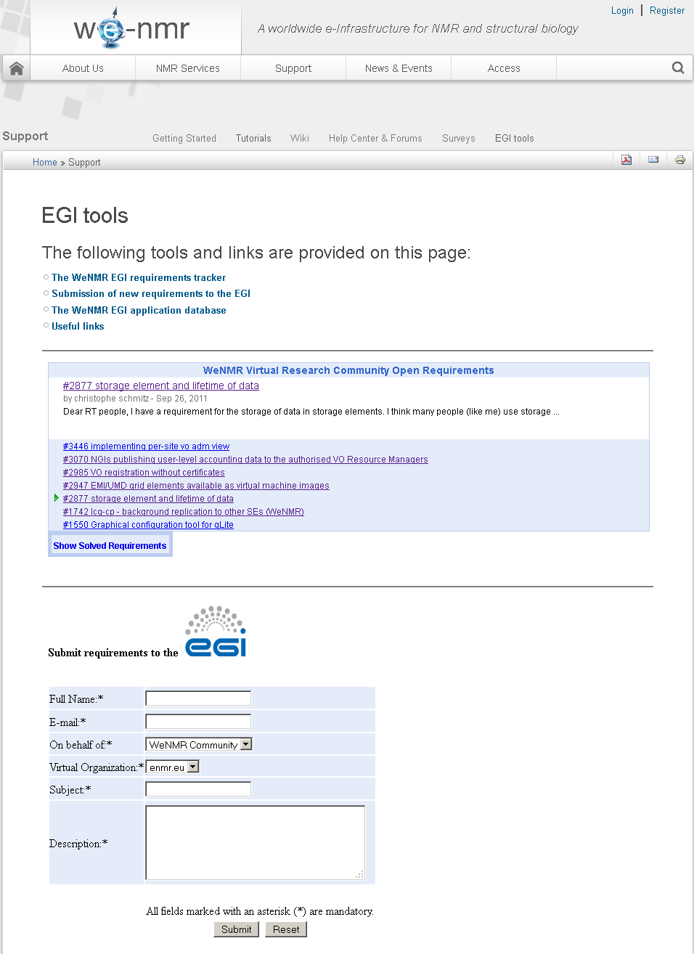
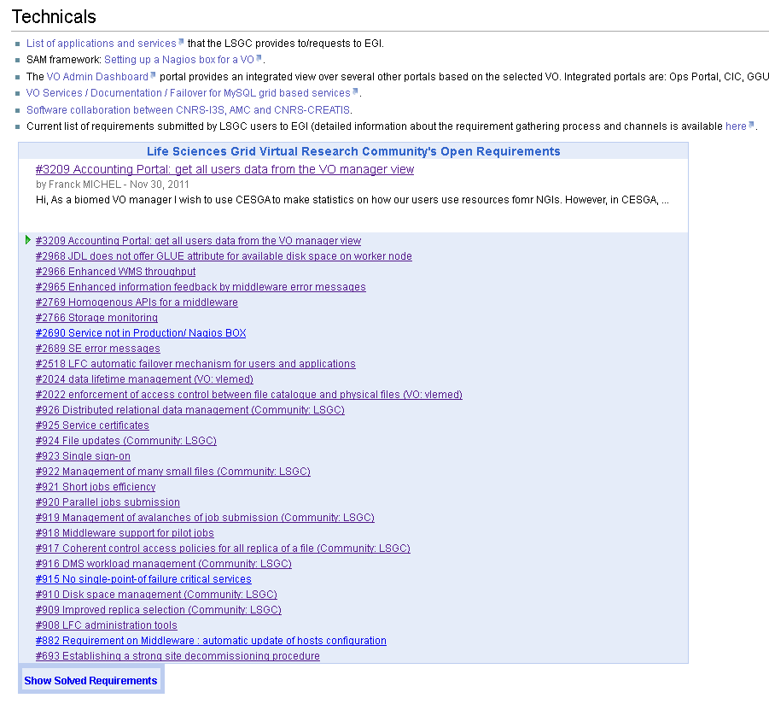
Web gadgets in use
WeNMR Grid Community Life Sciences Grid Community
/

Slide 34
Questions?
ucst@egi.eu

