Slide 1
Intelligence Collection and Analysis Process & ESFRI Contact list
Gergely Sipos
gergely.sipos@egi.eu

Slide 2
Goals
Support EGI outreach to new communities by
Establishing processes for NGIs and EGI.eu to collect, record and analyse information about potential new user communities and their needs.
Gathering and distributing within EGI-InSPIRE a comprehensive list of relevant ESFRI project contact points.

Slide 3
Intelligence collection processes
Key questions that the VT answered
What do we want to know?
Where and how to record it?
How to analyse it so a European-wide picture can emerge?
Answers emerged through a series of surveys and telcons with VT members:
Processes and questions got implemented in the EGI CRM: https://wiki.egi.eu/wiki/CRM
CRM is a new service from Ibergrid to all NGIs
Try and use it!

Slide 4
ESFRI contact list
In 2011 EGI.eu put together a list of ESFRI institutes from accross all the ESFRI projects
Data was collected from project homepages
~56 projects with ~600 institutes (some also in EGI-InSPIRE!)
Key question that the VT answered:
Who are the people at these institutes who we should talk to about collaboration?
In Czech Republic, Hungary, Italy, Spain, Switzerland, UK
What should we record about these leads?

Slide 5
EGI CRM: Data structure and use cases
Summarise key findings about groups of projects
Register projects
Projects (ESFRI & non-ESFRI; National & International)
Summarise key findings about each project
Register institutes
Institutes (universities, research labs, etc.)
Register people
People (researchers, developers, etc.)
Interview people & register key findings

Slide 6
EGI CRM: Data structure and use cases
Summarise key findings about groups of projects
Will happen
Happened for ESFRI projects (by EGI.eu)
Register projects
Projects (ESFRI & non-ESFRI; National & International)
Summarise key findings about each project
Register institutes
Institutes (universities, research labs, etc.)
Is happening for ESFRI projects (by NGIs and EGI.eu)
Register people
People (researchers, developers, etc.)
Interview people & register key findings

Slide 7
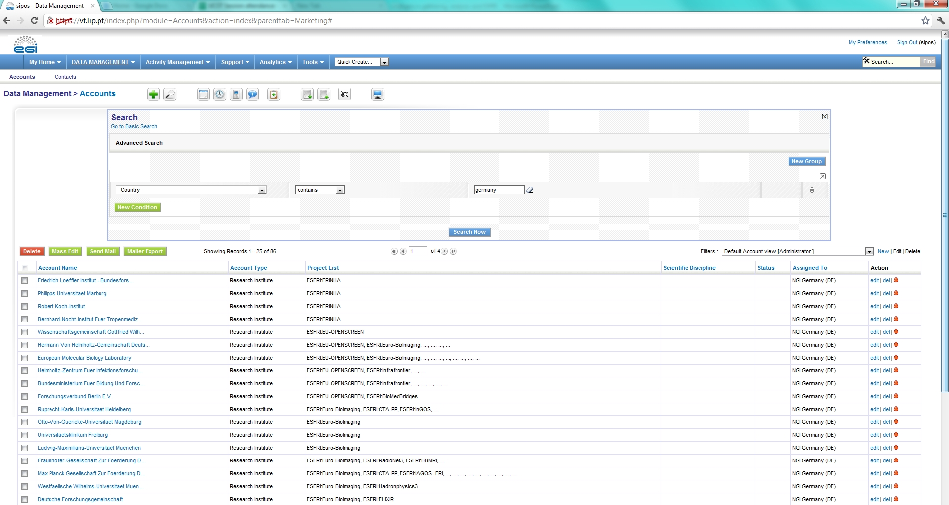
Example 1: ESFRI institutes in Germany
86 institutes

Slide 8
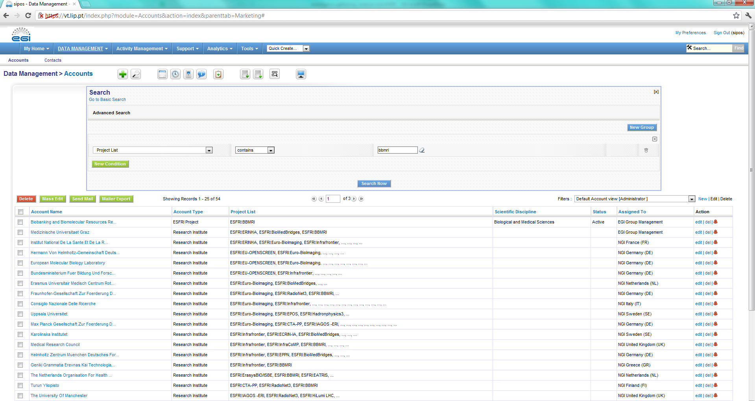
Example 2: BBMRI institutes
53 institutes

Slide 9
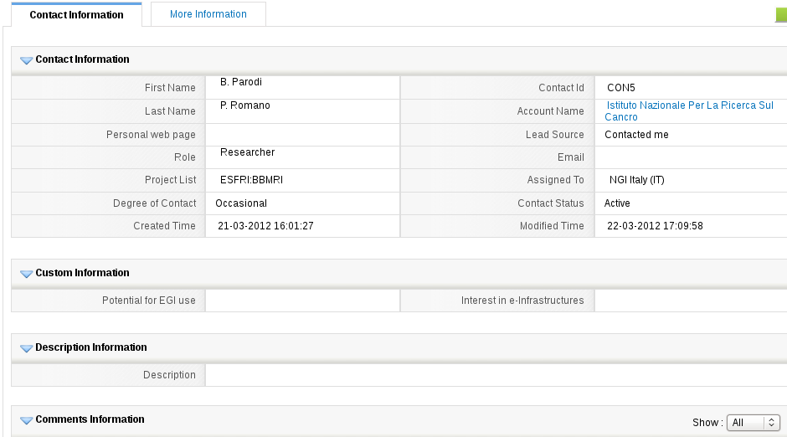
Example 3: Recording key points of an interview
His institute
His project
Key findings
What services does the project/institute need from EGI? Are these EGI services already available, or should they be developed? Is there a need to involve other NGIs into the support process (e.g. to develop and/or to provide the demanded services) If yes, then clarify the type of involvement.
What does the project/institute try to achieve? How could EGI contribute to achieving this goal? What benefit would this bring to the project/institute?

Slide 10
Conclusions
VTs delivered what promised
Processes to capture and analyse information about potential users of EGI – about projects, institutes, communities, persons
ESFRI contacts from a number of countries: Czech Republic, Hungary, Italy, Spain, Switzerland, UK
It’s time to populate the CRM with leads and with key findings we learn from them
It needs involvement from all NGIs!

Slide 11
Questions?
gergely.sipos@egi.eu

