Slide 1
Storage Services
StratusLab Tutorial

Slide 2
Storage Services
Persistent (Read-Write) Disks
Allows the storage of service state or user data
Mounted as a disk on VMs
Disks are persistent and have a lifecycle independent of a single VM
Can be mounted by single VM at any time
Only available within a single cloud instance
Static (Read-Only) Disks
Useful for distribution of quasi-static databases
Handled and shared like VM images via Marketplace
Volatile (Read-Write) Disks
Useful for temporary (!) data storage
Data will disappear when VM instance is destroyed

Slide 3
Other Storage Types
File-based Storage
Normal client tools can be installed in VMs
Access services normally from VM (e.g. tools for SRM)
Unlikely to be implemented by StratusLab, although will provide CDMI interface to persistent storage service
Object Storage
Simple object storage, usually minimal hierarchy and chunked data
Won’t implement this in StratusLab, could take implementations from elsewhere, e.g. OpenStack
Key-value Pair Database
Exposes simple API for “database” of key-value pairs (e.g. Cassandra)
Can deploy VM with persistent disk to provide this service

Slide 4
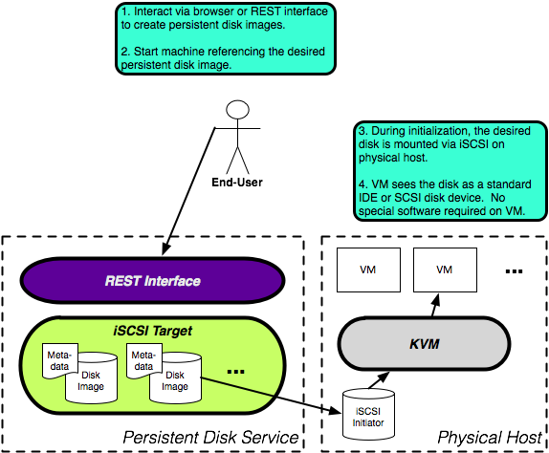
Persistent Storage Architecture

Slide 5
Using a Persistent Disk
Workflow
Create a disk with a given size via CLI/Web Portal.
Launch a machine instance referencing that image.
Partition (fdisk) and format (mkfs) the disk via the running VM
Store data to the disk as usual
Dismount the disk or halt the machine instance
Disk with persistent data is available for use by another VM

Slide 6
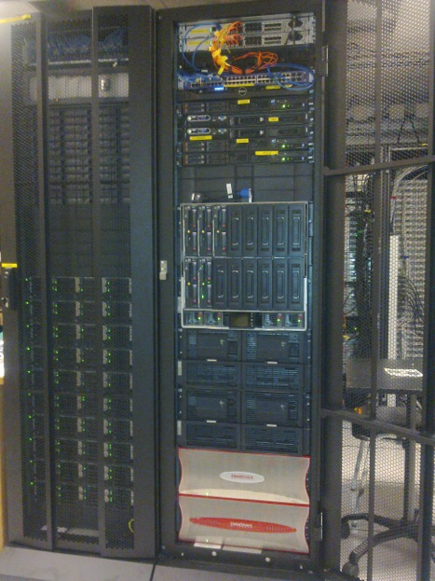
Using a Persistent Disk
Client Configuration
Must provide persistent disk service endpoint
Use pdisk.lal.stratuslab.eu

Slide 7
Create persistent disk: CLI
Create a persistent disk with the following properties:
size = 2GiB
tag = myprivate-disk
Run stratus-create-volume command to create your persistent disk.
Your persistent disk had been created with the UUID: dc90bd49-98fa-43a8-a5a2-e6e8e803fbf0
$ stratus-create-volume --size=2 --tag=myprivate-disk
DISK dc90bd49-98fa-43a8-a5a2-e6e8e803fbf0
NB:
By default all the persistent disks are private: could be read, written and deleted
only by their owner.
If you want other users have access (read and write only) to your persistent disks,
set it to be public.
To create public persistent disk, pass --public argument to stratus-create-volume.

Slide 8
List Persistent Disks: CLI
Stratus-describe-volumes allow you to:
List of all your public and private persistent disks,
List of all users public persistent disks
Run stratus-describe-volumes command:
$ stratus-describe-volumes
:: DISK dc90bd49-98fa-43a8-a5a2-e6e8e803fbf0
users: 0
created: 2012/03/15 14:53:50
isreadonly: false
visibility: private
iscow: false
tag: myprivate-disk
owner: egi_cf
size: 2

Slide 9
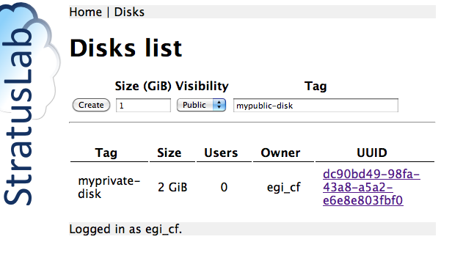
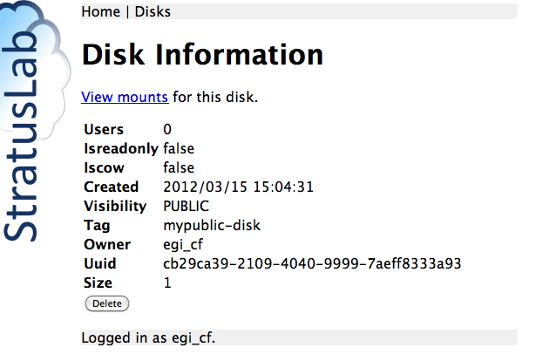
Create persistent disk : Web Portal
Create a public persistent disk with the following properties:
size = 1GiB
tag = mypublic-disk
Run stratus-create-volume command to create your persistent disk.
Log into https://pdisk.lal.stratuslab.eu:8445 with your StratusLab username and password

Slide 10
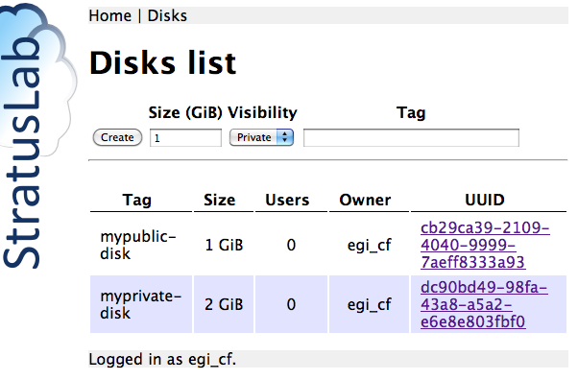
List Persistent Disks: Web Portal
Disks menu:

Slide 11
VM Instance with Persistent Disk
Use a ttylinux image Identifier from the Marketplace:
export TTYLINUX_ID=BzrqtDb2pYxA5_jha4IXG4WLyD3
Deploy your virtual machine:
stratus-run-instance --persistent-disk=dc90bd49-98fa-43a8-a5a2-e6e8e803fbf0 ${TTYLINUX_ID}
Response should give the VM ID and Public IP:
:::::::::::::::::::::::::
:: Starting machine(s) ::
:::::::::::::::::::::::::
:: Starting 1 machine
:: Machine 1 (vm ID: 18)
Public ip: 134.158.75.44
:: Done!

Slide 12
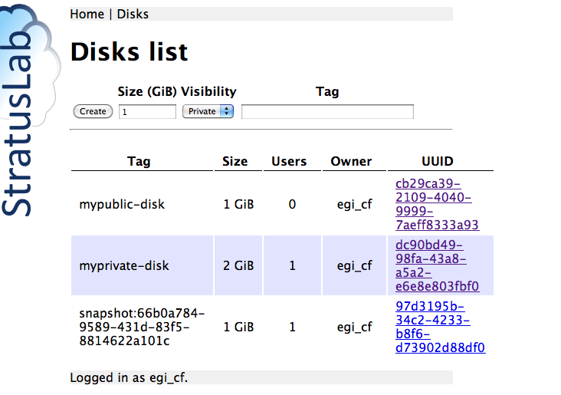
Mount Information on the Web Portal

Slide 13
Format the disk via the running VM
Partition (fdisk)? and format (mkfs) it via the running VM
In your VM, the persistent disk will be referenced as /dev/hdc or /dev/sdc. In ttylinux10.0, it will be /dev/hdc.
Format your disk
$ ssh root@134.158.75.44
# fdisk –l
…
Disk /dev/hdc: 2147 MB, 2147483648 bytes
255 heads, 63 sectors/track, 261 cylinders
Units = cylinders of 16065 * 512 = 8225280 bytes
…
# mkfs.ext3 /dev/hdc

Slide 14
Mount & store data into your disk
Mount your disk, store data into, and dismount it
# mkdir /mnt/test
# mount /dev/hdc /mnt/test
# echo "Testing Persistent Disk" > /mnt/test/test_pdisk
# umount /mnt/test

Slide 15
Deploying a Virtual Machine with persistent disk
Now deploy another virtual machine with the same persistent disk:
stratus-run-instance --persistent-disk=dc90bd49-98fa-43a8-a5a2-e6e8e803fbf0 ${TTYLINUX_ID}
Response should be:
[ERROR] Only 0/1 disk(s) can be attached. Aborting
Disk can only be attached to 1 Virtual Machine!

Slide 16
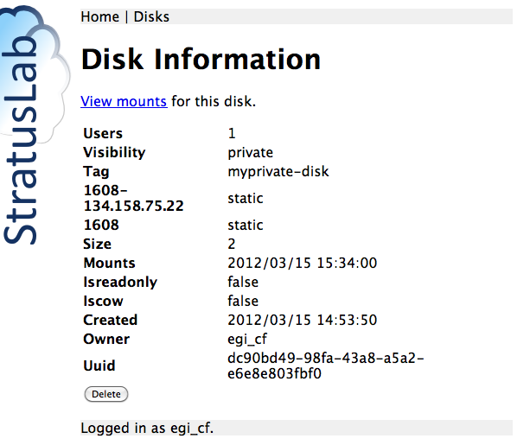
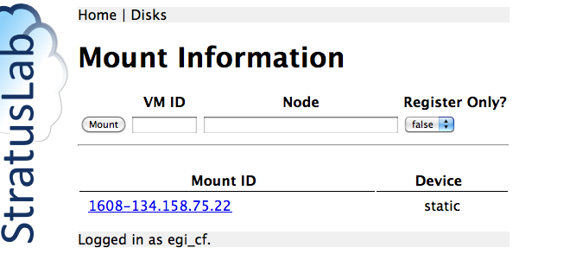
Unmount your disk via the Web Portal
Now deploy another virtual machine with the same persistent disk:
stratus-run-instance --persistent-disk=dc90bd49-98fa-43a8-a5a2-e6e8e803fbf0 ${TTYLINUX_ID}

Slide 17
Verify disk contents via the running VM
Log into your VM using ssh, verify existence of your persistent disk
$ ssh root@134.158.75.45
# fdisk –l
…
Disk /dev/hdc: 2147 MB, 2147483648 bytes
255 heads, 63 sectors/track, 261 cylinders
Units = cylinders of 16065 * 512 = 8225280 bytes
…
Mount your persistent disk, verify its content
#mkdir /mnt/test
# mount /dev/hdc /mnt/test
# ls /mnt/test
lost+found test_pdisk
# cat /mnt/test/test_pdisk
Testing Persistent Disk

Slide 18
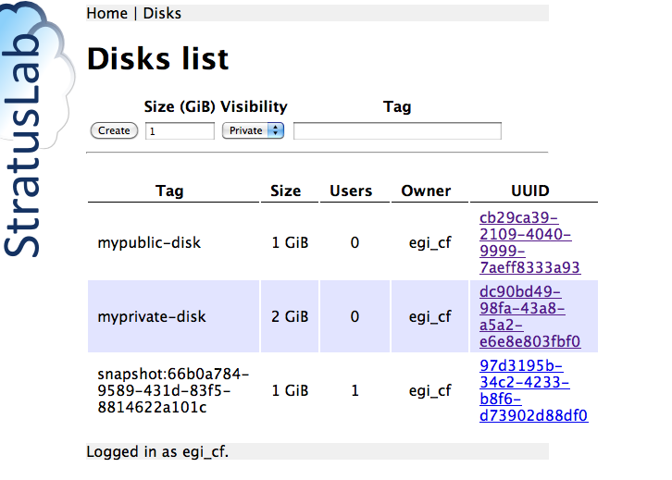
Kill you Virtual Machine
On the Web Portal: myprivate-disk nb. of users =0
$ stratus-kill-instance 19

Slide 19
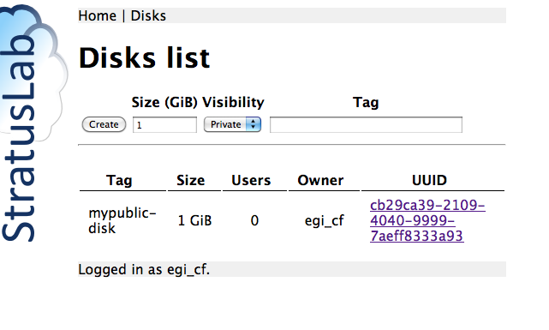
Persistent disk deletion
To delete your persistent disk: stratus-delete-volume <Disk UUID>
$ stratus-delete-volume dc90bd49-98fa-43a8-a5a2-e6e8e803fbf0
DELETED dc90bd49-98fa-43a8-a5a2-e6e8e803fbf0
List the existing persistent disks
$ stratus-describe-volumes
:: DISK cb29ca39-2109-4040-9999-7aeff8333a93
users: 0
created: 2012/03/15 15:04:31
isreadonly: false
visibility: PUBLIC
iscow: false
tag: mypublic-disk
owner: egi_cf
size: 1

Slide 20
Hot-plug Persistent Disks
To use the hot-plug feature, the running instance needed to have acpiphp kernel module loaded.
ttylinux doesn’t have this feature, you have to use base image like Ubuntu, CentOS, OpenSUSE or Fedora.
In this part of tutorial, we will be using CentOS-6.2 (DfXlr9qthtM6BKrPzeqyxqTvamx from http://marketplace.stratuslab.eu)
Persistent disks could be attached/detached using CLI or from the Web Portal
To attach one or more volumes to a running machine using CLI:
To detach one or more volumes from a running machine using CLI:
$ stratus-attach-volume –i <VM ID> <disk1 UUID> <disk2 UUID> …<diskn UUID>
$ stratus-detach-volume –i <VM ID> <disk1 UUID> <disk2 UUID> …<diskn UUID>

Slide 21
Deploying CentOS Virtual Machine
Use a CentOS image:
export CENTOS_ID=DfXlr9qthtM6BKrPzeqyxqTvamx
Deploy your virtual machine:
stratus-run-instance $CENTOS_ID
Response should give the VM ID and Public IP:
:::::::::::::::::::::::::
:: Starting machine(s) ::
:::::::::::::::::::::::::
:: Starting 1 machine
:: Machine 1 (vm ID: 19)
Public ip: 134.158.75.45
:: Done!

Slide 22
Hot-plug Persistent Disks
NB. Module acpiphp is loaded by default in CentOS-6.2 kernel.
To attach one or more volumes to a running machine using CLI:
To detach one or more volumes from a running machine using CLI:
$ stratus-attach-volume –i <VM ID> <disk1 UUID> <disk2 UUID> …<diskn UUID>
$ stratus-detach-volume –i <VM ID> <disk1 UUID> <disk2 UUID> …<diskn UUID>

Slide 23
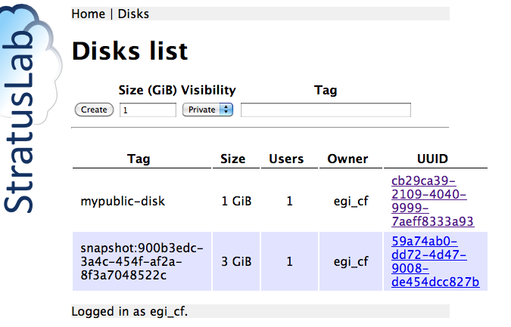
Hot-plug Persistent Disks
Attach mypublic-disk to your VM using CLI:
$ stratus-attach-volume -i 19 cb29ca39-2109-4040-9999-7aeff8333a93
ATTACHED cb29ca39-2109-4040-9999-7aeff8333a93 in VM 19 on /dev/vda

Slide 24
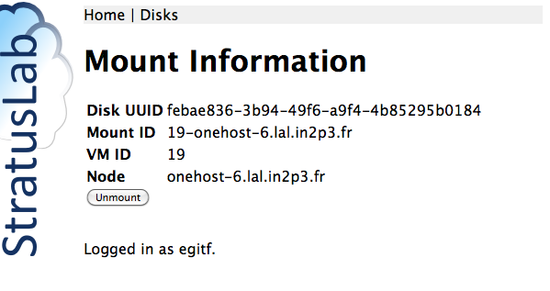
Hot-plug Persistent Disks

Slide 25
Verify disk availability via the running VM
Log into your VM, verify existence of your persistent disk
$ stratus-connect-instance 19
# fdisk –l
…
Disk /dev/vda: 1073 MB, 1073741824 bytes
16 heads, 63 sectors/track, 2080 cylinders
Units = cylinders of 1008 * 512 = 516096 bytes
Sector size (logical/physical): 512 bytes / 512 bytes
I/O size (minimum/optimal): 512 bytes / 512 bytes
Disk identifier: 0x00000000
…

Slide 26
Hot-plug Persistent Disks
Detach mypublic-disk from your VM using CLI
$ stratus-detach-volume -i 19 cb29ca39-2109-4040-9999-7aeff8333a93
DETACHED cb29ca39-2109-4040-9999-7aeff8333a93 from VM 19 on /dev/vda

Slide 27
Questions and Discussion

Slide 28
Exercises: Storage
Volatile Disks
Create VM with volatile disk.
Verify that disk space is present and usable.
Persistent Disk Lifecycle
Run through entire lifecycle without using a VM
Do this both via the command line interface and via the browser
Persistent Disks on VMs
Use persistent disk when starting a machine
Verify that disk can be remounted on another machine
Verify that data on disk is preserved
Verify that disk can be mounted/unmounted from running VM (warning: use Ubuntu11, Fedora16, openSUSE12 or CentOS6 to be sure acpiphp loaded)

