Slide 1
Common Framework for Extracting Information and Metrics from Multiple Change Trackers
Eamonn Kenny, TCD
Munich, 2012-03-29

Slide 2
EMI Quality Assurance Activities
Quality Assurance Policies
definition and monitoring
Metrics and KPIs
definition and collection
Quality Control
verification and reporting
Build/Test Tools and Repositories
selection, maintenance and integration
Certification and Integration Testbeds
setup, maintenance and deployment

Slide 3
Trackers → Format → Metrics
Savannah
Metrics
RT

Slide 4
Why Produce a Common Format?
Many data sources → many formats
e.g: UNICORE: 2 defect trackers, 2 request trackers, 1 enhancement and 1 regression test tracker (6-in-1)
Data obtained from multiple organisations must have the same meaning everywhere otherwise metrics are meaningless.
Helps the EMI project gather only the important information and leaves organisations the freedom to produce other internally useful information.

Slide 5
Request for Change (RfC) lifecycle
Open
Accept?
NO
Rejected
YES
Accepted
NO
Fixed
Test?
YES
Successful?
NO
YES
Not Tested
Tested
Closed

Slide 6
Validated Common Format (Yr 1)
Quality Assurance
Automated Validation
Tabulated Formats
Bug/Feature Trackers
Common formats
dashboard
Common Format
Common Format
Common Format
Common Format
Common Format
Common Format
Other formats
Dump/Export of RfC Tracker
Exported files in Common Format
Metric Calculation & Visualisation
Manual Validation
Automated Validation
Per Product Calculations
Trend Graphs

Slide 7
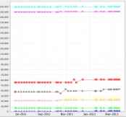
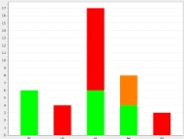
Implemented Framework
Validation
QA
Metrics
Policy
Tabulated Formats
Dashboard
CSV
/XSL
Report Generator (Java)
Manual Validation
Tracker to
Product
Mappings
Quality
Control
Release
Manager

Slide 8
Dashboard for Validation/Reports

Slide 9
Add the Static Analysers & Testing
Bug/Feature Trackers
Tabulated Formats
Quality Assurance
Common formats
Automated Validation
Common Format
Common Format
dashboard
Common Format
Common Format
Common Format
Common Format
Bug/Feature Trackers
Dump/Export of RfC Tracker
Common formats
Exported files in Common Format
Tabulated Formats
Other formats
Common Format
Common Format
Common Format
Common Format
dashboard
Multiple Builds
Common Format
Common Format
Dump/Export of RfC Tracker
Exported files in Common Format
Metric Calculation & Visualisation
Verification & Tests
Common Format
Other formats
Common Format
Per Product Calculations
Releases Dashboard
Common Format
Dated
Builds Results with Static Analysers
Trend Graphs
Product information
Metric Calculation & Visualisation
Manual Validation
Automated Validation
Outputs
Per Product Calculations
Trend Graphs
XY Bar/Stacked Charts Stacked, Trend Graphs, Distributions

Slide 10
Framework Actors
Bug/Feature Trackers
Common formats
Tabulated Formats
Common Format
Common Format
dashboard
Common Format
Common Format
Product Teams
QA Metrics
Common Format
Common Format
QA Metrics
Dump/Export of RfC Tracker
Exported files in Common Format
Other formats
Multiple Builds
Metric Calculation & Visualisation
Verification & Tests
Common Format
Product Teams
QA Tools
Common Format
Per Product Calculations
Releases Dashboard
Common Format
QA Metrics & Tools
Dated
Builds Results with Static Analysers
Trend Graphs
Product information
QA Policy & Testing
+ SA1 Release Manager
Outputs
XY Bar/Stacked Charts Stacked, Trend Graphs, Distributions
Release Manager,
QA, QC

Slide 11
Using the Chart Generator
Java Implementation
Chart
Generator
Chart
Configuration
Chart Framework
Data Provider
EMI Mapping
Plot
Provider
4
Edit Configuration
Details: XY titles,
Title, special settings
Plot type, etc.
Existing Metric Description
Existing Abstract Plotting Class
2
Clone existing metric
New
Metric Description
New Abstract Plotting Class
1
Add schema changes
3
Clone existing
Plotting method
XML Schema
XML Schema
Modified XML Schema
XML Schema
JAXB Stubs

Slide 12
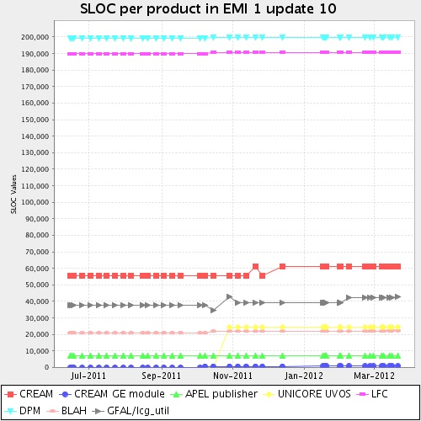
Sample Results

Slide 13
Current/Future Work
More time series data to produce trend data for analysis by QC
Ongoing maintenance/improvement of the XML, XSD and Chart generator
Possible introduction of more defect/feature trackers.

Slide 14
Questions?

