Slide 1
“From IPv4 to eternity” The High Energy Physics transition to IPv6
David Kelsey
EGI Community Forum, Munich 30 March 2012

Slide 2
On behalf of my co-authors
Bob Cowles (SLAC), Phil DeMar (FNAL), Marek Elias (FZU), Thomas Finnern (DESY), David Foster (CERN), Bruno Hoeft (KIT), Tomas Kouba (FZU), Soumaya Lanouar (EPFL), Simon Leinen (SWITCH), Edoardo Martelli (CERN), Mark Mitchell (Univ Glasgow), Kars Ohrenberg (DESY), Andreas Pfeiffer (CERN), Francesco Prelz (INFN), Mario Reale (GARR), Julia Rohlfing (KIT), Sandor Rozsa (Caltech), Sabah Salih (Univ Manchester), Luuk Uljee (SARA), Ronald van der Pol (SARA), Ramiro Voicu (Caltech), Mattias Wadenstein (Univ Umea), Tony Wildish (Princeton University)
Many thanks to them!

Slide 3
Outline
Background – why move to IPv6?
The HEPiX IPv6 Working Group
n.b. HEPiX is a forum of worldwide HEP IT staff
HEPiX IPv6 testbed and testing
WLCG software and tools IPv6 survey
Managing large sites – addressing etc.
IPv6 security
Recommendations and future plans

Slide 4
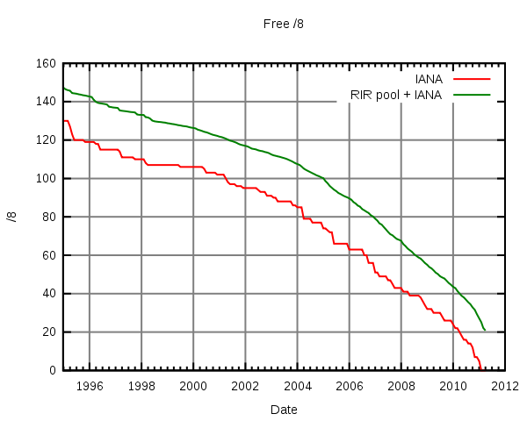
IPv4 Free Addresses (/8 blocks)
http://en.wikipedia.org/wiki/File:Ipv4-exhaust.svg

Slide 5
IPv4 Addresses
From Geoff Huston (http://ipv4.potaroo.net)
IANA Unallocated Address Pool (Global) Exhaustion happened: 03-Feb-2011
Projected Regional (RIR) Address Pool Exhaustion Dates:
APNIC: 19-Apr-2011 (Asia Pacific - happened)
RIPENCC: 11-Aug-2012 (Europe)
ARIN: 27-Jul-2013 (North America)
LACNIC: 28-Jan-2014 (South America)
AFRINIC: 29-Oct-2014 (Africa)

Slide 6
IPv6 more generally
IPv6 World Day (8 Jun 2011)
Many major players successfully turned on and tested IPv6 for 24 hours
Including Google, Facebook, Yahoo! ...
But then turned it off again!
In the future...
US Federal Government requires all their outward facing public services to be running IPv6 by 30 Sep 2012 (and clients by Sep 2014)

Slide 7
World IPv6 Launch Day
http://www.worldipv6launch.org/
6 June 2012 “The Future is Forever”
ISPs, home routing equipment vendors, web companies all coming together
Permanently enable IPv6 by 6th June 2012

Slide 8
When to move to IPv6?
IPv6 *is* coming
HEP, WLCG, EGI will need to move “soon”
Is HEP/WLCG ready?
What does “ready” mean?
When will HEP be ready?

Slide 9
HEPiX IPv6 Working Group
Created in April 2011 with aims:
Consider whether/how IPv6 should be deployed in HEP
especially WLCG (Worldwide Large Hadron Collider Grid)
Readiness and Gap analysis
HEP applications, middleware, security issues, system management and monitoring tools, end to end network monitoring tools
Run a distributed HEP testbed
to help explore all the above issues
Initial report at end of 2011

Slide 10
WG membership
Currently active:
CERN, DESY, EPFL, FNAL, FZU, GARR, Glasgow, INFN, KIT, Manchester, RAL, SARA, SLAC, SWITCH, Umea, USLHCNet (Caltech)
CMS & LHCb (ATLAS & ALICE to come)
Nearly 50 on the mail list

Slide 11
IPv6 and WLCG
We currently do not know when WLCG will need to deploy IPv6-capable services
No current requests or warnings
BUT to get there takes time!
Full survey of all software and tools
Need operational monitoring, security and tools
IPv6 operation, security and performance must be as good as IPv4
Physicists must not notice!

Slide 12
Limiting the scope
The working group decided to concentrate on outward-facing WLCG services
Some backend services, e.g. Databases, could stay IPv4 only
But need to include middleware, tools etc.
Wherever possible, work with others (EGI)

Slide 13
The HEPiX IPv6 Testbed
We have deployed a distributed testbed
CERN, DESY, FZU, GARR, INFN, KIT and USLHCnet
Connected to IPv6 and IPv4 networks
IPv6-only/IPv4-only names also registered in DNS
e.g. hepix-v6.desy.de & hepix-v4.desy.de
https://w3.hepix.org/ipv6-bis/doku.php?id=ipv6:testbed
A perl script (on wiki) validates configuration
Checks all DNS entries
runs ping and ping6 to all nodes

Slide 14
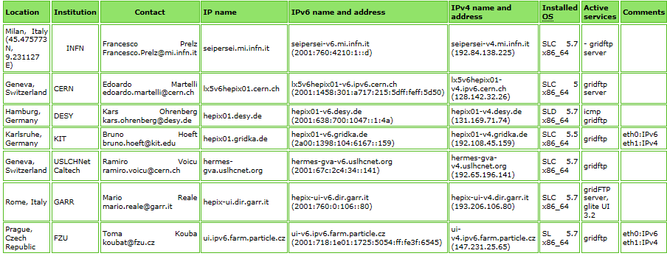
Testbed (2)

Slide 15
Data transfer tests
Virtual Organisation – ipv6.hepix.org
We have successfully installed and tested GridFTP clients and servers on all nodes
Full mesh of data transfers (globus_url_copy)
Tested and works
CMS members of the working group
Now performing continuous data transfers between pairs of nodes
In future this will use PhEDEx and FTS

Slide 16
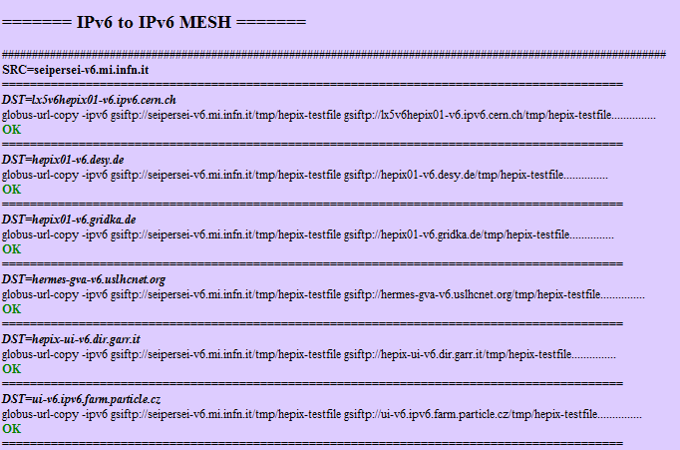
GridFTP mesh (extract)

Slide 17
CMS data transfer IPv6 reliability
Reliability test – not a stress/performance test
Single 200 MB file from IPv6 VM at CERN transfer to 2 systems
globus_url_copy and uberftp to confirm copy then delete
In 1 week: uslhc: 8373 transfers, infn: 8355 (1 error each)
BGP timers too short caused packet loss in firewall
Since then (3 weeks) transferring 2 GB files
uslhcnet: 8844, infn:8853, DESY:2207 transfers
Transfer failures: uslhcnet:106, infn:107, DESY:52
Vast majority since change in CERN IPv6 firewall hardware
Transfer speed less to DESY
still investigating both observations
Conclude: no show-stoppers. CMS PhEDEx should work.

Slide 18
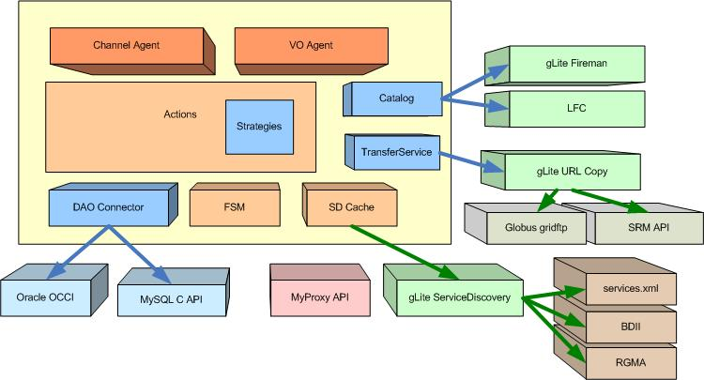
File Transfer Agent (FTS)
Thanks to EGEE JRA1

Slide 19
File Transfer Service (FTS) – to enable IPv6
Use gLite 3.2 repository
cGSI-GSOAP does not resolve IPv6 names up to version 2.7-1.3.3-1
still found on some production UIs
gSOAP supports IPv6
on TCP since version 2.5 (2005)
on UDP since version 2.7.2 (still 2005)
BUT compiled without the “WITH_IPv6” flag

Slide 20
FTS and IPv6 (2)
Oracle IPv6-enabled from version 11g rel 2
but FTS transfer agent libraries in EMI-1 still carry a hard dependency on Oracle V10
Transfer agents (Tomcat/Axis servlets) can be invoked on dual stack hosts and from dual stack clients
but ‘urlcopy’ agent still uses IPv4 for file transfer
As in the globus-url-copy command, IPv6 resolution in the Globus FTP client needs to be explicitly enabled

Slide 21
FTS and IPv6 - conclusions
FTS/IPv4 not broken on dual-stack host
Functional IPv6 support in a software component does not imply that IPv6 transport is enabled by default
This is hard to capture in either a survey or by automated code-checking tools
Next steps: CMS data transfers using FTS

Slide 22
Software & Tools IPv6 Survey
An “Asset” survey is now underway
A spreadsheet to be completed by sites and the LHC experiments
Includes all applications, middleware and tools
Tickets to be entered for all problems found
If IPv6-readiness is known, can be recorded
Otherwise we will need to investigate further
Ask developer and/or supplier
Scan source code or look for network calls while running
Test the running application under dual stack conditions

Slide 23
Software with IPv6 problems
Need to check many things
Break when installed on a dual-stack node?
Does it bind to both stacks?
Is IPv6 preferred?
Can it be configured to prefer V4 or V6?
Already found a few problems
OpenAFS, dCache, UberFTP
FTS, globus_url_copy etc.

Slide 24
Managing IPv6 at large sites
Best practices are still far from clear!
Large sites (e.g. CERN and DESY) wish to manage the allocation of addresses
Do not like autoconfiguration (SLAAC)
Wish to filter out Router Advertisements
DHCPv6 very attractive
BUT IETF still discussing
Will the ‘route’ options be there or not?

Slide 25
IPv6 security
Are operational security teams ready for IPv6? No!
Challenges include
Address format has multiple forms, many addresses per host and addresses difficult to remember
IPv6 standards contain many suggestions - implementation optional
Required security features, like RAGuard and SEND, are a long way from full deployment
Incomplete and immature implementations
Many vulnerabilities expected
Log parsing tools must all change
Dual stack causes problems – complicates packet inspection
Must test that things which are not supposed to work do not

Slide 26
Recommendations & future
Should we deploy IPv6? Answer: Yes! When we are ready
Aim to implement Dual Stack on all WLCG services
Avoid complications of tunnels, proxies, gateways etc.
Perform full asset survey (Spring 2012)
Identify show-stoppers & quantify effort and resources required to fix
Expand testbed gradually during 2012
work with EGI and EMI
Considering merging of EGI and HEPiX testbeds later this year?
All WLCG services
Perform more extensive functionality and performance tests
Must consider operational impact
including security and monitoring

Slide 27
Future plans (2)
Review status at end of 2012
Produce implementation plans for 2013
Need to perform tests on the production infrastructure – involve WLCG Tier 1 centres
Plan several HEP IPv6 “Days” (for 2013)
turn on dual stack for 24 hours on production infrastructure and test/observe
Earliest date for production of IPv6-only systems is (currently) Jan 2014

Slide 28
Further info
HEPiX IPv6 wiki
https://w3.hepix.org/ipv6-bis/
Working group meetings
http://indico.cern.ch/categoryDisplay.py?categId=3538

Slide 29
Summary
The HEPiX IPv6 working group has started well
MUCH work still to be done during the next year or two & effort is difficult to find
Further volunteers welcome to join
Please contact me
Very likely that we will not able to support IPv6-only systems in WLCG before 2014
Decision on timetable to be made during 2012

