Slide 1
An short overview of INSTRUCT and its computational requirements
EGI User Community Forum 2012, München
Alexandre M.J.J. Bonvin
Project coordinator
Bijvoet Center for Biomolecular Research
Faculty of Science, Utrecht University
the Netherlands
a.m.j.j.bonvin@uu.nl

Slide 2
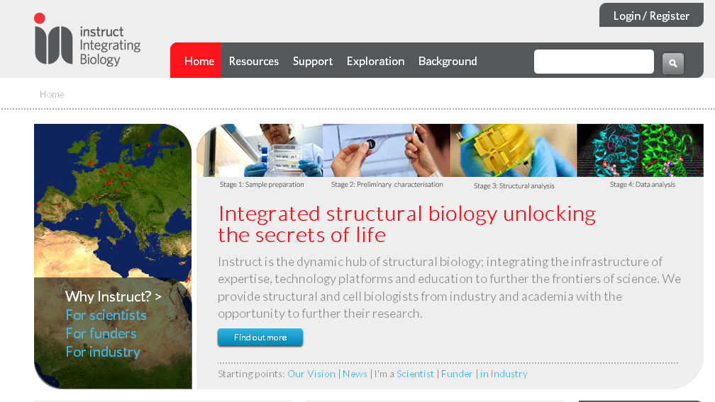
Instruct
One of 6 first-generation biomedical infrastructure projects in Europe (ESFRI)
Provides access to key technologies and support via 15 Centres and 5 National Affiliate Centres
Operational Phase formally launched at Brussels on 23rd February 2012.
http://www.structuralbiology.eu/

Slide 3
Instruct mission
Instruct is the dynamic hub of structural biology; integrating the infrastructure of expertise, technology platforms and education to further the frontiers of science.
http://www.structuralbiology.eu/

Slide 4
History of Instruct and Instruct-NL
ESFRI Roadmap
established
Instruct Centre for MS established in Utrecht and Oxford
Instruct agreement
signed by member
States including NL
Start of Instruct
Preparatory Phase
Start of Instruct
Operational Phase
2006
2008
2010
2011
2012
2008
2011
2011
2012
Instruct-NL Affiliate
Centre approved
founding members:
NWO-CW approves signing of Instruct Agreement for NL
Dutch Roadmap established, with
NeCEN (EM)
Dutch Roadmap updated, with
uNMR-NL (NMR) and Proteins@Work (MS)

Slide 5
Facilities
Community
Technologies
Dutch EU
“Molecular
Life Sciences”
NMR LSF
NMR
“From structure
to function”
Protein
modeling
Instruct-NL
Protein expression
NKI protein
facility
Crystallography
single crystal
facility
Electron
microscopy
Centre for Mass
Spectrometry of
Protein Complexes
(Utrecht / Oxford)
“From atoms
to cells”
Mass
spectrometry
Instruct-NL : www.instruct-nl.eu
Instruct : www.structuralbiology.eu

Slide 6
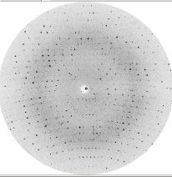
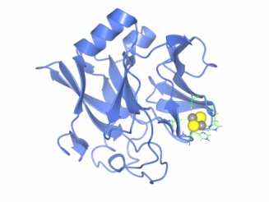
Computational Requirements of Macromolecular Crystallography
Traditional structure solution process:
A few hundred images, each 10s MB.
Quickly reduced to a list of average intensities.
Structure solution on desktop / laptop - combination of programs and manual steps
Deposition in Protein DataBank which provides long-term curation and dissemination
GRID resources not required in this scenario.

Slide 7
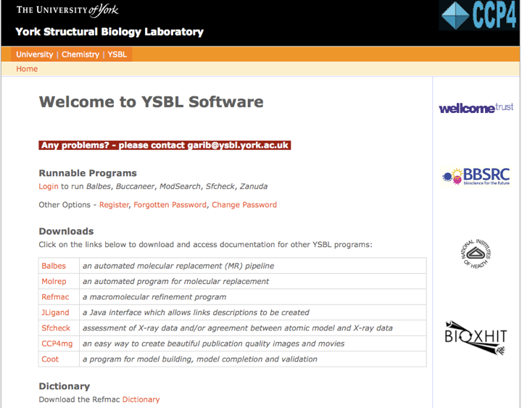
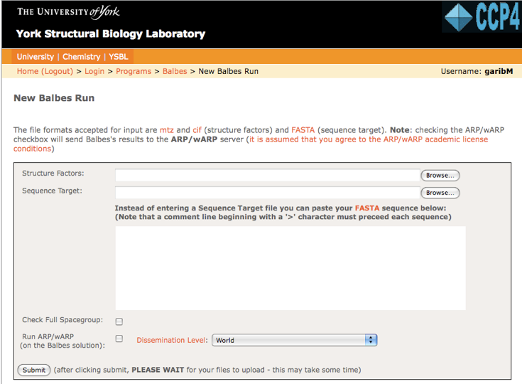
Automated approaches
Advent of automated structure solution, using computationally intensive parameter and protocol sweeps
ARP/wARP web service for automated model building. Based at EMBL-Hamburg.
Balbes web service for structure solution by molecular replacement. Being moved to CCISB at Harwell, backed by 40-node cluster.

Slide 8
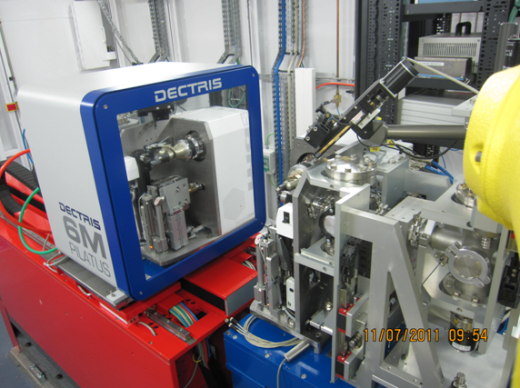
High-throughput data collection
New PILATUS detectors on macromolecular beamlines.
Users now collect 100s of datasets per day.
A beamline can produce TBs data per day.
Challenge is now to process the data very quickly, or store large quantities of data for later processing.

Slide 9
Challenges for Macromolecular Crystallography
Automated approaches require significant CPU time.
Can NGIs help here?
Potentially, but issue of software licensing unresolved.
Most MX software is free to academics, but nevertheless requires a licence.
Post-processing of synchrotron data requires remote access after beamtime is over.
Suggestion of running cloud-like service, where image data and MX software are available.
Resourcing is still an issue, but perhaps NGIs can help?

Slide 10
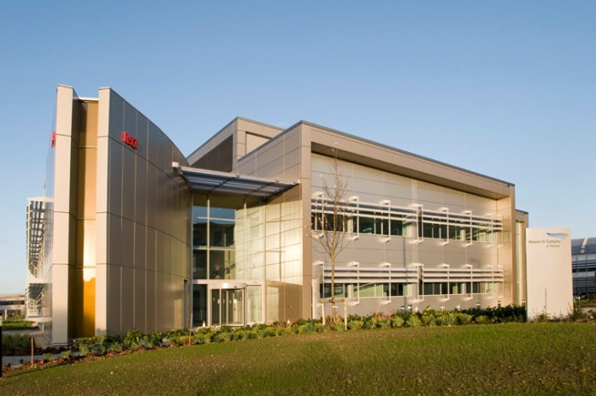
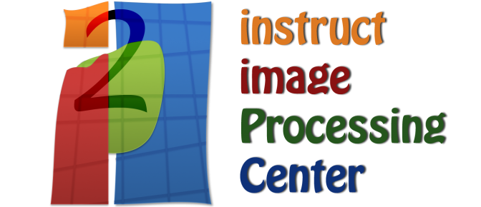
Computational Centre for Integrated Structural Biology (CCISB)
The Instruct Centre focussing on computational techniques
Software packages, web services, data processing at facilities
Formally based at the Research Complex at Harwell (adjacent to Diamond), but composed of geographically distributed groups
Brings together computational groups covering a range of structural biology techniques
Centre for Bioinformatics
University of Tel Aviv
CNB - Madrid

Slide 11
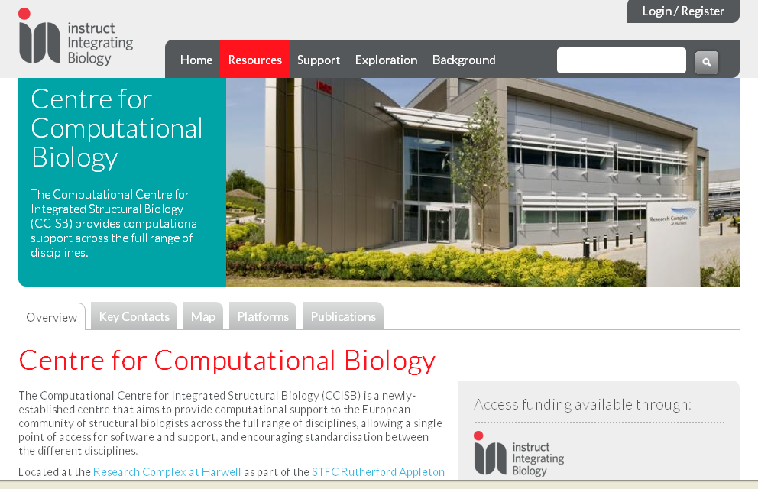
CCISB - what is offered through Instruct?
Instruct provides access to centres of expertise. Typically access to a facility or lab.
Computation somewhat different.
Aims to provide:
a route to a variety of software suites
increasing availability via web services
access to expert help
training
a focus for multi-disciplinary software development

Slide 12
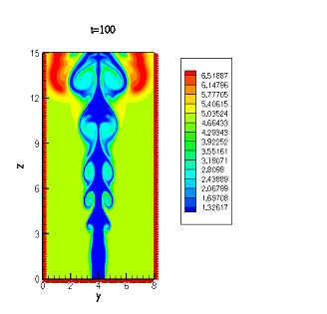
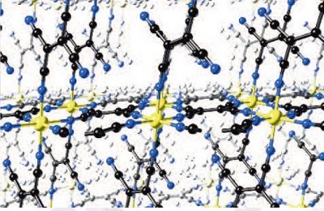
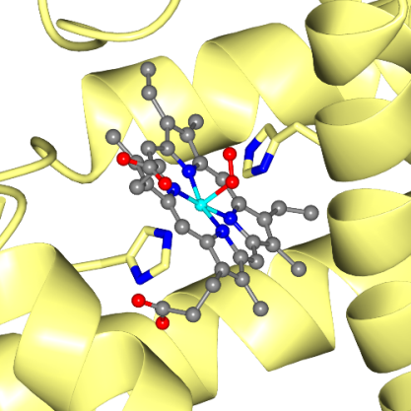
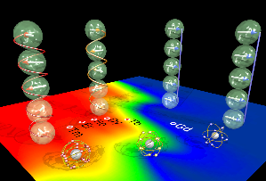
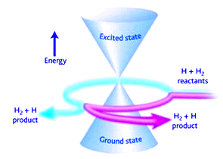
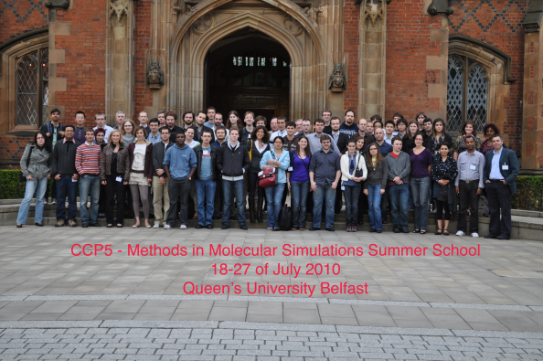
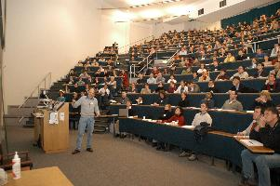
UK Collaborative Computational Projects
Exist to support the computational needs of particular science communities.
Carry out code development projects
Maintain and distribute code libraries
Organise training
Hold meetings and workshops
Mainly physical sciences, but also some biological

Slide 13
New: CCP-EM (cryo-EM)
Increase in cryoEM, evidenced by growth in EMDB entries (currently 1300 and growing fast)
MRC Partnership Grant:
"Towards a Collaborative Computational Project for Electron cryo-Microscopy (CCP-EM) and bridging the gaps between structure determination methods"
Planned for July 2012 - June 2015.
2 developers co-located with CCP4 at RCaH
Workshop and training schools
Requirements: simultaneous processing of a large amount of data (images) –GPU clusters are also being used for that

Slide 14
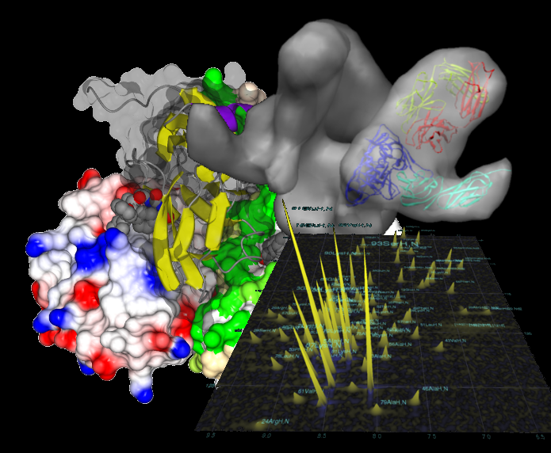
Future plans
BioMedBridges
BioMedBridges is a project to work on data interoperability between the biomedical ESFRI projects, of which Instruct is one.
See Instruct Network for more information:
http://www.structuralbiology.eu/networks/biomedbridges
CECAM Workshop: Integrated Software for integrative structural biology
Hosted by CCISB at Cosener's House (near Oxford) – coorganised by WeNMR
21st-23rd May 2012
http://www.cecam.org/workshop-0-646.html

Slide 15
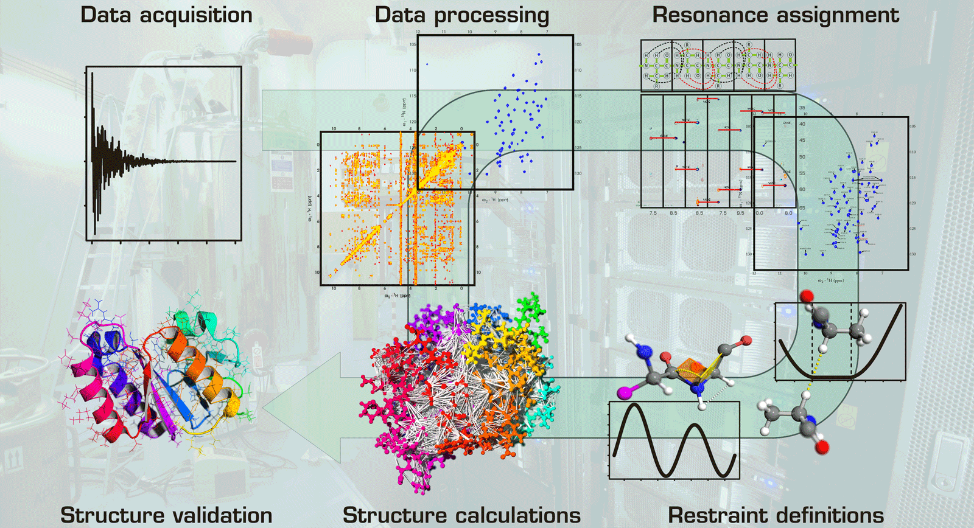
The NMR structure determination workflow
Notes:
15
15

Slide 16
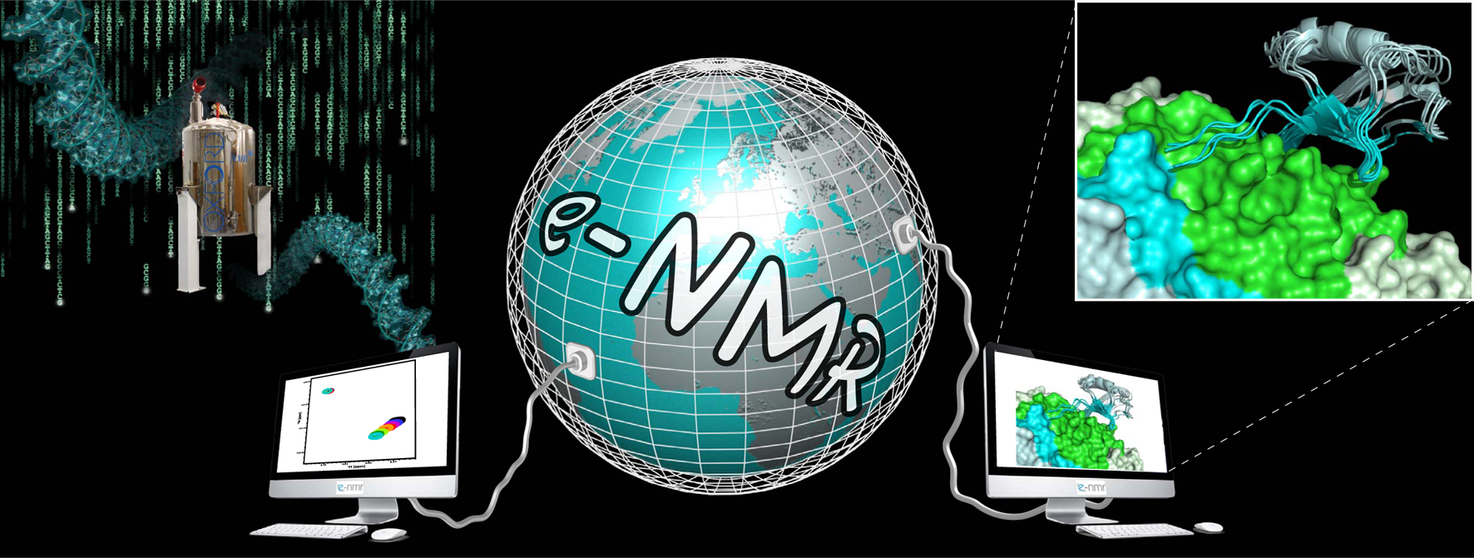
WeNMR platform (February 2012)
Largest VO in the life sciences
400 registered users from 41 nationalities and growing
~ 39 000 CPU cores
> 890 CPU years over the last 12 months
> 1.6 million jobs over the last 12 months
>30% of Life Sciences on the Grid
User-friendly access to Grid via web portals
www.wenmr.eu

Slide 17
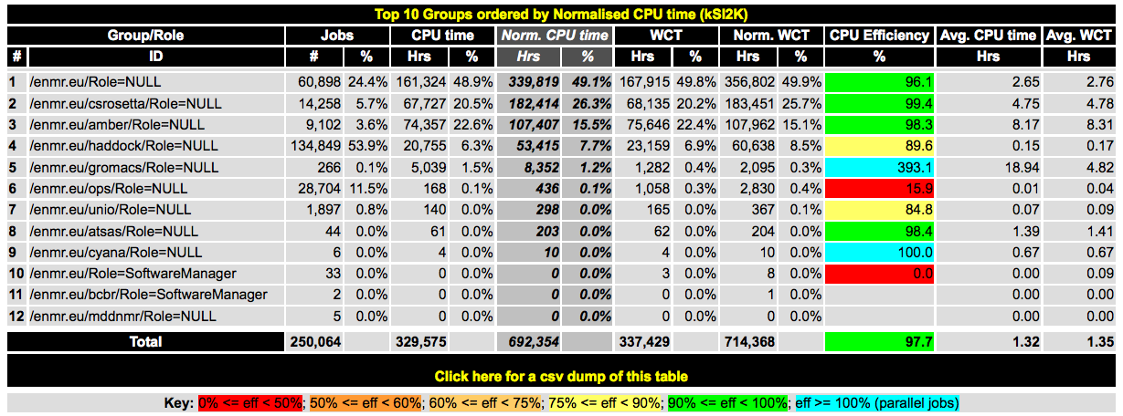
NMR Software characteristics
CPU intensive
Includes parallel jobs (Gromacs portal)
Limited data transfer (except for software deployment)
Usually low I/O
Usually no storage required
Our main requirements:
Lots of CPUs
Queues of various lengths (including short ones)

Slide 18
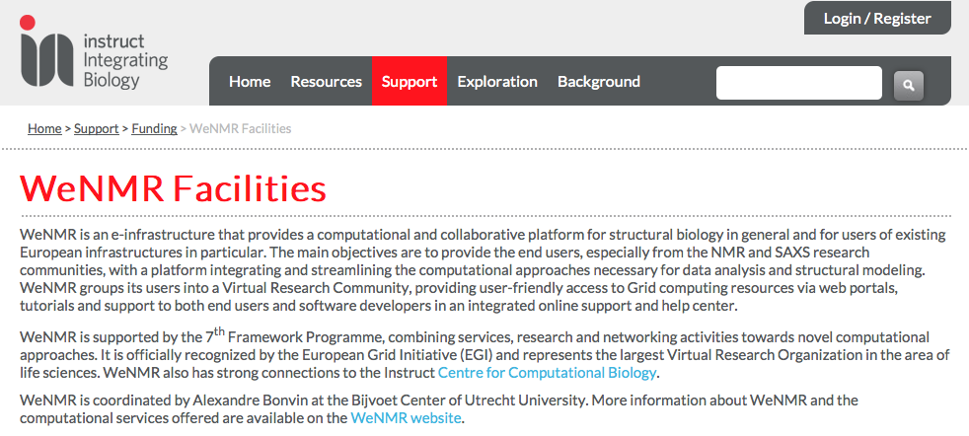
WeNMR & Instruct
http://www.structuralbiology.eu/support/funding/wenmr-facilities
Structural biology community in the life sciences
Linked to ESFRI–INSTRUCT
Linked to FP7 EU infrastructure projects (I3s) (e.g. BioNMR)

