Slide 1
Science Gateways
Nuno L. Ferreira - UCST EGI.eu
nuno.ferreira@egi.eu

Slide 2
Definition
Science gateway is ...
… a community-specific set of tools, applications, and data collections that are integrated together via a web portal or a desktop application, providing access to resources and services from the European Grid Infrastructure.
Definition is aligned with XSEDE.
Do you want to read more?
Users
Developers
http://go.egi.eu/sciencegateways

Slide 3
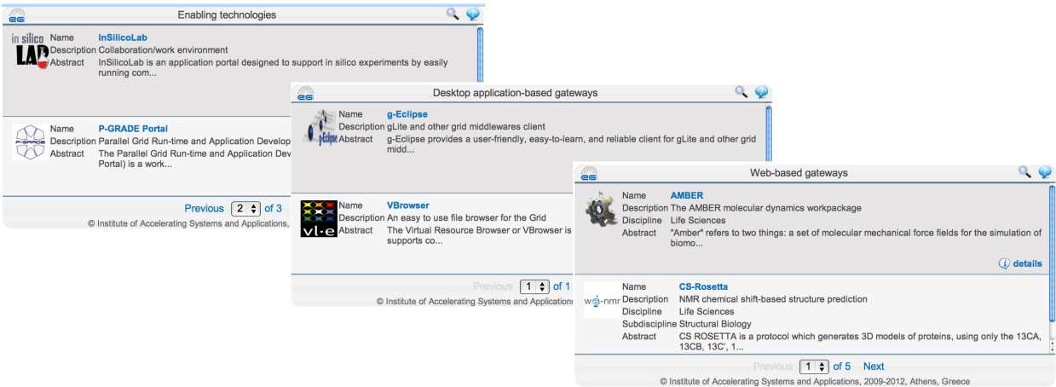
Science Gateways - AppDB
Science Gateways displayed through the AppDB gadget
Next steps:
Register your gateway & enabling technologies in AppDB.
Extend the developers’ section with a “Science gateways primer”
Join through the portal-community@mailman.egi.eu list!

