Slide 1
EGI in 2020: What will it be & how do we get there?
Steven Newhouse
EGI.eu Director

Slide 2
Henry Ford
“If I had asked people what they wanted, they would have said faster horses.”
You will be asked today about the future
Do not get locked into the past or present
Please think beyond horses!

Slide 3
EGEE & EDG “Ecosystem”
EGEE-III
“the Infrastructure”
Sites
Developers
Users
Public Funding Bodies
Policies + Funding
Partners
European Commission
National Research Councils
Strategic Feedback

Slide 4
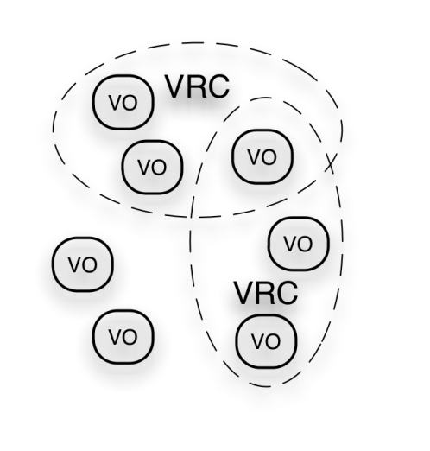
EGI Ecosystem
User Community
Policies + Funding
Requirements + Feedback
Services + Support
EGI-InSPIRE
Service & Resource Providers
Requirements + Feedback
Public Funding Bodies
Policies + Funding
Requirements + Feedback
European Commission
EGI.eu
Technology Providers
Open Source Providers
National Research Councils
Resource Infrastructure Providers
Strategic Feedback
Technology + Support
Commercial Providers
Policies + Funding

Slide 5
The Future

Slide 6
Common Strategic Framework architecture
Europe 2020 priorities
European Research Area
International cooperation
Shared objectives and principles
Tackling Societal Challenges
Health, demographic change and wellbeing
Food security and the bio-based economy
Secure, clean and efficient energy
Smart, green and integrated transport
Supply of raw materials
Resource efficiency and climate action
Inclusive, innovative and secure societies
Creating Industrial Leadership and Competitive Frameworks
Leadership in enabling and industrial technologies
ICT
Nanotech., Materials, Manuf. and Processing
Biotechnology
Space
Access to risk finance
Innovation in SMEs
EC’s
Users
Excellence in the Science Base
Frontier research (ERC)
Future and Emerging Technologies (FET)
Skills and career development (Marie Curie)
Research infrastructures
← E-Infrastructures
Simplified access
Common rules, toolkit of funding schemes
Dissemination & knowledge tranfer

Slide 7
Key Challenges
Sustainability
18K users but 1.8M publicly funded researchers
Do we need to appeal to the 100% or just 1%?
How do we engage with and support the long-tail of researchers?
Technology
The 99% want other services (e.g. not jobs!)
How do we enable these services to be deployed?
What are the core (infrastructure) services to do this and still share resources and data?
Customers or Users?
There are integration costs…. but who pays?
PRACE & XSEDE: application process provides strong ties
EGI & OSG: virtual organisations a barrier to strong ties
Do we need to rethink the autonomous VO model?

Slide 8
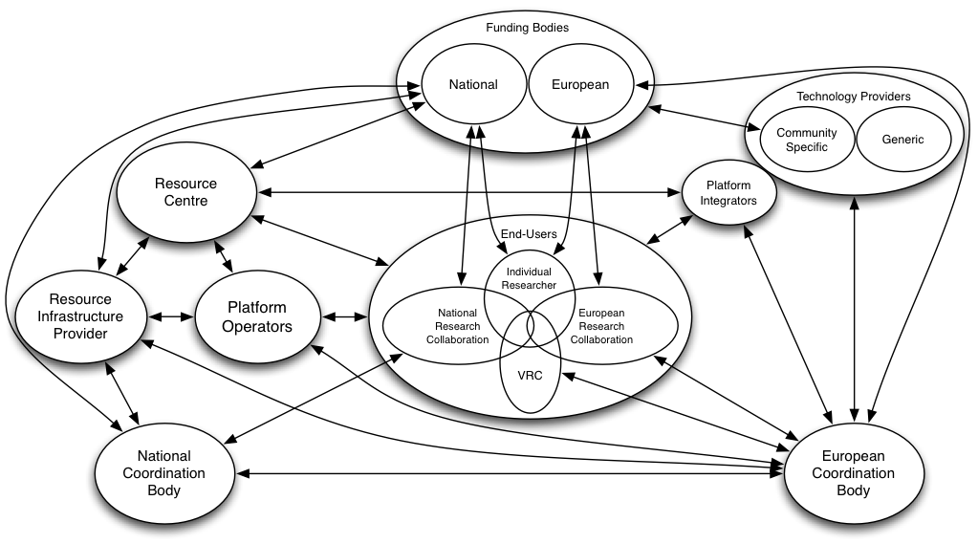
EGI 2.0 Ecosystem
Identify mutual value between components
But also management & control
EMI & IGE
NGIs
EGI.eu

Slide 9
Refactoring for 2020
Collaboration Services:
Accounting
Monitoring
VOMS
Federated ID
Persistent Data ID
…
Community Platforms:
Platform Integrators
Platform Operators
Community Platform 3
Platform Integrators
Ported Applications
Open Source Software
VMI Repository
VMI Marketplace
Community Platform 2
Community
Distributions
(UMD)
“Plat Store
for eScience”
Community Platform 1
IaaS Interface Layer
→ Federated Cloud TF
Federated Resources:
Public and commercial mix
Different countries (35+) and admin domains (350+)

Slide 10
Key Questions
What is in the Infrastructure Platform?
IaaS cloud models based on systems
E.g. OpenNebula, OpenStack
VOMS & ARGUS to federate private clouds
Monitoring, Accounting, …
What is in the Collaboration Platform?
Deployed to enable collaboration between communities
e.g. Persistent Data Identifiers, Federated Identifiers, etc.?
What is in the Community Platforms?
Deployed to meet the needs of each community
Services with development shared across communities

Slide 11
Example of Deployed Services
Deployed by EGI
Maintained & Supported by the community
Deployed by EGI
Maintained & Supported through EGI
USER
User Interface
User Access
RESPECT
External Components
EGEE Maintained Components
User Interface
COMMUNITY SERVICES
Information Services
General Services
Security
Services
Virtual Organisation Membership
Service
Workload
Management Service
Logging &
Book keeping
Service
Hydra
BDII
File Transfer
Service
LHC File
Catalogue
AMGA
Proxy Server
CORE SITE SERVICES
Compute Element
Storage Element
CREAM
LCG-CE
SCAS
Disk Pool Manager
MON
BLAH
Authz. Service
dCache
LCAS & LCMAPS
BDII
gLExec
Worker Node
Physical Resources
Notes:
Yellow – gLite, Green – externally supported components, gLite consortium

Slide 12
Henry Ford
“Any colour - so long as it's black”
Effectively our response for 10 years
How can we provide mass customisation?
Do we want to scale across the whole ERA?
Niche: Research Infrastructures
Long-tail: Need zero (ish) barrier to entry
Do users want choice?
No. They just want to solve their problems!

Slide 13
Timeline
Sustainability Workshop (January)
EGICF (March)
EGI Council & Workshop
EC Review (June)
EGITF (September)
EGI Council & Workshop

