Slide 1

A worldwide e-Infrastructure for NMR and structural biology
EGI Sustainability meeting, Amsterdam, January 26/27 2012
Alexandre M.J.J. Bonvin
Project coordinator
Bijvoet Center for Biomolecular Research
Faculty of Science, Utrecht University
the Netherlands
a.m.j.j.bonvin@uu.nl

Slide 2
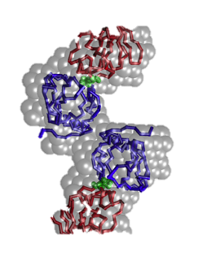
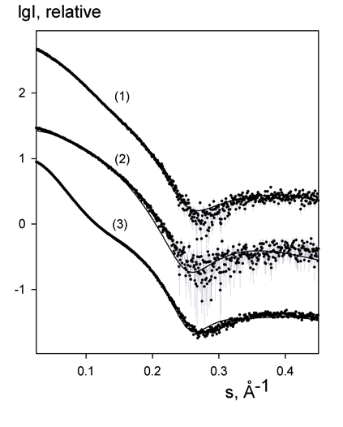

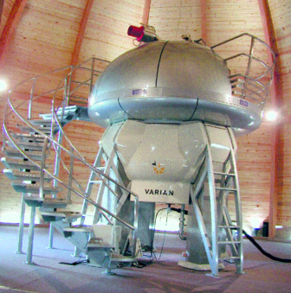

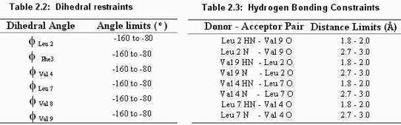
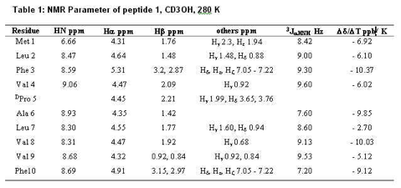



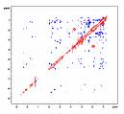
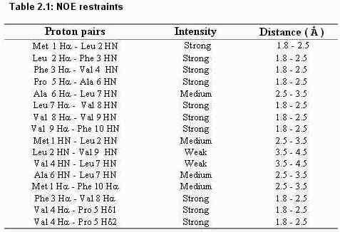
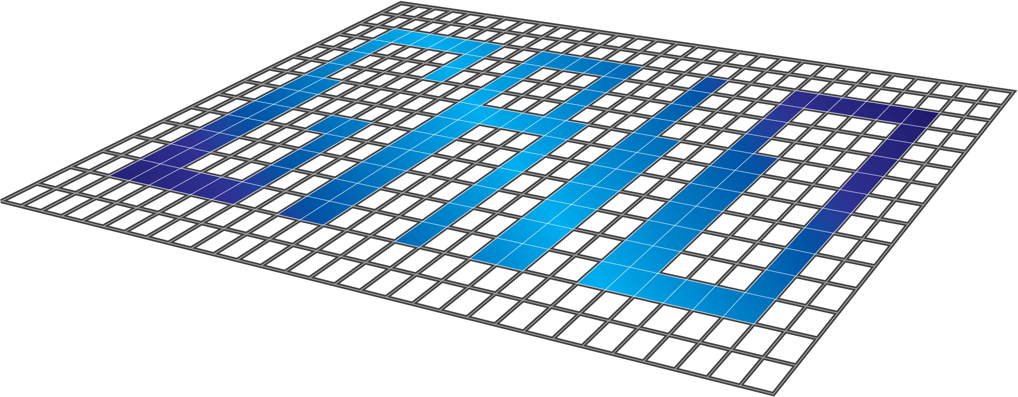
Exploiting GRID resources in structural biology…
NMR data collection and processing SAXS data analysis
# Number of dimensions 2
# INAME 1 1H
# INAME 2 1H
12 2.137 2.387 1 T 0.000e+00 0.00e+00 - 0 2756 2760 0
14 2.387 4.140 1 T 0.000e+00 0.00e+00 - 0 2760 2752 0
32 1.849 4.432 1 T 0.000e+00 0.00e+00 - 0 2259 2257 0
36 1.849 3.143 1 T 0.000e+00 0.00e+00 - 0 2259 2587 0
39 1.760 4.432 1 T 0.000e+00 0.00e+00 - 0 2260 2257 0
40 1.760 1.849 1 T 0.000e+00 0.00e+00 - 0 2260 2259 0
43 1.760 3.143 1 T 0.000e+00 0.00e+00 - 0 2260 2587 0
46 1.649 4.432 1 T 1.035e+05 0.00e+00 r 0 2583 2257 0
47 1.649 1.849 1 T 0.000e+00 0.00e+00 - 0 2583 2259 0
Data
interpretation
assign ( resid 501 and name OO )
( resid 501 and name Z )
( resid 501 and name X )
( resid 501 and name Y )
( resid 2 and name CA ) -0.1400 0.15000
assign ( resid 501 and name OO )
( resid 501 and name Z )
( resid 501 and name X )
( resid 501 and name Y )
( resid 3 and name CA ) -0.0100 0.15000
Computations
Structure, dynamics & interactions
➔ impact on research and health:
  origin of disease
- design of new experiments
- drug design …

Slide 3
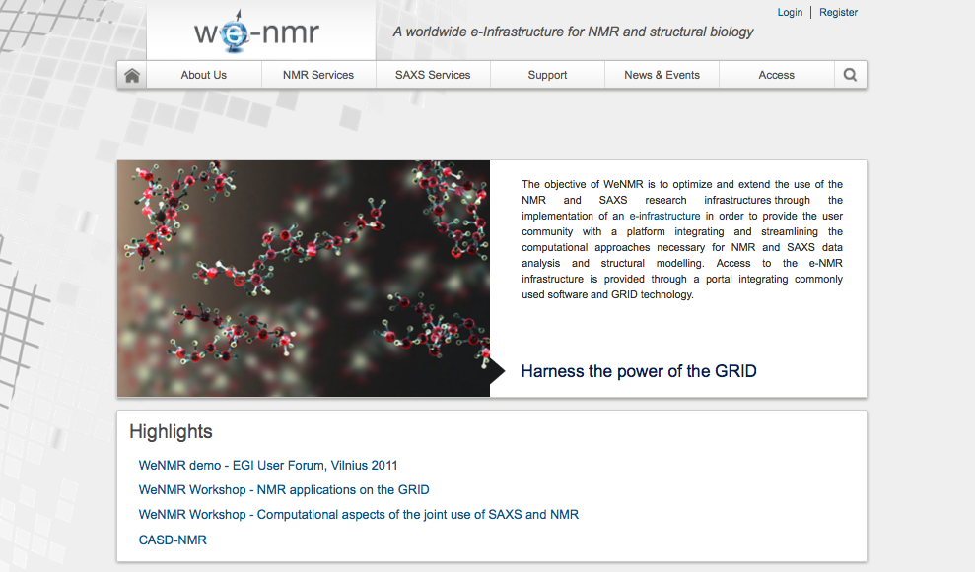
The VRC portal: www.wenmr.eu

Slide 4
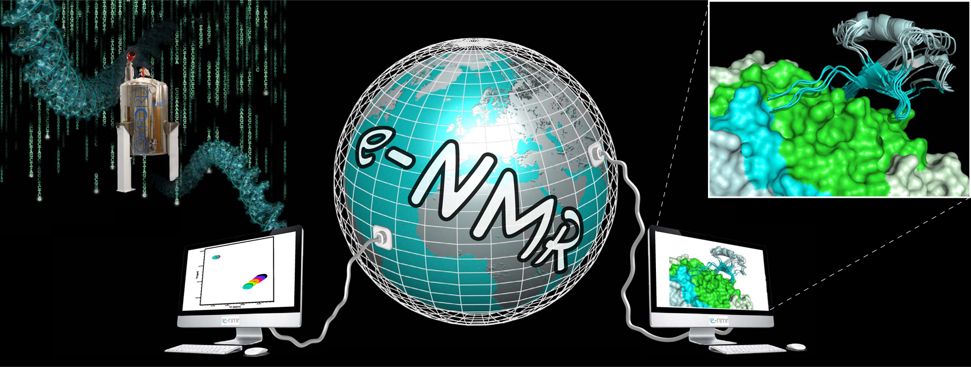
WeNMR platform (January 2012)
Largest VO in the life sciences
380 registered users from 38 nationalities and growing
~ 30 000 CPU cores
> 890 CPU years over the last 12 months
> 1.6 million jobs over the last 12 months
~30% of Life Sciences on the Grid
User-friendly access to Grid via web portals
www.wenmr.eu

Slide 5
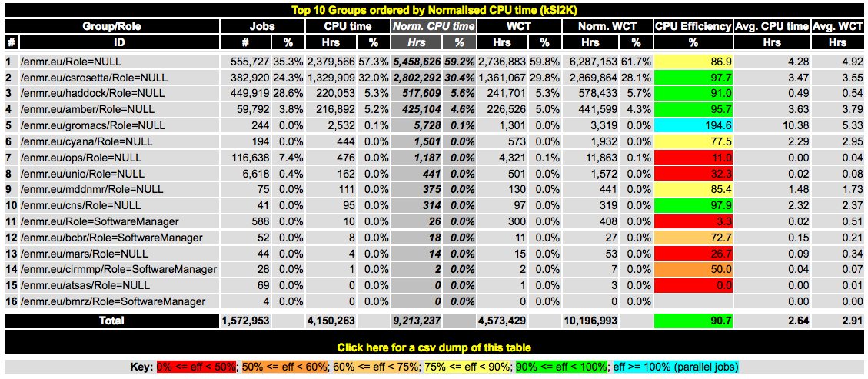
Software characteristics
CPU intensive
Includes parallel jobs (Gromacs portal)
Small internet transfer (except for software deployment)
Usually low I/O
Usually no storage required
Our main requirements:
Lots of CPUs
Queues of various lengths (including short ones)

Slide 6
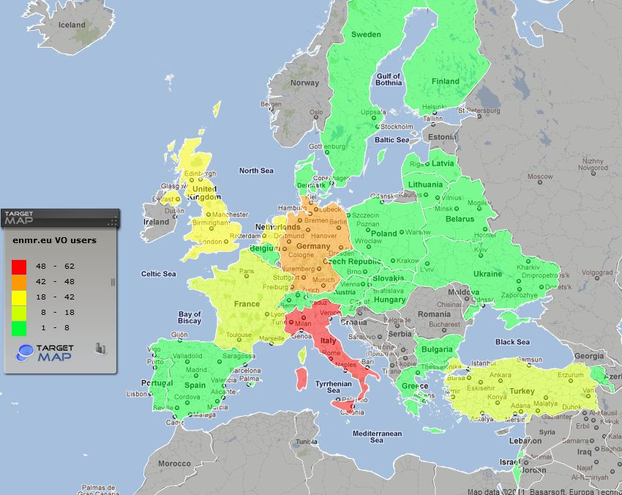
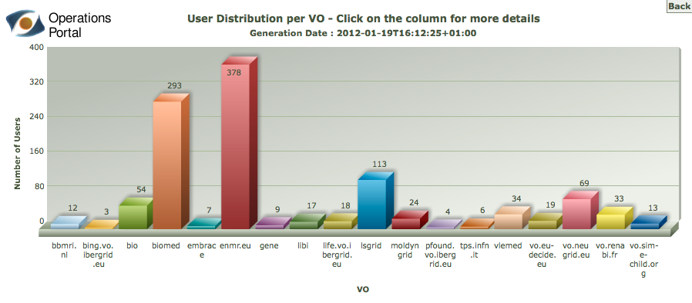
User community
Map as of October 31st, 2011
Structural biology community in the life sciences
Linked to ESFRI–INSTRUCT
Linked to EU infrastructure projects (I3s) (e.g. BioNMR)
380 users as of January 18th, 2012
~20% outside EU
~33% life sciences
Steady growth (~10 per month)

Slide 7
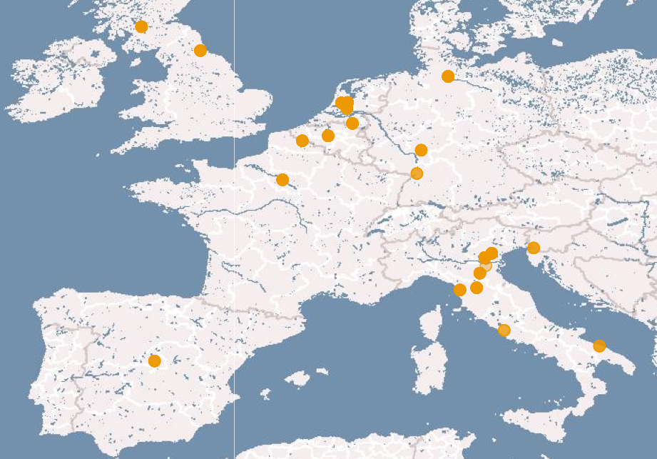
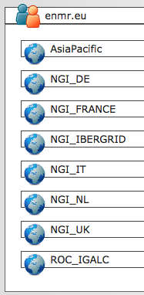
Distribution of resources
Source gstat2.0 and EGI VO ID Cards
We are also running our own dedicated infrastructure and services
  VOMS, WMS, LB, UI, CEs, WNs, ... (~400 dedicated cores)
  All sites certified and supported by their respective national NGI
Using also WMS from NGI_NL and NGI_IT as backup for job submission
Notes:
7
7

Slide 8
Sustainability
Infrastructure (hardware/resources)
Services (middleware, VO services)
Support (EGI, NGIs, VRCs)
Software (portals, software developers)
Users (end users, usage)
“Sustainability means nothing without an active user base and demonstrated usage”
(Should be valid both for VRCs and NGIs)

Slide 9
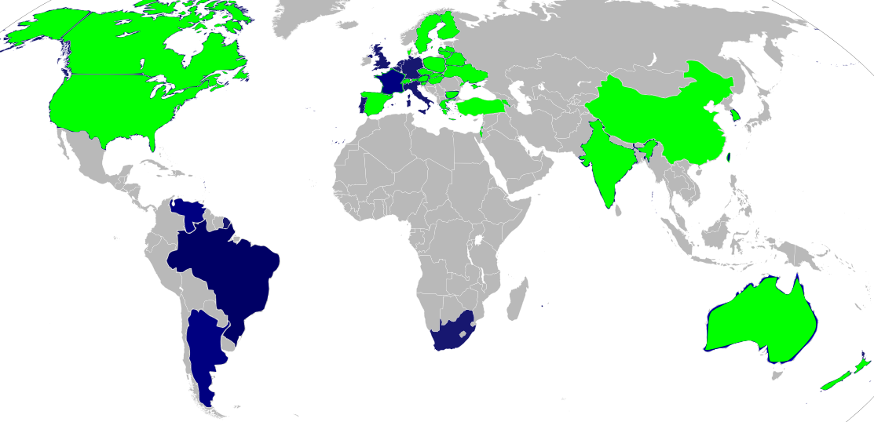
Sustainability: Users vs Resources
25k
2k
Infrastructure
Users
0.3k
0.2k
Ideally, the map should have only one color... i.e. each NGI should provide resources provided users and usage is demonstrated
Currently, some NGI(s) restrict access to national users only! ... With such a model this we don’t need the EGI anymore...
Notes:
9
9

Slide 10
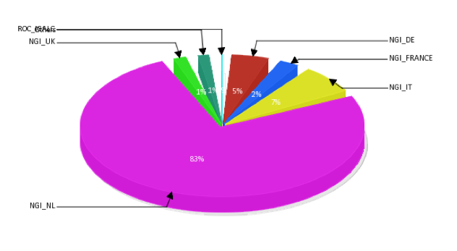
Sustainability: Users vs Resources
Jan 2011 – Jan 2012
83% of the CPU resources provided by NGI_NL (Thank you!!!)
But only 12% of VO members are Dutch!
Notes:
10
10

Slide 11
Sustainability: infrastructure requirements
Mainly Grid resources (CPUs!)
Local storage on CEs for remote software deployment and management
Limited storage on SEs
CLOUD:
  Only for specific and complex application workflows
  Not as a replacement of the Grid infrastructure
Paying for access not really an option
  Might lead to reduced access... and thus reduced sustainability
  Users will divert to other solutions (e.g. community computing)
  Only viable for non-profit users if linked to national science granting scheme...

Slide 12
Sustainability:
services and support requirements
Middleware
  Distributions for local installation (EGI/EMI)
  Possibly virtual, configurable machines for simplified local deployment of services (EGI/EMI, NGIs)
  Support (NGIs)
  If no local resources or manpower, access to WMSs (NGIs)
  Fine tuning of access (multiple queues of various lengths)
Support for robot certificates
VO services (e.g. EGI VO dashboard)
Accounting
Support to users for certificates

Slide 13
Sustainability: software and users
This is mainly a VRC issue
Develop new services / portals
Involve software developers
  To provide new services
  To contribute to application specific support and forums
Involve user community (attract new users)
  Scientific visibility crucial
  Links to ESFRI projects and EU infrastructures
Run / maintain / update the VRC sites and portals
  Depends usually on local resources
  Offer services / consulting to third parties

Slide 14
Our contribution to your sustainability
An active and growing user base
User-friendly portal solutions
Application porting support
End user support
Sharing of expertise
VRC solutions (web site building, hosting, consulting – SpronkNMR)
Visibility and acknowledgments in scientific publications (21 publications last year)
Lobbying based on user needs

Slide 15

wordle.net

