Slide 1
Value and Governance of the EGI Ecosystem
Sergio Andreozzi
Policy Development Manager, EGI.eu

Slide 2
Outline
EGI Ecosystem
What is its value creation capability?
How do govern the value creation?
What is the guiding vision?

Slide 3
What is Value Creation
to realise benefits
at an optimal cost
whilst reducing risks

Slide 4
EGI Ecosystem
Simplified version
A network of organisations to create value to its stakeholders

Slide 5
Value Creation Analysis: Why
Identify how the work actually gets done
Extract the value you are really creating
Understand how efficiently resources are converted to value
Highlight where the value creation failure points are in the networks
EGI ecosystem
A network of organisations
A Value Network

Slide 6
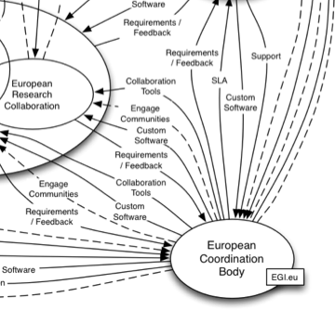
Value Creation Analysis: How
Value Network Analysis (VNA)
Identify roles in the ecosystem
Map the interactions between the roles
Identify value conversion within each role
Analyse the value exchange
Summary analysis - draft
https://documents.egi.eu/document/987

Slide 7
Governance
Multiple stakeholders have different and conflicting perceptions of benefits, risk and resources
Governance is about negotiating and deciding amongst different stakeholders’ value interests
The governance system must consider all stakeholders when making benefit, resource and risk assessments and decisions

Slide 8
What Governance for EGI
EGI Ecosystem: multi-stakeholder
How do we share governance in such a complex eco-system?
What are the structures and processes?
What are the best decision mechanisms?
How do we ensure transparency?
How do we measure advancements towards strategic goals? (KPIs)

Slide 9
The importance of an EGI Vision
It is focused on what needs to be achieved
It clarifies the general direction for the change
It simplifies the direction of the decisions
It appeals to the long term interest of all stakeholders
It can be communicated easily
E.g.: to new users, to funding bodies
Vision
a compelling image of the future that will most inspire us forwards

Slide 10
Vision and Sub-Visions
Each organisation in the EGI ecosystem should define its own vision
NGIs are expected to have different visions, nevertheless a common core should be present
TP
NGIs
End-Users
EU2020
EGI.eu

Slide 11
How to Move Forwards
Define the EGI vision for 2020
Define sub-visions for each participating organisations in the EGI ecosystem
at least NGIs/VRCs/TPs
Finalise the EGI Value Network Analysis
Describe the EGI governance

Slide 12
Summary
The EGI Ecosystem is a network of organisations whose ultimate goal is to create value to the end-users
Analysing the value creation within the network is fundamental to optimise the interactions within the ecosystem and reach peak performance
Defining a governance to steer the interactions is essential to deliver the desired value
We are performing an in-depth value analysis, nevertheless building a common vision is also important

