Slide 1
Introduction
T. Ferrari/EGI.eu
OMB, 19/06/2012

Slide 2
OMB Calendar (proposal)
24 July →17 July?
28 August
OMB workshop, 20 September 14:00 CET (Prague, Technical Forum 2012)
Funding
Technical advancement of EGI operations
23 October
20 November
18 December

Slide 3
EGI-InSPIRE PY2 review
27-28 June 2012
Latest version of slides available at:
https://indico.egi.eu/indico/conferenceDisplay.py?confId=1049

Slide 4
NGI actions
July
express interest in deployment of UI and CREAM VMs by July OMB
Comments to draft procedure for renaming of sites: https://wiki.egi.eu/wiki/Draft_PROC
August 03: submission of QR9 report and metrics (EGI-InSPIRE partners)

Slide 5
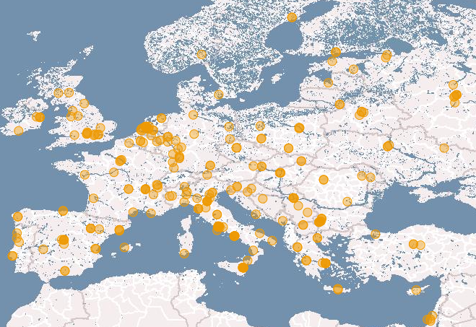
Site longitude/latitude
Make sure that “Location” information is available for all production sites in GOCDB (latitude/longitude) → many sites missing this information
Needed for correct visualization of gstat geo views of the infrastructure
COD tickets to NGIs

Slide 6
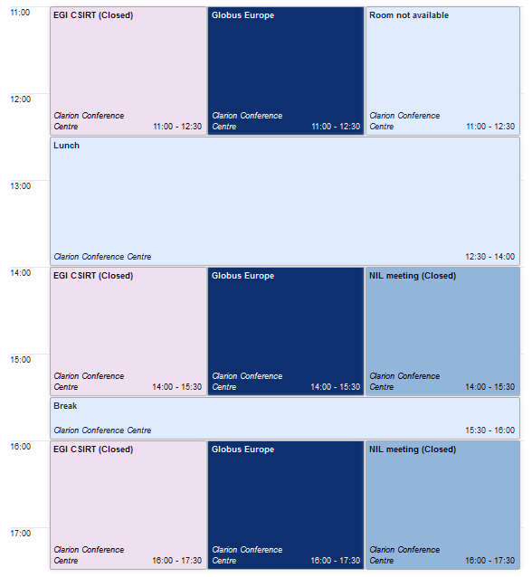
Technical Forum 2012 17-21/09 draft programme
Monday 17/09
Project meetings
SA1: EGI CSIRT

Slide 7
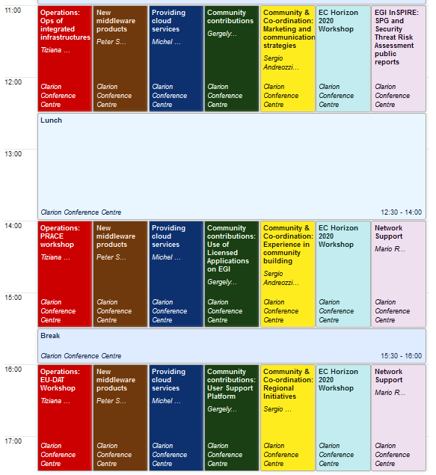
Tuesday 18/09
Operations of integrated and peer infrastructures: Asia Pacific, OSG, Latin America, IGALC…
Workshops on interoperations with PRACE and EUDAT
SPG and SVG reports
Network support and IPv6

Slide 8
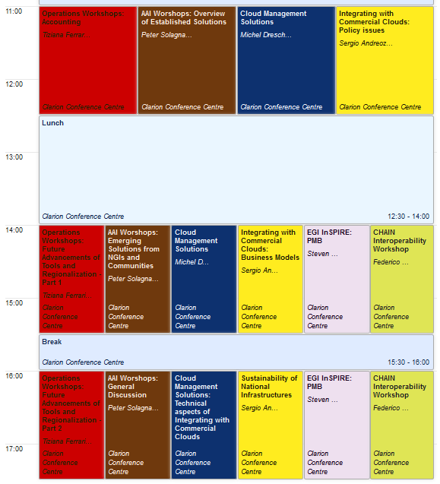
Wed 19/09
Workshop on accounting
Advancement of operational tools
NGI sustainability

Slide 9
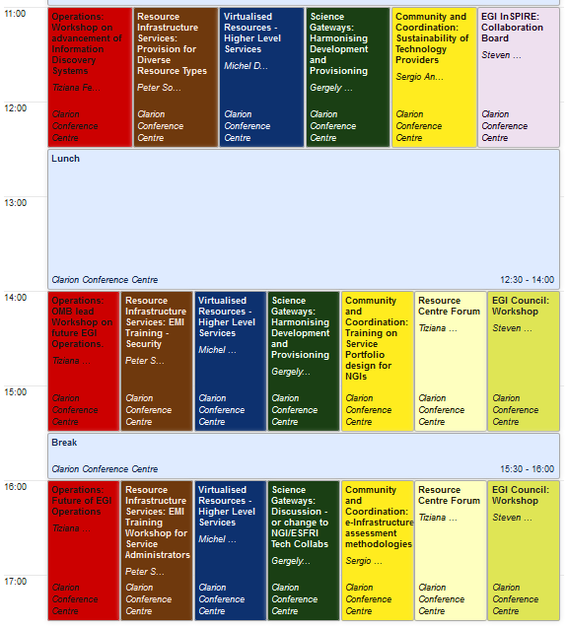
Thu 20/09
Information discovery services/GLUE workshop
OMB workshop
Resource centre forum (TBC), if confirmed likely to be rescheduled on Wed
Training for site managers, including EMI security training

Slide 10
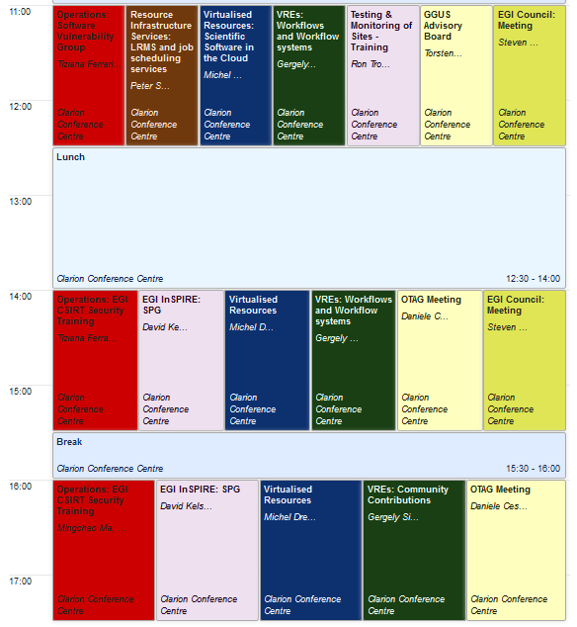
Fri 21/09
Training
Morning: ROD training
Afternoon: EGI CSIRT security training
SVG and SPG metings
GGUS Advisory Board

